Slide 1

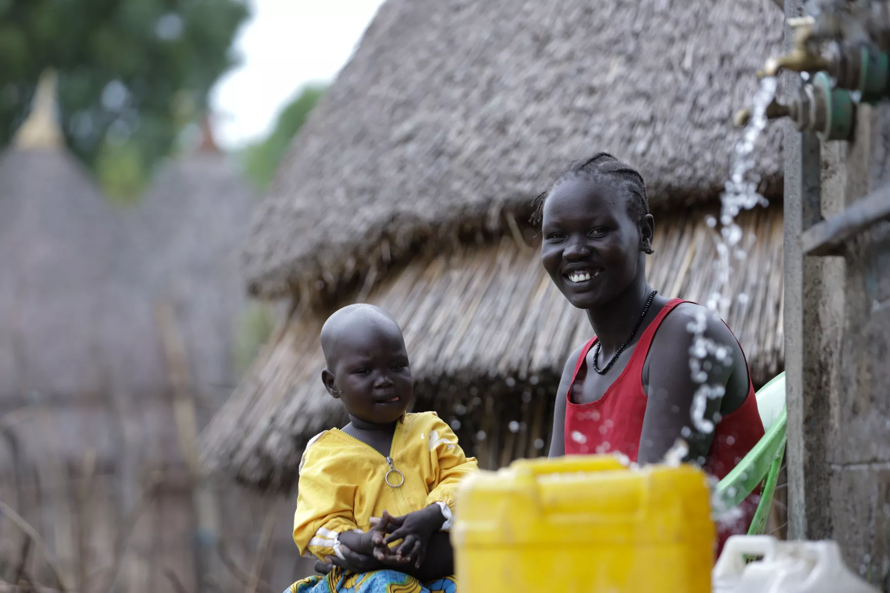
PROSPECTS 2.0.
INTEGRATED RESULTS FRAMEWORK
ITERATIVE EVALUATION – ETHIOPIA (2026)

Slide 2
RATIONALE
PROSPECTS 2.0 is a new phase of the program that keeps improving its planning and monitoring systems to show progress.
Tools such as the global Theory of Change (ToC) have been customized, and the elements defined in the MACP such as the Program Portfolio are complemented by the milestones of the Policy Matrix and by the multi-annual indicators.
Key Challenges Identified in the Iteration 1: October 2024 - February 2025
OPPORTUNITY IDENTIFIED
(In the course of fieldwork in Uganda and Kenya)
These 4 elements complement each other; having a common interface to see how all of them interact and interlink with each other was missing.
“The need to reviewing all existing frameworks, interconnect them and put a strong emphasis on achieving high-level outcomes. Linking activities to policy-level outcomes”
“Lack of clarity in connecting key components of the program, including the policy matrix, theory of change, and results framework”
The iterative evaluation identified in its first iteration this gap and proposes an Integrated Results Framework, where all the elements cohabite and are put in perspective.
“Ensure that our activities are connected to the overarching objectives, emphasizing the importance of demonstrating linkages across different pillars. Not to operate in silos”
This framework can be used:
To better understand and explain the integrated logic of PROSPECTS
To better identify synergies
To better discuss and report on progress
“Limited interconnections across pillars, and the pillar system leading to think in siloes”
“There is a strong emphasis on collaboration between different pillars. This includes joint program documents and coordination meetings. The primary area for improvement is internal coordination among pillars, inter-pillar planning in addition to pillar-specific planning.”
This solution has been very well received, like the “missing piece”, by PROSPECTS UNICEF Coordination team, by the two CO visited during the first iteration (Uganda and Kenya), and by PROSPECTS multilateral partners focal points at headquarters, and country level, including the PROSPECTS Netherlands partner.
The Uganda country team has used this tool for the UNICEF country team meeting and shared it with the PROSPECTS multilateral partners (ILO, UNHCR, WB, IF) to facilitate coordination.
These points were deemed relevant to all the countries by the PROSPECTS UNICEF Coordination team, PROSPECTS multilateral partners focal points at HQ (and country level in the iteration 1 countries), and the PROSPECTS Netherlands partner.

Slide 3
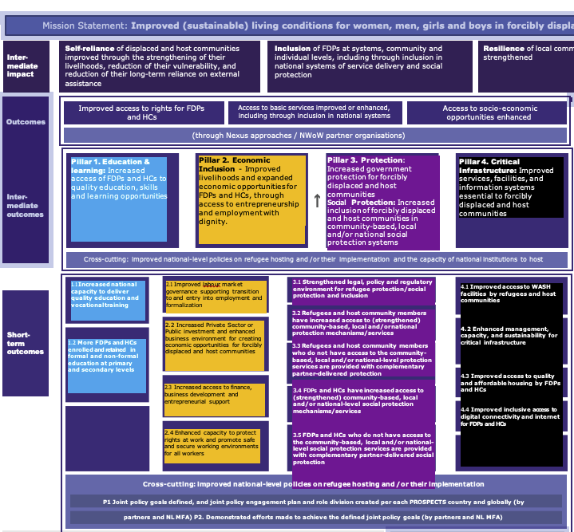
COLOR CODING
We have applied this colour code to the PROSPECTS pillars for the Integrated Framework:
TOC Pillar 1 Education
TOC Pillar 2 Economic
TOC Pillar 3 Protection
TOC Pillar 4 Infrastructure
Pillar 2. Economic Inclusion - Improved livelihoods and expanded economic opportunities for FDPs and HCs, through access to entrepreneurship and employment with dignity.
Pillar 4. Critical Infrastructure: Improved services, facilities, and information systems essential to forcibly displaced and host communities
2.1 Improved labour market governance supporting transition to and entry into employment and formalization
4.1 Improved access to WASH facilities by refugees and host communities
4.2 Enhanced management, capacity, and sustainability for critical infrastructure
4.3 Improved access to quality and affordable housing by FDPs and HCs
4.4 Improved inclusive access to digital connectivity and internet for FDPs and HCs
2.2 Increased Private Sector or Public investment and enhanced business environment for creating economic opportunities for forcibly displaced and host communities
2.3 Increased access to finance,
business development and entrepreneurial support
2.4 Enhanced capacity to protect rights at work and promote safe and secure working environments for all workers

Slide 4
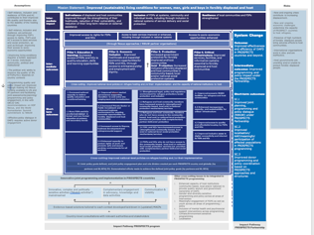
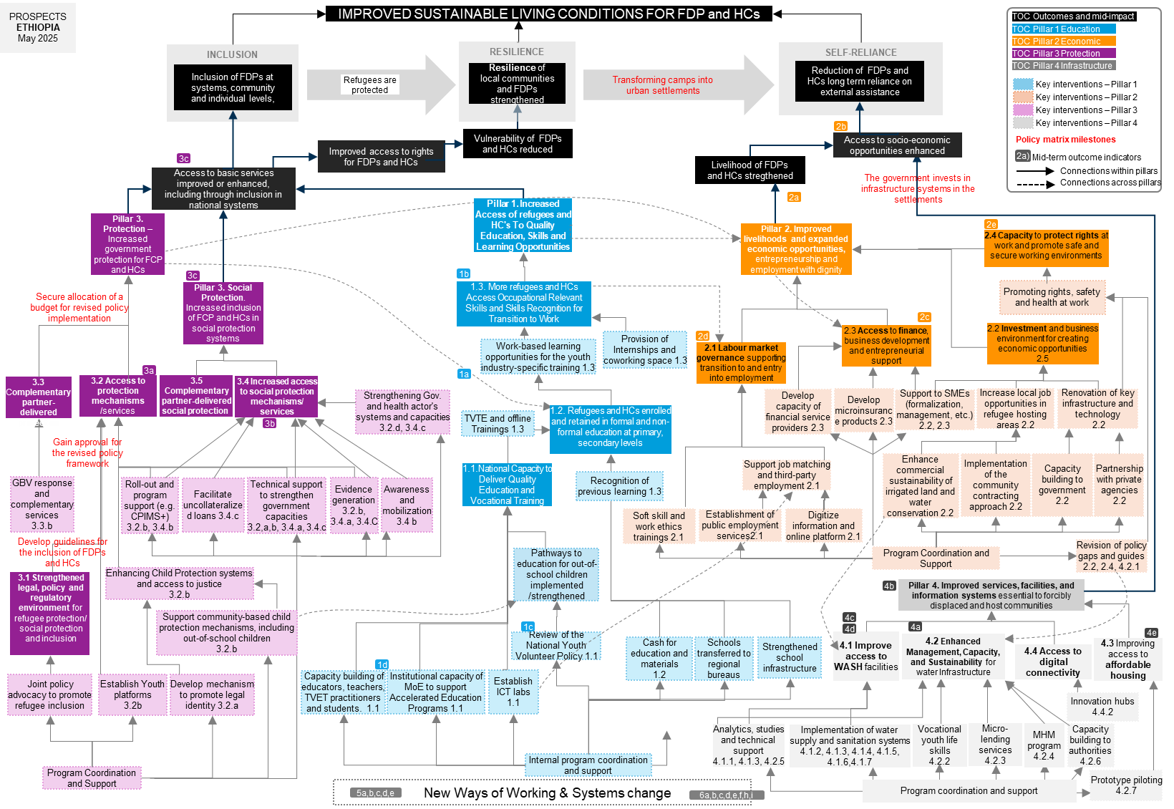
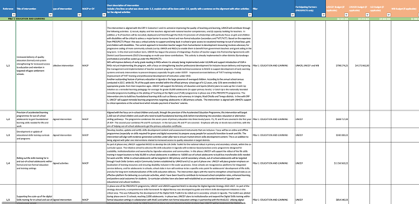
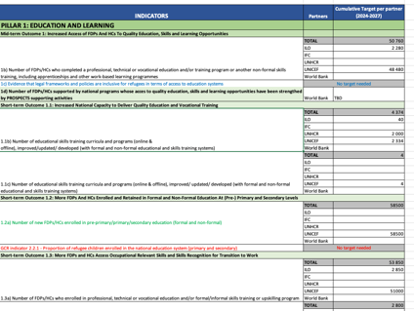

ELEMENTS INTEGRATED IN THIS FRAMEWORK
ToC Global
Programme portfolio
Policy Matrix
Multi-annual targets

Slide 5
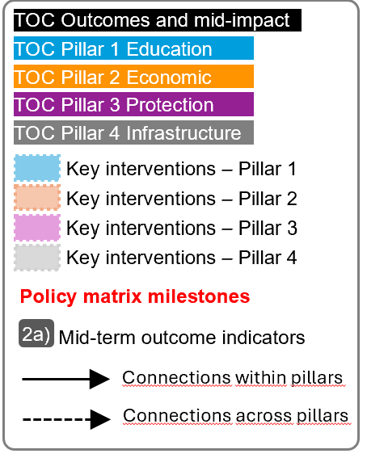
For the next slide:
Please turn to presentation mode
You will find the framework...
… where you can find:
Represent all PROSPECTS outcomes and inter-mediate impact as per the Global Theory of Change
Represent all PROSPECTS short-term outcomes (X.X) , and mid-term outcomes (X) as per the Global Theory of Change
Represent all groups of actions/interventions considered in the MACP 2024-2027 that aim at supporting and contributing to specific areas within each pillar
Represent all relevant policy matrix milestones considered for the period 2024-2027
Represent where the MACP 2024-2027 mid-term outcome indicators sit in the diagram
Click in the presentation icon
so the elements appear progressively

Slide 6
PROSPECTS
ETHIOPIA
March 2026
IMPROVED SUSTAINABLE LIVING CONDITIONS FOR FDP and HCs
TOC Outcomes and mid-impact
TOC Pillar 1 Education
INCLUSION
RESILIENCE
SELF-RELIANCE
TOC Pillar 2 Economic
TOC Pillar 3 Protection
Inclusion of FDPs at systems, community and individual levels,
Resilience of local communities and FDPs strengthened
Transforming camps into urban settlements
Reduction of FDPs and HCs long term reliance on external assistance
TOC Pillar 4 Infrastructure
Refugees are protected
Key interventions – Pillar 1
Key interventions – Pillar 2
Key interventions – Pillar 3
2b
Key interventions – Pillar 4
Improved access to rights for FDPs and HCs
Vulnerability of FDPs and HCs reduced
Access to socio-economic opportunities enhanced
Policy matrix milestones
Mid-term outcome indicators
3c
Livelihood of FDPs and HCs stregthened
2a)
Connections within pillars
Access to basic services improved or enhanced, including through inclusion in national systems
The government invests in infrastructure systems in the settlements
Connections across pillars
Pillar 3. Protection – Increased government protection for FCP and HCs
Pillar 1. Increased Access of refugees and HC's To Quality Education, Skills and Learning Opportunities
2a
Pillar 2. Improved livelihoods and expanded economic opportunities, entrepreneurship and employment with dignity
2e
2.4 Capacity to protect rights at work and promote safe and secure working environments
3c
1b
Promoting rights, safety and health at work
Pillar 3. Social Protection. Increased inclusion of FCP and HCs in social protection systems
1.3. More refugees and HCs Access Occupational Relevant Skills and Skills Recognition for Transition to Work
2c
2.2 Investment and business environment for creating economic opportunities
2.5
1a
Work-based learning opportunities for the youth industry-specific training 1.3
Provision of Internships and coworking space 1.3
2d
2.3 Access to finance,
business development and entrepreneurial support
4.3 Secure budget allocation for revised policy implementation
2.1 Labour market governance supporting transition to and entry into employment
3a
3.5 Complementary partner-delivered social protection
3.3 Complementary partner-delivered protection
3.2 Access to protection mechanisms /services
3.4 Increased access to social protection mechanisms/ services
Strengthening Gov. and health actor's systems and capacities
3.2.d, 3.4.c
Develop capacity of financial service providers 2.3
Develop microinsurance products 2.3
Support to SMEs (formalization, management, etc.) 2.2, 2.3
Increase local job opportunities in refugee hosting areas 2.2
Renovation of key infrastructure and technology
2.2
3b
TVTE and offline Trainings 1.3
1.2. Refugees and HCs enrolled and retained in formal and non-formal education at primary, secondary levels
3.2 Strengthening social service workforce
4.1 Revised National Social Protection policy is approved
4.2 Guidelines for the inclusion of FDPs and HCs
1.1.National Capacity to Deliver Quality Education and Vocational Training
Support job matching and third-party employment 2.1
Enhance commercial sustainability of irrigated land and water conservation 2.2
Implementation of the community contracting approach 2.2
Capacity building to government 2.2
Partnership with private agencies 2.2
GBV response and complementary services
3.3.b
Roll-out and program support (e.g. CPIMS+)
3.2.b, 3.4.b
Facilitate uncollateralized loans 3.4.c
Technical support to strengthen government capacities
3.2,a,b, 3.4.a, 3.4.c
Evidence generation
3.2.b, 3.4.a, 3.4.C
Awareness and mobilization
3.4 b
Recognition of previous learning 1.3
Soft skill and work ethics trainings 2.1
Establishment of public employment services2.1
Digitize information and online platform 2.1
Gain approval for the revised policy framework
Revision of policy gaps and guides 2.2, 2.4, 4.2.1
Pathways to education for out-of-school children implemented /strengthened
Program Coordination and Support
3.1 Strengthened legal, policy and regulatory environment for refugee protection/ social protection and inclusion
Enhancing Child Protection systems and access to justice
3.2.b
3.3 Revision Alternative Childcare Directive
4b
Pillar 4. Improved services, facilities, and information systems essential to forcibly displaced and host communities
Support community-based child protection mechanisms, including out-of-school children
3.2.b
1c
4c
4a
4d
4e
Review of the National Youth Volunteer Policy 1.1
Cash for education and materials
1.2
Schools transferred to regional bureaus
Strengthened school infrastructure
4.1 Improve access to WASH facilities
4.2 Enhanced Management, Capacity, and Sustainability for water Infrastructure
4.4 Access to digital connectivity
4.3 Improving access to affordable housing
3.1 Revision of the National Child Protection Case Management Framework
1d
Capacity building of educators, teachers, TVET practitioners and students. 1.1
Institutional capacity of MoE to support Accelerated Education Programs 1.1
Establish ICT labs
1.1
Joint policy advocacy to promote refugee inclusion
Establish Youth platforms
3.2b
Develop mechanism to promote legal identity 3.2.a
Innovation hubs
4.4.2
Analytics, studies and technical support
4.1.1, 4.1.3, 4.2.5
Implementation of water supply and sanitation systems
4.1.2, 4.1.3, 4.1.4, 4.1.5, 4.1.6,4.1.7
Vocational youth life skills
4.2.2
Micro-lending services
4.2.3
MHM program
4.2.4
Capacity building to authorities
4.2.6
Program Coordination and Support
Program coordination and support
New Ways of Working & Systems change
Program coordination and support
Prototype piloting
4.2.7
5a,b,c,d,e
6a,b,c,d,e,f,h,i

Slide 7
NOTES
2
High-level outcomes logic
Within the high-level results, Inclusion comes first, to reduce vulnerability and increase resilience, to promote self-reliance.
We tried to link key results to the high-level results for greater clarity on how each of them contribute.
1
Pillars’ logic
As agreed with the MFA, Protection becomes the entry pillar. First, we protect, then we provide access to education, and then we facilitate access to microeconomic activities and the job market (infrastructure would be cross-cutting).
That is the reason why we placed pillar 3 on the left, followed by pillar 1 and 2.
3
Additional mid-level goals
Some goals (not numbered) were added as mid steps to explain the cause-effect logic.
4
Pillars’ connections
There are numerous actual connections between pillars that are not reflected in the Global ToC diagram but they are reflected in the IF. We tried to include links connecting results across pillars.
5
MACP Coding
The programme portfolio does not follow a consistent numbering for the initiatives included within pillars. This limits the capacity to track actions to the different results.
INDICATORS MAPPING
Only the Mid-Term Outcomes indicators have been mapped, which measure elements of the mid part of the diagram (above short-term outcomes and below impact).
Short-term outcomes indicators could be also mapped under the CO demand.
Most of the indicators of section 5 and 6 of the multi-annual targets (SYSTEMS CHANGE and NWOW and Cross-cutting indicators) seem like strategies indicators (enablers rather than results).
Other comments:
Policy matrix does not include expected deadlines (-)
Policy matrix does not include targets for pillar 1 and 2 (-)
PROSPECTS EHIOPIA
May 2025

Slide 8
PRACTICAL USES OF THE INTEGRATED FRAMEWORK
1
Shared understanding
The overall picture of how PROSPECTS work at different levels will contribute to developing a clear and shared understanding of PROSPECTS within UNICEF, across sectors and partners, aligning expectations and roles between them and clarifying vision and strategies.
4
Spot implementation bottlenecks and/or key enablers
The framework adopts a bottom-up approach, and implementers can pinpoint areas of interest and then work backwards to identify potential bottlenecks or opportunities to optimize achievements.
5
Enhance monitoring and evaluation
The framework helps prioritize what to measure by clearly outlining the interconnections between results and the overall line of sight. It can also support contribution analysis by illustrating how programme activities are expected to contribute to overarching goals.
2
Adaptive Management & learning
The framework is a tool for continuous learning and adaptation. It allows teams to test their assumptions and make evidence-based adjustments to their strategies and resource allocation.
3
Coordination & collaboration
The framework can help ensure that interventions are well-coordinated and aligned with overarching goals, while also aiding in identifying opportunities for collaboration.
6
Communication
The framework can be used to communicate the complex logic and strategy of PROSPECTS to diverse audiences, including donors, partners and beneficiaries.
“The integrated framework is designed not only as a conceptual tool to interrogate and possibly refine the design of PROSPECTS, but also as a practical framework that can be applied at various levels.”

Slide 9
Annexes
ETHIOPIA
ASSESSMENT OF THE FRAMEWORK
2
High-level outcomes logic
Within the high level results, Inclusion comes first, to reduce vulnerability and increase resilience, to promote self-reliance.
We tried to link key results to the high-level results for greater clarity on how each of them contribute.
1
Pillars’ logic
As agreed with the MFA, Protection becomes the entry pillar. First, we protect, then we provide access to education, and then we facilitate access to microeconomic activities and the job market (infrastructure would be cross-cutting).
That is the reason why we placed pillar 3 on the left, followed by pillar 1 and 2.
3
Kenya’s MACP
Some pillars have outputs, others just lists of actions/results (that have been group in “outputs”). Policy is clearly embedded, beyond the Policy matrixes
Titles in the Policy matrix
Some key results appear in the milestones grouping (ex. Inclusion in national education, inclusion in GBV mechanisms, access to asylum procedures, etc.)
Pillars’ connections
There are numerous connections between pillars that are not reflected in the Global ToC diagram.
We tried to include links between connecting results across pillars.
INDICATORS MAPPING
Only the Mid-Term Outcomes indicators have been mapped, which measure elements of the mid part of the diagram (above short-term outcomes and below impact).
Short-term outcomes indicators could be also mapped under the CO demand.
Most of the indicators of section 5 and 6 of the framework (SYSTEMS CHANGE and NWOW and Cross-cutting indicators) seem like strategies indicators (enablers rather than results).

Slide 10
PROSPECTS
ETHIOPIA
March 2026
MACP Program Portfolio
Pillar 1: EDUCATION AND LEARNING
Pillar 2: ECONOMIC INCLUSION
Pillar 3: PROTECTION AND SOCIAL PROTECTION
Mid-term Outcome 1: Increased Access of FDPs And HCs To Quality Education, Skills and Learning Opportunities
Short-term Outcome 1.1: Increased national capacity to deliver quality education and vocational training (Ethiopia’s pledges on TVET)
 | Structured Capacity Development to Promote Inclusive and Safe Schools
 | Technical and Financial Support to the Ministry of Education-led the Accelerated Education Technical Working Group to develop the Accelerated Education Curricula, Guidelines and Program aligned to the Revised General Education Curriculum and TVET curricula and market needs.
 | Strengthening workforce development, capacity building, and continuous professional development (CPD) aligned to the new curriculum and Teacher Education Curriculum Framework (TECF) for ECE, primary and secondary education teachers, and instructional leaders in communities hosting FDPs.
 | Education Quality Improvement intervention
 | National Youth Policy
 | Digital Skill training
 | Support the Ministry of Education and regional education bureaus in establishing ICT labs in selected learning institutions in Addis Ababa, Afar and Somali
Mid-term Outcome 2: Improved Livelihoods and Expanded Economic Opportunities for FDPs and HCs
Short-term Outcome 2.1: Improved labor market governance supporting transition to and entry into employment and formalization (Decent work)
2.1 | Work Ethics and Core Skills
 | Job Search support
 | Public Employment service
 | Digitize the PES
 | Refugees are supported to access third-country employment opportunities for labour mobility
 | Strengthen referral pathways for labour mobility by building the capacity of Implementing Partners and building evidence surrounding the right to work
Short-term Outcome 2.2: Increased Private Sector or Public investment and enhanced business environment for creating economic opportunities for forcibly displaced and host communities (Agriculture Cooperatives, Trade and Services)
2.2.1 | Climate-Smart Share Farming Project
 | FDPs/HC members already employed or self-employed increase their income, enhance their working conditions or maintain their resilient livelihoods
 | New wage employment and/or self-employment (business) opportunities are supported by PROSPECTS
 | Community Contracting Approach
 | Con/renov. of community school
 | Contractor development
 | Occupational Safety and Health
 | Policy
 | Capacity building
 | Job creation
 | Institutional Support
Short-term Outcome 2.3: Increased access to finance, business development and entrepreneurial support (Financial Inclusion)
 | Youth Led organizations for youth employment
 | Increased access to business development services and entrepreneurial support
 | Entrepreneurship support to Host and refugees
 | Enterprise formalization
 | AIMS (Approach to inclusive Market Systems)
 | Increased access to business development services and entrepreneurial support
 | financial inclusion (Making Microfinance work for host and refugees)
 | Financial Inclusion ( Financial Education)
 | Financial Inclusion (Microinsurance)
Short-term Outcome 2.4: Enhanced capacity to protect rights at work and promote safe and secure working environments for all workers (Residence/Work Permits/Labor rights)
 | Right at Work and to Work
Mid-term Outcome 3: (1)Protection: Increased Government Protection for FDPs and HCs; (2) Social Protection: Increased Inclusion of FDPs and HCs In Community-based, Local and/or National Social Protection Systems
Short-term Outcome 3.1: Strengthened Legal, Policy and Regulatory Environment for Refugee Protection/Social Protection and Inclusion
3.1a) 1 | Joint policy advocacy to promote refugee inclusion into relevant legal and policy frameworks
3.1a) 2
Short-term Outcome 3.2: Refugees and HCs Have Increased Access To (Strengthened) Community-based, Local and/or National Protection Mechanisms/Services
3.2a) 1 | Promote legal identity for all, including birth registration
3.2a) 2 | Issuance of Refugee and Asylum-seeker ID, Work and Residence Permitsand inclusion the National Digital Identity System
3.2b) 1 | Facilitate access to the national justice system for the forcibly displaced populations
3.2b) 2 | Facilitate access to services and information for FDPs and HCs through Case Management & Referral, Safeguarding, MHPSS, Safe Digital Access
3.2b) 2 | Child Protection Information Management System (CPIMS+) active in refugee settlements and in Host Communitties integratied to the national system
3.2b) 3 | Children have access to a Protective environment through the reinforcement/set up of Child Protection Community Based Mechanisms (CPCBM) in intervention areas and includes addressing barriers to services
3.2b.4 | Children and caregivers have access to community based MHPSS services with the focus on capacity building of frontline workers and community based structures
3.2b.6 | Adolescents girls and boys including young people are empowered and made self-reliant through strengthening youth platforms and digital connectivity
3.2b) 7 | Systematically scaling-up proven VAC and GBV prevention models in refugee settlements and host community settings
3.2b) 8 | Institutional strengthening for inclusive justice for children
3.2b) | Generating Evidence to Inform Learning and Policy Advocacy
Short-term Outcome 3.2d) PROSPECTS has provided technical or financial assistance to strengthen the asylum system, in accordance with international standards
3.2d) | Strengthen the asylum system in Ethiopia
Short-term Outcome 3.3 Refugees and HCs Who Do Not Have Access to the Community-based, Local And/or National-level Protection Services Are Provided with Complementary Partner-delivered Protection
3.3b) 1 | Complementary CP Services including Best Interests Procedures (BIA and BID)
3.2b) 2 | Provision of GBV response for survivors and implementation of GBV risk mitigation measures across all sectors
3.3b) 3 | Implementation and delivery of Complementary Pathways initiatives in Ethiopia
Short-term Outcome 1.2: More FDPs and HCs enrolled and retained in formal and non-formal education at primary and secondary levels (integration into public schooling systems)
 | Facilitating access to education through a "cash voucher initiative" for refugee girls in secondary education
 | Education Quality Improvement intervention
 | Education Quality Improvement intervention
 | Building and upgrading of secondary schools to increase access and enhance FDP and Host community integration and social cohesion.
Short-term Outcome 1.3: More FDPs and HCs access occupational relevant skills and skills recognition for transition to work (Demand driven labor markets)
 | Technical and Vocational Skills Training Programmes (TVET)
 | Development and Operationalization of an Integrated Online and Offline Skills Training Program for Young People in schools and communities from FDPs and HCs.
 | Development and implementation of the Catalyst Fellowship for Change Makers- a work-based learning opportunity at UNICEF for youth leaders.
 | Work-place training
 | Recognition of prior learing
 | Digital livelihood and internship

Slide 11
PROSPECTS
ETHIOPIA
March 2026
MACP Program Portfolio
Pillar 3: PROTECTION AND SOCIAL PROTECTION
Pillar 4: CRITICAL INFRASTRUCTURE
Short-term Outcome 3.4: FDPs and HCs Have Increased Access To (Strengthened) Community-based, Local and/or National-level Social Protection Mechanisms/Services
3.4a) Evidence that legal frameworks and policies are inclusive for refugees in terms of Social protection | Review and revise the National Social Protection Policy framework (and related policy documents) to ensure inclusion of FDPs and HCs
 | Capacity Bulding of Government Partners through assigning Technical Assistance (TA) and workforce development in FDPs and HCS.
 | Enhanced Public Finance Management intervention
 | Strengthened evidence of the long-term effectiveness of including refugees and host in the urban safety net
3.4b) Number of FDPs andHCs benefiting from Social Protection Schemes | Support to pilot extension of Social Health Protection coverage under CBHI in Addis Ababa
 | Awareness and Mobilization for SHP
 | Strengthen the PSNP, especially component related to social health protection and inclusiveness of non-nationals
 | Support social protection programmes that provide assistance to FDPs and HCs
 | Strengthen financial inclusion of FDPs to facilitate their access to services
 | Public Employment Programme (PEP)
3.4c) Number of measures/schmes that extend access to national/local social protection benefits | i) Facilitate uncollateralized loans for FDPs and host communities through a partnership with a private bank. ii) Support Cash plus social protection framework to be in place for FDPs and HCs by Integrating with education, child protection, health, nutrition, WASH in UPSNP
 | Support Community-Based Health Insurance (CBHI) for FDPs and Host communities in Addis Ababa and Amhara to improve healthcare access
 | Strengthening social health protection schemes and quality
 | Support assessment of financial sustainability and recommendations and capacity building thereof to EHIA and the CBHI schemes
 | Capacity Building of Social Health Protection actors
3.4d) Number of countries with social protection programs that are genderresponsive or lead to transformative gender equality results | Integrate gender-responsive into social protection system
Short-term Outcome 3.5: FDPs and HCs Who Do Not Have Access to the Community-based, Local and/or National-level Social Protection Services Are Provided with Complementary Partner-Delivered Social Protection
Mid-term Outcome 4: Improved Services, Facilities and Information Systems Essential to FDPs and HCs
Short-term Outcome 4.1: Improved Access to WASH Facilities by FDPs and HCs
4.1.1: | Support the Afar regional water bureau to improve access to water supply services for Serdo refugee settlement and nearby host communities
4.1.2 | Support the ministry of education and regional education bureaus in improving access to water supply and sanitation services in selected learning institutions in Addis Ababa, Afar and Somali
4.1.3 | Improving water supply system and sustainability
4.1.4 | FDPs/HC members are reached with at least basic water that is safe and available when needed
4.1.5 | FDPs and HCs have improved access to sanitation facilities and Hygiene services
4.1.6 | Provision of water and sanitation facilities
4.1.7 | Provision of health facility
Short-term Outcome 4.2: Enhanced Management, Capacity, and Sustainability for Critical Infrastructure
4.2.1 | Support the Afar regional water bureau in the development of regulatory framework and integrating the management of water services for refugees and nearby host community towns/villages into the national systems
4.2.2 | Support the Afar regional water bureau in facilitating transferrable, entrepreneurial and vocational youth life skills trainings in selected areas (O&M, solar, water franchise, water smart ATMs, spare parts business etc)
4.2.3 | Support the ministry of health and regional health bureaus in implementing sanitation marketing/city wide inclusive sanitation (CWIS) approaches in targeted areas in Addis Ababa, Afar and Somali
4.2.4 | Support the ministry of education and health and regional education and health bureaus in rolling out market-based MHM activities in selected schools in Addis Ababa, Afar and Somali
4.2.5 | Legislative and policy frameworks related to critical infrastructure (WASH, housing, digital connectivity) include FDPs
4.2.6 | Enhanced Management, Capacity, And Sustainability for Critical Infrastructure
4.2.7 | Coordination and collaboration of key stakeholders in housing sector improved
Short-term Outcome 4.3: Improved Access to Quality and Affordable Housing by FDPs and HCs
4.3.1 | Provision of dignified house
Short-term Outcome 4.4: Improved Inclusive Access to Digital Connectivity and Internet for FDPs and HCs
 | FDPs/HCs have improved access to digital connectivity services
 | Digital Innovation Hub

Slide 12
PROSPECTS
ETHIOPIA
March 2026
POLICY MATRIX
 | POLICY PRIORITIES | KEY CHALLENGES | KEY MILESTONES | KEY STAKEHOLDERS | SUPPORT THROUGH PROGRAMMING
1. | Forcibly displaced populations obtain a legal identity through access to national identity documentation including digital IDs, civil registration including birth registration services, to facilitate their protection and the learning to earning pathway. | Legislative obstacles, risk of refoulment due to lack of valid IDs, mandatory presence of both parents for birth registration, requirements for birth registration at the place of habitual residence and renewed keble ID, mandatory notification paper for registration of regugee children; restriction on moving the civil register books from the civil register offices, fees for birth certificates (for non refugees), limited demand for civil registration/Birth registration services; limited digitization and interoperability of existing digital systems; limited coordination between civil registration, and other services such as social services, health and education | 1. Advocacy for removal of legal and procedural barriers for civil registration of FDP; 2. Revision of laws and policies; 3. Development of guidelines and standard operating procedures to ensure continuous registration of vital events in humanitarian contexts | Immigration and Citizenship Service, Refugees and Returnees Service, National ID Program | Support, review and revision of existing legal and policy framework, consultative process and advocacy for endorsement
2. | Transformation of refugee camps into sustainable (urban) settlements. (2016 pledge), which will provide a pathway into inclusive national protection, educational, and employment support services. (Netherlands part of the mega pledge on economic inclusions and social protection) | - Political instability and lack of political will -Bureaucratic hurdles -Limited access to resources which if inadequately allocated, can exacerbate prejudice and discrimination -Cultural differences especially in places like Alemwach where the refugee population, mostly Eritrean, does not share the same language or cultural, economic and livelihood practices and characteristics as the hosts -Limited job opportunities,lack of skills, and competition for employment. | Guided by the Rural development strategy: -Guidelines and regulations that encourage the development of sustainable infrastructure, energy-efficient buildings, and environmentally friendly practices. -Adequate financing resources in the forms of grants, subsidies and low-interest loans to developers and individuals involved in sustainable settlement projects. -Government investment in infrastructure systems such as roads, water supply systems and waste management facilities in the settlements. -Government investment in training and capacity-building programmes for individuals involved in sustainable settlement projects, including technical training on sustainable construction practices, renewable energy systems, and waste management techniques. -Collaboration with international organisations, non-governmental organisations (NGOs), and other stakeholders would leverage their expertise and resources in supporting sustainable settlement projects | Ministry of Urban Development and Infrastructure, Refugees and Returnees Agency (RRS) | Implementation of the Sustainable Settlement and Shelter Refugee Response Roadmap - Developing resources for regional bureaus providing critical services to refugees. - Revisiting the directives on freedom of movement, access to justice, and right to work in light of MoU on Kebrebeyah, Alemwach, Bokh. -critical infrastructure improvements to support transition of services in WASH, housing, and digital connectivity. -Inclusion in social protection systems and facilitating linkages/evidence on operationalizing right to work
3. | Strengthening inclusive child protection systems at all levels that cater to the needs of all children in Ethioipia inclduing refugee, asylum seekers and stateless children and host community children Implementation of inclusive national child protection, GBV and justice systems | 1. Reluctance to provide case management services to the refugees, aylum seekers and stateless children through national case management system | 3.1 Review and revision of the National Child Protection Case Management Framework to identify and address gaps through the case management technical working group | Ministry of Women and Social Affairs, Refugee and Returnee Service | 1. Suport review and revision of the of the Case Managment Framework through the National Case Management Techncial Working Group and revision of the case managemnet training package and providing training for the workforce
 |  | 2. Lack of adeqaute skilled workforce for child protection and GBV, amongst other, for very low budget allocation for GBV and child protection in the federal and regional budgets | 3.2 Advocacy for strengthening social service workforce based on the findings of the recently concluded social service workforce mapping and assessment conducted by the Ministry of Women and Social Affairs and supported by UNICEF including advocay for pubkic finance for child protection | Ministry of Women and Social Affairs | 2. Support advocacy strengthening social service workforce, including their capacity building throiugh institutionalized training
 |  | 3. | 3.3 Revision Alternative Childcare Directive to include refugee, asylum seekers and stateless children | Ministry of Women and Social Affairs, Refugee and Returnee Service | 3. Support consultatuve process and advocacy for endorsement and roll out of the Alternative Childcare Directives

Slide 13
PROSPECTS
ETHIOPIA
March 2026
POLICY MATRIX
Policy Priorities | Key challenges | Key milestones | Key stakeholders | Support through programming
4. Revision of National Social Protection Policy to improve inclusion of FDPs and Host communities | 1) Resistance from existing stakeholders or reluctance to adapt to the inclusion of FDPs and HCs. | 4.1 Gain approval for the revised policy framework; | Ministry of Women and Social Affairs, Refugee and Returnee Service, Ministry of Finance | 1) Conduct policy advocacy workshops and consultations.
 | 2) Legal and regulatory obstacles to amend the existing policy framework. | 4.2 Develop clear guideline for the inclusion of FDPs and HCs; |  | 2) Provide technical expertise in policy drafting.
 | 3) Challenges gathering accurate data and analysis on FDPs and HCs to inform policy revisions. | 4.3 Secure allocation of a budget for revised policy implementation |  | 3) Advocate for policy revision through awareness campaigns.
5. Transformation of refugee camps into sustainable (urban) settlements (2016 pledge), which will provide a pathway into inclusive national protection, educational and employment support services. (Netherlands part of the mega pledge on economic inclusions and social protection.) | Transforming refugee camps into sustainable settlements is a complex process that requires government and other stakeholder support. Political instability, lack of political will, and bureaucratic hurdles can hinder implementation. The process requires planning and coordination, especially in relation to infrastructure development such as housing, schools, healthcare facilities and transport systems. In a context where access to resources is limited and if inadequately allocated, can exacerbate prejudice and discrimination. Transforming camps into urban settlements requires addressing cultural differences and promoting social integration. The case of Alemwach merits attention, as the refugee population, mostly Eritrean, does not share the same language or cultural, economic and livelihood practices and characteristics as the hosts which serve as barriers to promoting inclusion. Furthermore, limited job opportunities, lack of skills, and competition for employment can hinder the successful transformation of camps into urban settlements. | The policy should define its financing sources in the forms of grants, subsidies and low-interest loans to developers and individuals involved in sustainable settlement projects. It is paramount for the government to invest in infrastructure systems such as roads, water supply systems and waste management facilities in the settlements to create a conducive environment for sustainable living. The government should provide training and capacity-building programmes for individuals involved in sustainable settlement projects, including technical training on sustainable construction practices, renewable energy systems, and waste management techniques. Collaboration with international organisations, non-governmental organisations (NGOs), and other stakeholders would leverage their expertise and resources in supporting sustainable settlement projects. |  | Develop resources for regional bureaus providing critical services to refugees. Improve critical infrastructure improve services in WASH, housing, and digital connectivity. Implement the Sustainable Settlement and Shelter Refugee Response Roadmap 2022–2027. Revisit the directives on freedom of movement, access to justice, and right to work considering the MoU on Kebrebeyah Alemwach, Bokh, etc.

Slide 14
PROSPECTS
ETHIOPIA
March 2026
MULTI ANNUAL MID-TERM OUTCOME INDICATORS
MID-TERM OUTCOME INDICATORS INCLUDED IN THE MACP
PILLAR 1: EDUCATION AND LEARNING
Mid-term Outcome 1: Increased Access of FDPs And HCs To Quality Education, Skills and Learning Opportunities
1a) Number of FDPs/HCs who completed their primary or secondary education program (formal and non-formal)
1b) Number of FDPs/HCs who completed a professional, technical or vocational education and/or training program or another non-formal skills training, including apprenticeships and other work-based learning programmes
1c) Evidence that legal frameworks and policies are inclusive for refugees in terms of access to education systems
1d) Evidence that PROSPECTS contributed to institutional capacity strengthening in relation to inclusion in education and trainings for FDPs and HCs
PILLAR 2: ECONOMIC INCLUSION
Mid-term Outcome 2: Improved livelihoods and expanded economic opportunities for FDPs and HCs, through access to entrepreneurship and employment with dignity
2a) Number of new wage employment and/or self-employment (business) opportunities supported by PROSPECTS
2b) Number of FDPs/HC members already employed or self-employed who have either increased their income, enhanced their working conditions or maintained resilient livelihoods
2c) Number of Government institutions, BDS providers, financial institutions, input providers and/or cooperatives that have introduced new services or scaled their service offer for FDPs and HCs
2d) Evidence that legal frameworks and policies are inclusive for refugees in terms of access to labor market and formality
2e) Evidence that PROSPECTS contributed to institutional capacity strengthening in relation to inclusion of FDPs and HCs in the labour market and to improved labour rights
GCR indicator 2.1.1 - Proportion of refugees who have access to decent work by law
PILLAR 3: PROTECTION, SOCIAL PROTECTION AND INCLUSION
3a) Extent of inclusion of FDPs in the social protection system (UNICEF SP Indicator 5.2.1)
3b) Evidence on how PROSPECTS has contributed to strengthened institutional capacity to include protection systems in national and sub-national systems and development planning
3c) Evidence that PROSPECTS contributed to institutional capacity strengthening in relation to inclusion of FDPs and HCs in social protection systems
GCR indicator 2.1.2 - Proportion of refugees who are able to move freely within the host country
PILLAR 4: CRITICAL INFRASTRUCTURE
Mid-term Outcome 4: Improved Services, Facilities and Information Systems Essential to FDPs and HCs
4a) Evidence that legislative and policy frameworks related to critical infrastructure (WASH, housing, digital connectivity) are inclusive of FDPs
4b) Evidence that PROSPECTS contributed to improved services, facilities and information systems essential for FDPs and HCs
4c) Proportion of FDPs/HC members using at least basic drinking water services
6c) Extent to which PROSPECTS interventions contribute to climate adaptation of FDPs and vulnerable HC members
6f) Number of platforms, management systems, and/or registration systems improved, updated and/or developed
SET OF OVERALL MID-TERM OUTCOME INDICATOR FOR PROSPECTS
PILLAR 1: EDUCATION AND LEARNING
Mid-term Outcome 1: Increased Access of FDPs And HCs To Quality Education, Skills and Learning Opportunities
1a) Number of FDPs/HCs who completed their primary or secondary education program (formal and non-formal)
1b) Number of FDPs/HCs who completed a professional, technical or vocational education and/or training program or another non-formal skills training
1c) Evidence on how PROSPECTS has contributed to a change in legal frameworks, policies and asylum system related to access for refugees to education and training systems
1d) Evidence that PROSPECTS contributed to institutional capacity strengthening in relation to inclusion in education and trainings for FDPs and HCs
PILLAR 2: ECONOMIC INCLUSION
Mid-term Outcome 2: Improved livelihoods and expanded economic opportunities for FDPs and HCs, through access to entrepreneurship and employment with dignity
2a) Number of new employment and/or self-employment (business) opportunities supported by PROSPECTS
2b) Number of FDPs/HC members already employed or self-employed who have either increased their income, enhanced their working conditions or maintained resilient livelihoods
2c) Number of Government institutions, BDS providers, financial institutions, input providers and/or cooperatives that have introduced new services or scaled their service offer for FDPs and HCs
2d) Evidence on how PROSPECTS has contributed to a changes in legal frameworks, policies and asylum system related to inclusion of refugees in the labor market and formality
2e) Evidence that PROSPECTS contributed to institutional capacity strengthening in relation to inclusion of FDPs and HCs in the labour market and to improved labour rights
GCR indicator 2.1.1 - Proportion of refugees who have access to decent work by law
PILLAR 3: PROTECTION, SOCIAL PROTECTION AND INCLUSION
Mid-term Outcome 3: Protection: Increased Government Protection for FDPs and HCs. Protection: Increased Government Protection for FDPs and HCs Social Protection: Increased Inclusion of FDPs and HCs In Community-based, Local and/or National Social Protection Systems
3a) Extent of inclusion of FDPs in the social protection system and alignment of national SP system with international standards
3b) Evidence on how PROSPECTS has contributed to strengthened institutional capacity to include protection systems in national and sub-national systems and development planning
3c) Evidence that PROSPECTS contributed to institutional capacity strengthening in relation to inclusion of FDPs and HCs in social protection systems
GCR indicator 2.1.2 - Proportion of refugees who are able to move freely within the host country
PILLAR 4: CRITICAL INFRASTRUCTURE
Mid-term Outcome 4: Improved Services, Facilities and Information Systems Essential to FDPs and HCs
4a) Evidence that PROSPECTS has contributed to a change in legal frameworks, policies and asylum system related to inclusive critical infrastructure (WASH, housing, digital connectivity) for refugees
4b) Evidence that PROSPECTS contributed to improved services, facilities and information systems essential for FDPs and HCs
4c) Proportion of FDPs/HC members using at least basic drinking water services
4d) Proportion of FDPs/HC members with access to safe household sanitation
4e) Proportion of FDPs and HC living in habitable and affordable housing

Slide 15
PROSPECTS
ETHIOPIA
March 2026
MULTI ANNUAL MID-TERM OUTCOME INDICATORS
MID-TERM OUTCOME INDICATORS INCLUDED IN THE MACP
5. SYSTEMS CHANGE and NWOW
Outcome: Improved Effectiveness and Efficiency of DAFD in Prospects Countries and Beyond
5a) Evidence that the Partnership fostered improved responses and innovative ways to address protracted forced displacement in PROSPECTS countries
5b) Perception of change by partners in joint-up planning and programming (strategic alignment, sequencing, layering, integrated interventions) and in the joint implementation experience
5c) Extent to which collective outcome-based interventions are jointly designed and implemented (two or more partners)
5d) Number of shared target geographical areas identified
5e) Number of PROSPECTS beneficiaries receiving services from two partners or more
6. CROSS-CUTTING INDICATORS
6a) Extent to which PROSPECTS interventions contribute to transformative approaches and solutions for youth, gender equality and people with disabilities
6b) Number and % of young people involved in (i) voicing their recommendations, or (ii) taking action in individual or collective civic engagement initiatives, entrepreneurial action, adovacy oppportunites or (iii) providing inputs to agency specific or joint PROSPECTS programming decisions
6c) Extent to which PROSPECTS interventions contribute to climate adaptation of FDPs and vulnerable HC members
6f) Number of platforms, management systems, and/or registration systems improved, updated and/or developed
SET OF OVERALL MID-TERM OUTCOME INDICATOR FOR PROSPECTS
5. SYSTEMS CHANGE and NWOW
Outcome: Improved Effectiveness and Efficiency of DAFD in Prospects Countries and Beyond
5a) Evidence that the Partnership fostered improved responses and innovative ways to address protracted forced displacement in PROSPECTS countries
5b) Perception of change by partners in joint-up planning and programming (strategic alignment, sequencing, layering, integrated interventions) and in the joint implementation experience
5c) Extent to which collective outcome-based interventions are jointly designed and implemented (two or more partners)
5d) Number of shared target geographical areas identified
5e) Number of PROSPECTS beneficiaries receiving services from two partners or more
6. CROSS-CUTTING INDICATORS
6a) Extent to which PROSPECTS interventions contribute to transformative approaches and solutions for youth, gender equality and people with disabilities
6b) Number and % of young people involved in: I) voicing their recommendations, or ii) taking action in individual, or; collective - civic engagement initiatives, entrepreneurial action, advocacy opportunities, or;iii) providing inputs to agency specific or joint prospects programming decisions
6c) Extent to which PROSPECTS interventions contribute to climate adaptation of FDPs and vulnerable HC members
6d) Number of institutions receiving technical assistance or capacity building to improve their services to FDPs and HCs
6e) Number of staff participating in capacity building or training sessions (all pillars)
6d) Number of platforms, management systems, and/or registration systems improved, updated and/or developed
6e) Number & percentage of total interventions classified as promoting/addressing gender equality as a key objective: Not targeted (score 0): the project has not been found to target gender equality Significant (score 1): gender equality is an important and deliberate objective, but not the principal reason for undertaking the project. Principal (score 2): gender equality is the main objective of the project and is fundamental to its design and expected results. The project would not have been undertaken without this gender equality objective.
6h) Number of FDPs and HCs using feedback and response mechanisms to voice concerns or recommendations to improve PROSPECTS programming
6i) Number of plans, strategies, measures, and/or policy recommendations created, enhanced and/or delivered to the government
6f) Number of analytics, reports or data collection efforts completed informing ongoing or pipeline operations and/or contributing to improved evidence and data on poverty, vulnerability, and displacement

