Slide 1

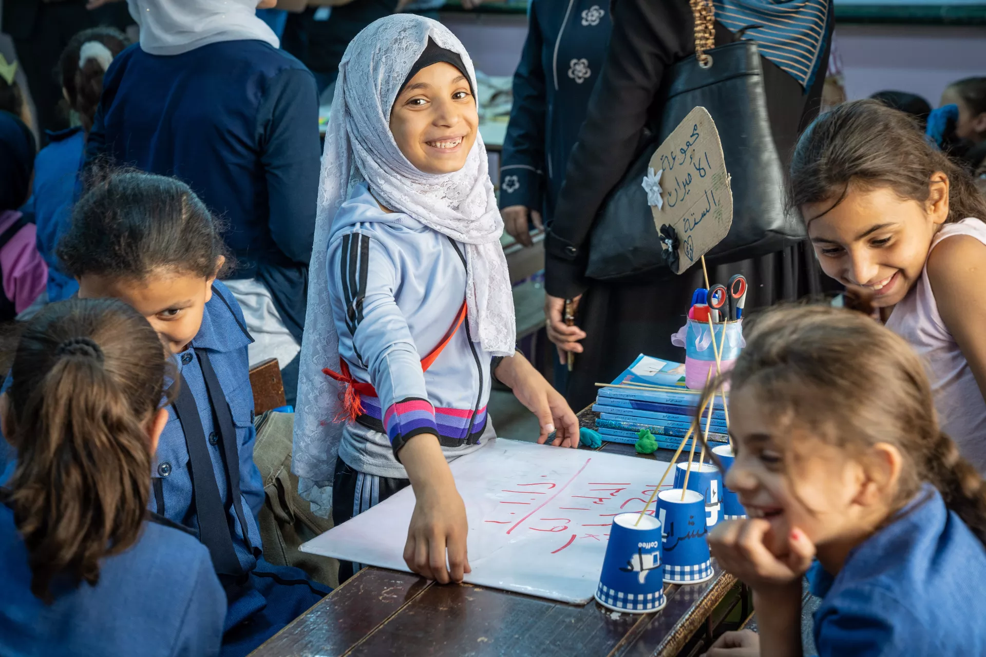
INTEGRATED RESULTS FRAMEWORK
PROSPECTS 2.0.
ITERATIVE EVALUATION – JORDAN CO (2026)

Slide 2
RATIONALE
PROSPECTS 2.0 is a new phase of the program that keeps improving its planning and monitoring systems to show progress.
Tools such as the global Theory of Change (ToC) have been customized, and the elements defined in the MACP such as the Program Portfolio are complemented by the milestones of the Policy Matrix and by the multi-annual indicators.
Key Challenges Identified in the Iteration 1: October 2024 - February 2025
OPPORTUNITY IDENTIFIED
(In the course of fieldwork in Uganda and Kenya)
These 4 elements complement each other; having a common interface to see how all of them interact and interlink with each other was missing.
“The need to reviewing all existing frameworks, interconnect them and put a strong emphasis on achieving high-level outcomes. Linking activities to policy-level outcomes”
“Lack of clarity in connecting key components of the program, including the policy matrix, theory of change, and results framework”
The iterative evaluation identified in its first iteration this gap and proposes an Integrated Results Framework, where all the elements cohabite and are put in perspective.
“Ensure that our activities are connected to the overarching objectives, emphasizing the importance of demonstrating linkages across different pillars. Not to operate in silos”
This framework can be used:
To better understand and explain the integrated logic of PROSPECTS
To better identify synergies
To better discuss and report on progress
“Limited interconnections across pillars, and the pillar system leading to think in siloes”
“There is a strong emphasis on collaboration between different pillars. This includes joint program documents and coordination meetings. The primary area for improvement is internal coordination among pillars, inter-pillar planning in addition to pillar-specific planning.”
This solution has been very well received, like the “missing piece”, by PROSPECTS UNICEF Coordination team, by the two CO visited during the first iteration (Uganda and Kenya), and by PROSPECTS multilateral partners focal points at headquarters, and country level, including the PROSPECTS Netherlands partner.
The Uganda country team has used this tool for the UNICEF country team meeting and shared it with the PROSPECTS multilateral partners (ILO, UNHCR, WB, IF) to facilitate coordination.
These points were deemed relevant to all the countries by the PROSPECTS UNICEF Coordination team, PROSPECTS multilateral partners focal points at HQ (and country level in the iteration 1 countries), and the PROSPECTS Netherlands partner.

Slide 3
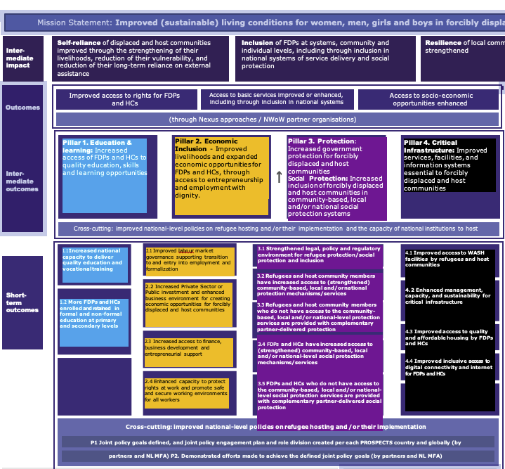
COLOR CODING
We have applied this colour code to the PROSPECTS pillars for the Integrated Framework:
TOC Pillar 1 Education
TOC Pillar 2 Economic
TOC Pillar 3 Protection
TOC Pillar 4 Infrastructure
Pillar 2. Economic Inclusion - Improved livelihoods and expanded economic opportunities for FDPs and HCs, through access to entrepreneurship and employment with dignity.
Pillar 4. Critical Infrastructure: Improved services, facilities, and information systems essential to forcibly displaced and host communities
2.1 Improved labour market governance supporting transition to and entry into employment and formalization
4.1 Improved access to WASH facilities by refugees and host communities
4.2 Enhanced management, capacity, and sustainability for critical infrastructure
4.3 Improved access to quality and affordable housing by FDPs and HCs
4.4 Improved inclusive access to digital connectivity and internet for FDPs and HCs
2.2 Increased Private Sector or Public investment and enhanced business environment for creating economic opportunities for forcibly displaced and host communities
2.3 Increased access to finance,
business development and entrepreneurial support
2.4 Enhanced capacity to protect rights at work and promote safe and secure working environments for all workers

Slide 4
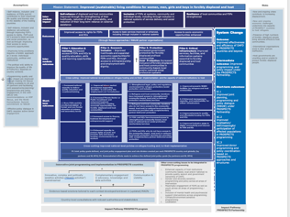
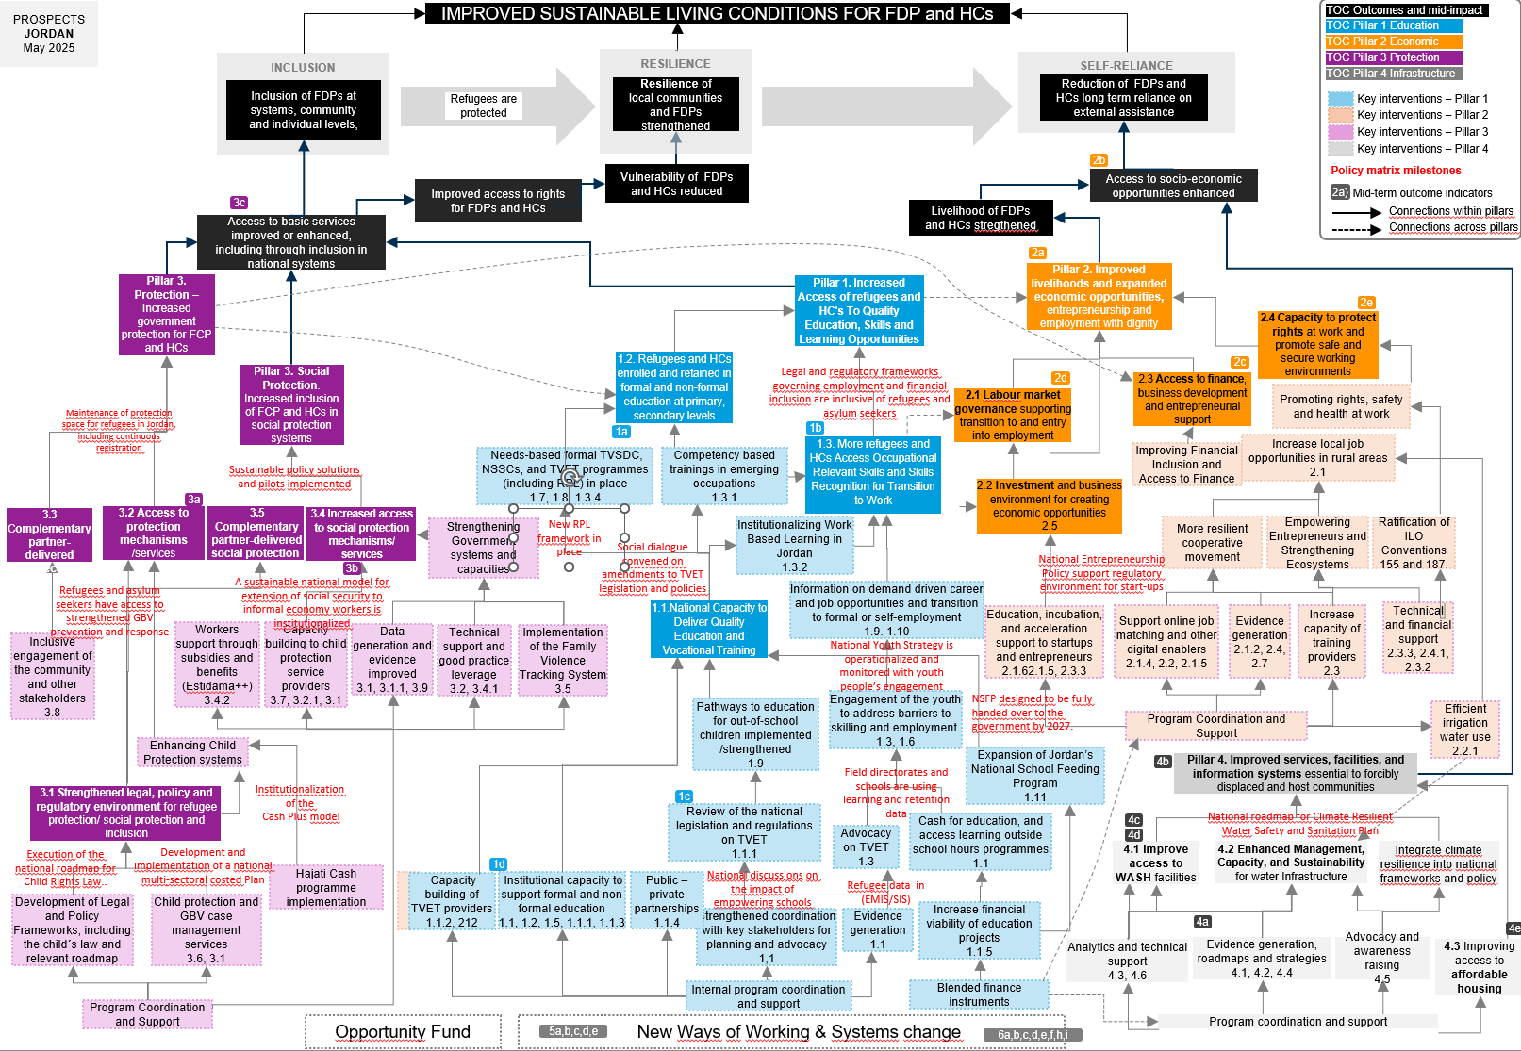
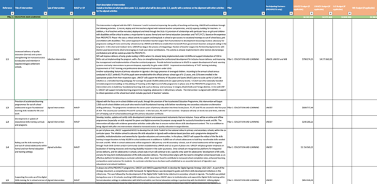
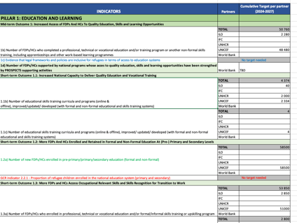

ELEMENTS INTEGRATED IN THIS FRAMEWORK
We have placed the 4 elements in one page:
ToC Global
Programme portfolio
Policy Matrix
Multi-annual targets

Slide 5
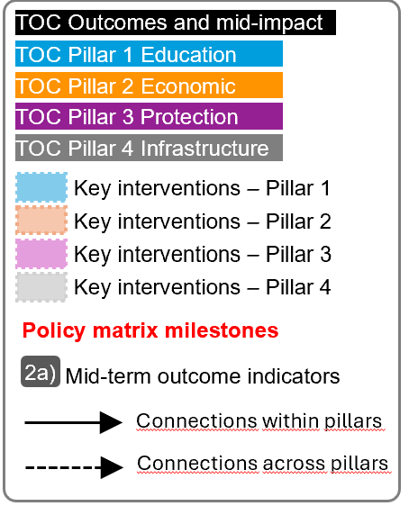
For the next slide:
Please turn to presentation mode
You will find the framework...
… where you can find:
Represent all PROSPECTS outcomes and inter-mediate impact as per the Global Theory of Change
Represent all PROSPECTS short-term outcomes (X.X) , and mid-term outcomes (X) as per the Global Theory of Change
Represent all groups of actions/interventions considered in the MACP 2024-2027 that aim at supporting and contributing to specific areas within each pillar
Represent all relevant policy matrix milestones considered for the period 2024-2027
Represent where the MACP 2024-2027 mid-term outcome indicators sit in the diagram
Click in the presentation icon
so the elements appear progressively

Slide 6
PROSPECTS
JORDAN
March 2026
IMPROVED SUSTAINABLE LIVING CONDITIONS FOR FDP and HCs
TOC Outcomes and mid-impact
TOC Pillar 1 Education
RESILIENCE
TOC Pillar 2 Economic
INCLUSION
SELF-RELIANCE
TOC Pillar 3 Protection
Inclusion of FDPs at systems, community and individual levels,
Resilience of local communities and FDPs strengthened
Reduction of FDPs and HCs long term reliance on external assistance
TOC Pillar 4 Infrastructure
Refugees are protected
Key interventions – Pillar 1
Key interventions – Pillar 2
Key interventions – Pillar 3
2b
Key interventions – Pillar 4
Vulnerability of FDPs and HCs reduced
Access to socio-economic opportunities enhanced
Policy matrix milestones
Improved access to rights for FDPs and HCs
Mid-term outcome indicators
3c
Livelihood of FDPs and HCs stregthened
2a)
Connections within pillars
Access to basic services improved or enhanced, including through inclusion in national systems
Connections across pillars
2a
Pillar 3. Protection – Increased government protection for FCP and HCs
Pillar 1. Increased Access of refugees and HC's To Quality Education, Skills and Learning Opportunities
Pillar 2. Improved livelihoods and expanded economic opportunities, entrepreneurship and employment with dignity
2e
2.4 Capacity to protect rights at work and promote safe and secure working environments
1a
Maintenance of protection space for refugees in Jordan, including continuous registration
Pillar 3. Social Protection. Increased inclusion of FCP and HCs in social protection systems
1.2. Refugees and HCs enrolled and retained in formal and non-formal education at primary, secondary levels
1.6 Refugees access to inclusive and quality education under the national education systems
2d
2c
2.1 Labour market governance supporting transition to and entry into employment
2.3 Access to finance,
business development and entrepreneurial support
Promoting rights, safety and health at work
1b
Increase local job opportunities in rural areas
2.1
Needs-based formal TVSDC, NSSCs, and TVET programmes (including RPL) in place
1.7, 1.8, 1.3.4
Competency based trainings in emerging occupations
1.3.1
1.3. More refugees and HCs Access Occupational Relevant Skills and Skills Recognition for Transition to Work
Improving Financial Inclusion and Access to Finance
Sustainable policy solutions and pilots implemented
2.2 Investment and business environment for creating economic opportunities
2.5
3b
3.5 Complementary partner-delivered social protection
3a
3.3 Complementary partner-delivered protection
3.2 Access to protection mechanisms /services
3.4 Increased access to social protection mechanisms/ services
Strengthening Government systems and capacities
New RPL framework in place
Institutionalizing Work Based Learning in Jordan
1.3.2
More resilient cooperative movement
Empowering Entrepreneurs and Strengthening Ecosystems
Ratification of ILO Conventions 155 and 187.
Social dialogue convened on amendments to TVET legislation and policies
National Entrepreneurship Policy support regulatory environment for start-ups
Refugees and asylum seekers access GBV prevention and response services
6.2 National model for extension of social security to informal economy workers institutionalized
6.1 Support the implementation of the NSP
Information on demand driven career and job opportunities and transition to formal or self-employment
1.9. 1.10
1.1.National Capacity to Deliver Quality Education and Vocational Training
Education, incubation, and acceleration support to startups and entrepreneurs
2.1.62.1.5, 2.3.3
Support online job matching and other digital enablers
2.1.4, 2.2, 2.1.5
Evidence generation
2.1.2, 2.4, 2.7
Increase capacity of training providers
2.3
Technical and financial support
2.3.3, 2.4.1, 2.3.2
Inclusive engagement of the community and other stakeholders
3.8
Workers support through subsidies and benefits (Estidama++)
3.4.2
Capacity building to child protection service providers
3.7, 3.2.1, 3.1
Data generation and evidence improved
3.1, 3.1.1, 3.9
Technical support and good practice leverage
3.2, 3.4.1
Implementation of the Family Violence Tracking System
3.5
1.4 National Youth Strategy is operationalized and monitored
Pathways to education for out-of-school children implemented /strengthened
1.9
Engagement of the youth to address barriers to skilling and employment.
1.3, 1.6
1. 7 NSFP designed to be fully handed over to the government by 2027.
Efficient irrigation water use
2.2.1
6.5 and 6.6 National multi-sectoral costed Plan of Action and assessment reports
6.7 Support on the implementation of Jordan Response Plan 2024-2027
Program Coordination and Support
Enhancing Child Protection systems
1.2 Field directorates and schools use data to become more accountable
Expansion of Jordan’s National School Feeding Program
1.11
4a
1.3 Share accurate information on the availability of scholarships
Pillar 4. Improved services, facilities, and information systems essential to forcibly displaced and host communities
3.1 Strengthened legal, policy and regulatory environment for refugee protection/ social protection and inclusion
6.3 Institutionalization of the Cash Plus model
1c
4b
Review of the national legislation and regulations on TVET
1.1.1
Cash for education, and access learning outside school hours programmes
1.1
4c
National roadmap for Climate Resilient Water Safety and Sanitation Plan
6.4 Implementation of the national roadmap for Child Rights Law.
Advocacy on TVET
1.3
4d
4.2 Enhanced Management, Capacity, and Sustainability for water Infrastructure
Integrate climate resilience into national frameworks and policy
1d
1.1 National discussions about empowering schools triggered
4.1 Improve access to WASH facilities
Hajati Cash programme implementation
Capacity building of TVET providers
1.1.2, 212
Institutional capacity to support formal and non formal education
1.1, 1.2, 1.5, 1.1.1, 1.1.3
Public –private partnerships
1.1.4
1.5 Refugee data
in (EMIS/SIS)
Development of Legal and Policy Frameworks, including the child´s law and relevant roadmap
Child protection and GBV case management services
3.6, 3.1
Strengthened coordination with key stakeholders for planning and advocacy
1,1
Evidence generation
1.1
Increase financial viability of education projects
1.1.5
Evidence generation, roadmaps and strategies
4.1, 4.2, 4.4
Advocacy and awareness raising
4.5
4e
Analytics and technical support
4.3, 4.6
4.3 Improving access to affordable housing
Program Coordination and Support
Internal program coordination and support
Blended finance instruments
New Ways of Working & Systems change
Program coordination and support
5a,b,c,d,e
6a,b,c,d,e,f,h,i

Slide 7
NOTES
2
High-level outcomes logic
Within the high-level results, Inclusion comes first, to reduce vulnerability and increase resilience, to promote self-reliance.
We tried to link key results to the high-level results for greater clarity on how each of them contribute.
1
Pillars’ logic
As agreed with the MFA, Protection becomes the entry pillar. First, we protect, then we provide access to education, and then we facilitate access to microeconomic activities and the job market (infrastructure would be cross-cutting).
That is the reason why we placed pillar 3 on the left, followed by pillar 1 and 2.
3
Additional mid-level goals
Some goals (not numbered) were added as intermediate steps to explain the cause-effect logic.
4
Pillars’ connections
There are numerous actual connections between pillars that are not reflected in the Global ToC diagram but they are reflected in the IF. We tried to include links connecting results across pillars.
5
Jordan’s MACP
Some pillars have outputs; others just lists of actions/results (that we have grouped in “outputs”).
Pillar 4
Is cross-cutting and linked to all others three pillars.
INDICATORS MAPPING
Only the Mid-Term Outcomes indicators have been mapped, which measure elements of the mid part of the diagram (above short-term outcomes and below impact).
Short-term outcomes indicators could be also mapped under the CO demand.
Most of the indicators of section 5 and 6 of the Multi Annual Mid-term Outcome Indicators (SYSTEMS CHANGE and NWOW and Cross-cutting indicators) seem like strategies indicators (enablers rather than results).
Other comments:
Policy matrix does not include expected deadlines (-)
Policy matrix includes more strategies than results (-)
Indirect links among pillars are observed
PROSPECTS JORDAN
May 2025

Slide 8
PRACTICAL USES OF THE INTEGRATED FRAMEWORK
1
Shared understanding
The overall picture of how PROSPECTS work at different levels will contribute to developing a clear and shared understanding of PROSPECTS within UNICEF, across sectors and partners, aligning expectations and roles between them and clarifying vision and strategies.
4
Spot implementation bottlenecks and/or key enablers
The framework adopts a bottom-up approach, and implementers can pinpoint areas of interest and then work backwards to identify potential bottlenecks or opportunities to optimize achievements.
5
Enhance monitoring and evaluation
The framework helps prioritize what to measure by clearly outlining the interconnections between results and the overall line of sight. It can also support contribution analysis by illustrating how programme activities are expected to contribute to overarching goals.
2
Adaptive Management & learning
The framework is a tool for continuous learning and adaptation. It allows teams to test their assumptions and make evidence-based adjustments to their strategies and resource allocation.
3
Coordination & collaboration
The framework can help ensure that interventions are well-coordinated and aligned with overarching goals, while also aiding in identifying opportunities for collaboration.
6
Communication
The framework can be used to communicate the complex logic and strategy of PROSPECTS to diverse audiences, including donors, partners and beneficiaries.
“The integrated framework is designed not only as a conceptual tool to interrogate and possibly refine the design of PROSPECTS, but also as a practical framework that can be applied at various levels.”

Slide 9
Annexes
JORDAN
ASSESSMENT OF THE FRAMEWORK
2
High-level outcomes logic
Within the high level results, Inclusion comes first, to reduce vulnerability and increase resilience, to promote self-reliance.
We tried to link key results to the high-level results for greater clarity on how each of them contribute.
1
Pillars’ logic
As agreed with the MFA, Protection becomes the entry pillar. First, we protect, then we provide access to education, and then we facilitate access to microeconomic activities and the job market (infrastructure would be cross-cutting).
That is the reason why we placed pillar 3 on the left, followed by pillar 1 and 2.
3
Kenya’s MACP
Some pillars have outputs, others just lists of actions/results (that have been group in “outputs”). Policy is clearly embedded, beyond the Policy matrixes
Titles in the Policy matrix
Some key results appear in the milestones grouping (ex. Inclusion in national education, inclusion in GBV mechanisms, access to asylum procedures, etc.)
Pillars’ connections
There are numerous connections between pillars that are not reflected in the Global ToC diagram.
We tried to include links between connecting results across pillars.
INDICATORS MAPPING
Only the Mid-Term Outcomes indicators have been mapped, which measure elements of the mid part of the diagram (above short-term outcomes and below impact).
Short-term outcomes indicators could be also mapped under the CO demand.
Most of the indicators of section 5 and 6 of the framework (SYSTEMS CHANGE and NWOW and Cross-cutting indicators) seem like strategies indicators (enablers rather than results).

Slide 10
PROSPECTS
JORDAN
March 2026
MACP Program Portfolio
Pillar 1: EDUCATION AND LEARNING
1,1 | Support the MOE in its ambition to catch up students on learning and develop stronger mechanisms for retention
1,2 | Capacity building to formal and non-formal skills training programmes
1,3 | Harmonized TVET stakeholders engagement
1,4 | Meaningful young peoples engagment
1,5 | 21st century Skills including digital and financial literacy training
1,6 | Volunteering/Service Leadership
1,7 | Increased access to green skills for climate action
1,8 | Career ready skills for employment
1,9 | Internship programme
1,10 | Mentorship
1.1.1 | Support the skills and TVET system and private sector engagement to promote market relevant skills and lifelong learning in the context of future of work.
1.1.2 | Build capacity of TVET institutions to design and implement more inclusive quality training
1.1.3 | Enhance the capacity, contribution, and visibility of National Sector Skills Councils (NSSCs) in Jordan
1.1.4 | Exploratory work towards a Public Private Partnership model for TVET in Jordan
1.1.5 | Private sector education / TVET - Blended Finance
1.3.1 | Roll out competency based training for HCs and Syrian refugees, with a focus on green and digital sectors
1.3.2 | Expand work-based learning programs to target more HCs and Syrian refugees, with more engagement of private sector
1.3.4 | Expand recognition of prior learning (RPL) to nationally accredit the skills and competencies of FDPs and HCs
1.3.5 | Support refugee access to education
1,11 | Jordan’s National School Feeding Program – Healthy Meals for Students
Pillar 2: ECONOMIC INCLUSION
2.1 | Self-employment through entrepreneurship
2.1.2 | Strengthen capacity of Ministry of Labour and national partners to monitor and follow-up with job seekers and placed workers
2.1.3 | Strengthen national labour market information systems (LMIS) to inform evidence based employmnt policies
2.1.4 | Develop and pilot friendly and accessible methods of employment service delivery integrated into national systems
2.1.5 | Expand Job Search Clubs to other areas and sectors
2.1.6 | Start Mashreq (Fully funded under Prospects 1.0)
2,2 | Skills for creative economy employment
2,3 | Developing entrepreneurship mindset through experiential learning
2,4 | Evidenced based advocacy for policy change
2,5 | Advisory Services/ Irbid Municipality Fresh Market
2.5.1 | Blended Finance Support/ Irbid Municipality Fresh Market
2,6 | Manufacturing
2,7 | Analytical work
2.2.1 | Pilot an EIIP approach to water management, with a focus on agriculture
2.3.1 | Provide institutional capacity building and support for implementation of the National Cooperative Strategy in line with international standards and ILO's Recommendation 193.
2.3.2 | Support MSMEs to increase productivity and job creation potential, and improve working conditions
2.3.3 | Provide technical support and enhance access to finance for cooperatives, MSMEs and social enterprise initiatives in selected sectors.
2.3.4 | Improved access to finance
2.4.1 | Technical guidance and support to promote labour protection for all workers through better alignment of relevant national legislation with international labour standards
2.4.2 | Launch social dialogue on decent work in the digital economy
2.4.3 | Increased representation of vulnerable workers in trade unions
2.4.4 | Improved capacity of partner institutions to promote and engage on rights at work for refugees, and Host communities
Pillar 3: PROTECTION AND SOCIAL PROTECTION
3.1 | Strengthen the social protection policy environment through evidence generation, capacity building, advocacy and cross-nexus sectoral partnerships for rights-based approaches
3,2 | Implement the national social protection strategy through System strengthening interventions to develop and operationalize an integrated and right-based social protection system, with a focus on institutionalizing an inclusive national Cash Plus model
3,3 | UNICEF-led child- and youth-focused Cash Plus programme (child cash grant) to support most vulnerable housholds with focus on FDPs
3,4 | Policy, advocacy, and legal reform
3,5 | Coordination and information management
3,6 | Case management system strengthening and continuum of services
3,7 | Improving capacity of child protection workforce
3,8 | Community engagement and child participation
3.1.1 | Enhance evidence based policy advice for the extension of social security to vulnerable workers (including refugees) and transition from cash assistance to employment-related social insurance.
3.2.1 | Integrated support in addressing the root causes of child labour
3.4.1 | Outreach and sensitization on social security rights and entitlements, with a focus on refugee and informal workers
3.4.2 | Sustainable expansion of social (health) protection to reach Estidama ++ refugee and host community workers
3,9 | Refugee continous registration
3,1 | Coordinate refugee GBV assistance
3,11 | Operationalizing responsibility sharing through the Jordan Response Program
 | Innovative and sustainable policy solutions to fill social health protection gap for refugees and host communities through national social health protection systems
Pillar 4: CRITICAL INFRASTRUCTURE
4.1 | Support water sector partners to integrate most vulnerable population’s needs into provision of climate resilient WASH services
4,2 | Capacity development and GoJ system’s strengthening for institutionalization of climate resilience and prioritization of interventions.
4,3 | Improved integrated management and use of water and sanitation services in Syrian refugee camps
4,4 | Advocacy for equitable access to Climate resilient WASH services
4,5 | Awareness raising on Social Behaviour Change
4,6 | Addressing the Refugee-Climate Nexus in Jordan
4,7 | Improved water management and access
4,8 | Crticial Infratructure/ Belnded Finance

Slide 11
PROSPECTS
JORDAN
March 2026
POLICY MATRIX
POLICY PRIORITIES | KEY CHALLENGES | KEY MILESTONES | KEY STAKEHOLDERS | SUPPORT THROUGH PROGRAMMING
#1 Policy priority Increase transparency and accountability among education and training providers and increase learning, well-being and inclusion outcomes of refugee and host community youth in education | The 2022 MOE-UNICEF National Diagnostic Assessment (NDA) found that many students lack understanding of Arabic and basic mathematical concepts that underpin higher level learning. Without a national gender responsive prevention and retention strategy, and a coordinated action plan, drop out will continue to increase due to high-risk of negative coping mechanisms including child labour and child marriage. In Jordan, there is a trend towards an under-skilled, yet over-educated population, with post-secondary graduates having gender skewed lower employment rates than those with only a secondary education. Low levels of voice and accountability towards citizens, including adolescents and youth. Young people have limited opportunities to engage in policy and advocacy making processes on important issues that directly affect them. While the Government of Jordan generously permits refugees to access local schools, the quality is limited due to infrastructure challenges and overwhelmed human resources which has led to the adoption of double-shift system to accommodate large number of refugee children. 86.6% of Syrian children attend grades 1 to 10, but the drop-out rate at secondary level is high and just 30% attend grades 11 and 12. UNHCR estimates that less than 10% of university aged refugees are enrolled in tertiary education in Jordan. Additionally, food insecurity is a key barrier to educational outcomes and is strongly associated with school attendance, highlighting its importane to Jordan's education context. This is also supported by evidence indicating that poor, vulnerable, and refugee children often had insufficient nutrition which was associated with lower school attendance and performance. | 1.1 Lessons learned from school-level programming leads to national discussions on the effectiveness and impact of empowering schools to become more accountable for learning, well-being and inclusion of all children and adolescents in basic schools. 1.2 Field directorates and schools are using learning and retention data to become more accountable for the well-being and learning of boys and girls aged 10 and above in the most vulnerable areas of Jordan and in the Syrian refugee camps. 1.3 Coordinated outreach to share accurate information on the availability of scholarships, including Technical Vocational Educational Training (TVET) and other educational certificates, upskilling programs and programs that facilitates access to higher education and labour market. 1.4 National Youth Strategy is operationalized and monitored with youth people’s engagement 1.5 Reflection of refugee data in National Education Management Information System (EMIS/SIS) 1.6BY 2025, refugees access to inclusive and quality education under the national education systems as well as the completion of education with relevant skills locally and through enhanced use of complementary pathways. 1.7 NSFP is jointly implemented and funded by the Ministry of Education and WFP but is designed to be fully handed over to the government by 2027. | Ministry of Education and DOE staff Ministry of Education teachers, Ministry of Youth, Refugee and Jordanian Youth, TVET providers, WFP | UNICEF will implement the Teacher of the Future programme through field directorates and schools. UNICEF will contribute to research on out-of-school children to inform national policy and programmes; support the Ministry of Education to develop a national and cross sectoral Drop-Out Prevention and Retention Strategy; and pilot prevention of drop-out intervention(s). UNICEF will deliver its Reading Recovery programme in camp schools and non-formal education centres (2024 only). UNICEF will continue to support school leadership in camps with school improvement/development planning. The NSFP addresses food insecurity and malnutrition as a barrier to education in order to reduce inequality affecting poor and vulnerable children. WB will focus on the expansion and enhancement of Jordan's National School Feeding Program to support children's access to education and their school performance.
#2 Policy Priority Development of a more market relevant and accessible TVET system | TVET regulations remain disconnected and fail to reflect a consultative process in design. There is limited private sector engagement in TVET systems and processes 71 per cent of young Jordanians believe that TVET is not suitable for women. There is an absence of national frameworks to organize the TVET sector Employers report occupation-relevant skills gaps as a key constraint in their operations | By 2024, social dialogue convened on amendments to TVET legislation and policies By 2024, Pilot Recognition of Prior Learning and Work Based Learning based on the new RPL framework | Ministry of Education, Technical Vocational and Skills Development Commission, Sector Skills Councils | ILO will support Sector Skills Councils in anticipating and identifying in-demand skills and designing and implementing work-based learning and RPL programs Exploratory work on Public Private Partnerships for TVET UNICEF will support exploratory work on Public Private Partnerships for TVET IFC support in implementation of a blended finance instrument to both help de-risk and increase financial viability of high impact projects in the TVET sector Development and launch of competency-based trainings in emerging occupations that support a green and digital transformation of the economy, in partnership with TVSDC

Slide 12
PROSPECTS
JORDAN
March 2026
POLICY MATRIX
POLICY PRIORITIES | KEY CHALLENGES | KEY MILESTONES | KEY STAKEHOLDERS | SUPPORT THROUGH PROGRAMMING
#3 Policy priority Support the Government and national partners to increase productivity along key value chains employing Syrian refugee and vulnerable host community members | Economic growth has not been accompanied by job creation, contributing to high levels of unemployment, particularly among youth Micro, small and medium enterprises (MSMEs) account for 98.5 percent of business and 60 per cent of formal sector jobs. Yet still, a large segment of MSMEs remain informal. Business environment remains burdensome and unpredictable for startups such as in the areas of business licensing, taxation and social security costs, etc. MSMEs have limited access to finance, poor productivity, and working conditions. | By 2025, national dialogue on productivity bottlenecks along select value chains By 2026, chambers participate in pilots to address bottlenecks along value chains, aligned to the National Entrepreneurship policy By 2027, joint action taken with MoDEE under the National Entrepreneurship Policy to support regulatory environment for start-ups MSMEs are supported with financial and technical support to introduce changes in their operation, improve productivity and working conditions, and support decent job creation. Business startups, cooperatives, and and Social and Solidarity Economy (SSE) initiatives, particularly those led by youth and in green and digital sectors are provided with technical and financial support | Jordan Chamber of Industry, Jordan Chamber of Commerce, Ministry of Agriculture, cooperatives, MSMEs, MoDEE, Jordan Cooperatives Corporation (JCC) | Prospects Blended Finance and Advisory Services IFC lead on continued implementation of Start Mashreq. IFC help in attracting new investment and export growth, creating supportive conditions for vertical integration and helping increase training and participation in supporting value chains and of workers, especially youth, women and FDPs. ILO support to cooperatives to play a more prominent role in promoting local socio-economic development and decent work World Bank, UNHCR and ILO to collaborate on analytics and possible concrete interventions based on UNHCR/WFP socio-economic skill mapping. Technical and financial support to local initiatives that respond to social issues and local needs across specific value chains in the sector. ILO support to Jordan Chamber's support to MSMEs with a view to target increased productivity job creation, and working conditions.
#4 Policy priority Enhance access to socio-economic opportunities for forcibly displaced persons and host communities, with a focus on women and youth | By the end of 2022, more than 340,000 work permits have been issued to Syrian refugee workers since 2016, yet unemployment among Syrian refugees remains high, in particular for youth and women Lack of policy coherence across sectors (employment, social security) that generate a complex and often contradictory regulatory environment for Syrian refugees’ employment Syrian refugees have restricted access to certain sectors of the economy constraining their employment opportunities whilst Jordanians have less opportunities due to public sector shrinkage and limited private sector. National employment policies have been unable to tackle the growing youth unemployment. With limited job opportunities in the public sector and lack of skills to secure jobs in the private sector, job seekers (in particular youth) increasingly take on informal employment. Youth unemployment is persistently high in Jordan with limited career pathways for young people to transition to wage or self employment. Poor water management practices in agriculture with potential for improvement through labour intensive approaches | In 2024 national partners, led by Social Security Corporation and Ministry of Labour, continue to convene dialogue on coherence across policies and practices for employment and social protection of Syrian refugees (continuation from Phase I), and by 2025 extending participation to relevant national partners including Ministry of Interior, Ministry of Education and Ministry of Digital Economic and Entrepreneurship (MoDEE) Evidence based dialogue fostered amongst ILO's tripartite constiuents and key stakeholders on employment opportunities that need to be tapped in green and digital sectors. By 2025, legal and regulatory frameworks governing employment and financial inclusion are inclusive of refugees and asylum seekers Youth centers provide career guidance and job search services to young Jordaians and Syrian refugees Employment officers provide enhanced employment services to job seekers that are infomred by the labour market infrmaton systems and labour market assessments. EIIP approach to water management piloted to support good agricutural practices and promote short-term employment opportunities. | Ministry of Labour, Social Security Corporation, MoDEE, Ministry of Interior, General Federation of Jordanian Trade Unions, Jordan Chamber of Industry | ILO technical Support and Guidance on National Employment Policy Joint analytical work pertaining to key issues, such as labor integration, market skills needs and FDP skills assessments in key geographical areas defined by size of FDP population and proximity to sizeable businesses and economic development areas. UNICEF will support embedding behavioural insights into career counselling materials, and through gender transformative trainings, counter stereotypes about “male” and “female” jobs at the local and community levels, and link adolescents and youth with non-traditional training and employment opportunities. UNICEF will support preparing young women to successfully respond to market requirements through career counselling and trainings on life and digital skills and financial literacy. UNICEF will assist new and existing businesses led by women to grow and consolidate, including by addressing potential resistances from family and community members through training on entrepreneurship, seed funding, business linkages and follow up support. UNICEF will engage in discussions with government, private sector and development agencies working on similar topics, to identify ways to expand childcare provision, including by licensing home-based nurseries or by helping companies strengthen their partnerships with childcare providers.

Slide 13
PROSPECTS
JORDAN
March 2026
POLICY MATRIX
POLICY PRIORITIES | KEY CHALLENGES | KEY MILESTONES | KEY STAKEHOLDERS | SUPPORT THROUGH PROGRAMMING
#5 Policy Priority Maintenance of protection space for refugees in Jordan, including continuous registration | There is no effective access to registration since January 2019, when the Cabinet issued a decision requesting UNHCR to suspend registration of any person who entered Jordan on a visa/permission in the case of Syrians. This decision impacts non-Syrians and new arrivals. Many of them face serious challenges in meeting basic needs as lack of registration and UNHCR documentation precludes assistance and access to key services. | By 2025, GOJ considers registration modalities for individuals with life-threatening medical conditions or at heightened protection risks with the view of finding suitable durable solution for them. By 2026, presentation to GOJ of alternative options for legalizing the stay of those affected by suspension of registration. By 2027, actions str taken to improve alignment between UNHCR and GOJ issued documents. By 2027, refugees and asylum seekers have access to efficient registration and documentation processes, and access to territory is preserved. Through joint advocacy, including other agencies in the protection space, all refugee and asylum seekers in Jordan hold valid documentation. By 2027, refugees and asylum seekers have access to strengthened GBV prevention and response, ensuring a principled approach to the provision of accessible, prompt, confidential and appropriate services to GBV survivors. | Ministry of Interior (including Civil Status Department), Syrian Refugees Affairs Directorate (SRAD), Refugees Affairs Coordination Office (RACO), Judge Department (through the Sharia Courts | UNHCR led capacity building to support discharging of international protection responsibilities. UNHCR led advocacy efforts on aligning Jordan to International standards on documentation and statelessness. UNHCR to build and coordinate a network of existing and new partners (including refugee lead) with the capacity to address the barriers limiting refugee access to complementary pathways.
#6 Policy priority Legislative, policy and structural reforms for sustainable and strengthened protection systems, including social protection (social security) and child protection, with a focus on the most vulnerable, including informal workers, refugees, women and girls, and youth. | The social protection landscape in Jordan is somewhat fragmented between contributory social insurance and non-contributory social assistance. There is a lack of fiscal space made available for the expansion of inclusive social protection systems. Refugee do not have access to the poverty targeted national social assistance programme, and instead rely on cash assistance from UNHCR and other international actors While refugees have access to contributory social insurance, the cost and design of contributions are not aligned with their needs and realities. Awareness and information on social protection programmes is limited within refugee and vulnerable host communities. Absence of a well-defined theory of change for addressing child protection issues, and inadequate national financial support for children and related policies, emphasize the need of assisting the Government in identifying crucial priorities and giving priority to allocating public funds to protect and enforce the rights of all children living in Jordan. Moreover, the current Jordan Response Plan 2020-2022 is ending, a development-focused refugee response, ensuring refugee access to national health and education services and expanded refugee economic opportunities and access to labor markets. As the crisis enters its second decade, and with little likelihood of Syrian refugees returning to their place of origin soon, it is timely to support the GoJ to strengthen the current approach and deliver better outcomes and better value for money for refugees and vulnerable host communities. | 6.1 As an implementation support of National Social Protection Strategy, evidence is generated including an analysis and investment case for inclusive contributory and non-contributory social protection approaches (e.g. Estidama++, Cash Plus model amogst other), and structures/capacities for nexus coordinaton are enhanced 6.2 A sustainable national model for extension of social security to informal economy workers is institutionalized based on lessons learned through Estidama++. By 2027, national contribution subsidies are made available to vulnerable groups of workers on a permanent basis 6.3 Government of Jordan to institutionalize Cash Plus model and NAF staff to have capacity to operationalize Cash Plus intervention, while sustaining UNICEF-led Cash plus interventions. 6.4 Execution of the developed national roadmap for Child Rights Law.. 6.5 Yearly national reports assessing the implementation of the law and contributing to the National CRC reports. 6.6 Development and implementation of a national multi-sectoral costed Plan of Action for Prevention and Response to Violence Against Children, Gender based violence and Family Violence in Jordan. 6.7 Sustainable policy solutions and pilots implemented to fill social health protection gap for refugees and host communities through national social health protection systems 6.8Implementation of Jordan Response Plan 2024-2027 | National Aid Fund Ministry of Social Development Department of Statistics, National Social Security Corporation (NSSC), Ministry of Labour, The National Council for Family Affairs National Team for Protection, UNFPA, UNWomen,WHO Ministry of Planning and International Cooperation | UNICEF and ILO facilitated technical assistance and system strengthening to operationalize Cash plus model, institutionalized contribution subsidy schemes and nexus coordination Development of key evidence on benefits of cash plus model and sustainability of contribution subsidies in terms of public finance and retention, especially for youth and children. Joint outreach and communication within refugee communities on social security rights and entitlements ILO and UNHCR to cooperate on expansion of Estidama++ and pilot health insurance benefiting migrant workers and refugees. UNICEF will support the National Council for Family Affairs, as per its mandate, to oversee the implementation of the law. UNICEF will help the Council and the Governmental institutions to implement the law's road map, engage with concerned stakeholders, and produce annual reports on key achievements for Cabinet review and action. UNICEF will support the National Council For Family Affairs and the National Team for Protection in developing and executing a five-year, costed National Plan of Action to combat Violence against Children, Gender-Based Violence, and Family Violence in Jordan. Strengthen GoJ's/MOPIC's technical and analytical capacity to support the implementation of the new Jordan Response Plan 2024-2027 and provide technical and capacity support to engage in policy dialogue with all Stakeholders.

Slide 14
PROSPECTS
JORDAN
March 2026
POLICY MATRIX
POLICY PRIORITIES | KEY CHALLENGES | KEY MILESTONES | KEY STAKEHOLDERS | SUPPORT THROUGH PROGRAMMING
#7 Policy Priority Support the Government of Jordan for incorporation of climate resilience into national frameworks for WASH and infrastructure at community and institutional levels | Climate change poses a significant threat to Jordan's water sector. According to the Intergovernmental Panel on Climate Change (IPCC), the Middle East and North Africa region, including Jordan, is expected to experience increased temperatures and decreased precipitation due to climate change, exacerbating water scarcity (IPCC, 2014). A study by Al-Hasani et al. (2023) found that climate change could lead to reductions in crucial water balance components in the Amman-Zarqa Basin, one of Jordan's primary water sources. These changes could have severe implications for water availability and quality, affecting both human consumption and agricultural use. Jordan’s agri-food sector is an important source of income, employment and exports, and the horticulture sector (fruits and vegetables) in particular holds untapped potential as an engine for jobs - including as a source of decent employment for refugees. Moreover, climate change is expected to increase the frequency and intensity of extreme weather events, such as droughts and floods. These events can further strain water resources, damage water infrastructure, and increase the risk of waterborne diseases. On an instutional level, the education sector in Jordan continues to face a number of challenges, with the influx of Syrian refugees bringing an additional 130,000 students into public schools, increased the pressure on already limited existing WASH facilities. Many children attend public schools without running water or adequate sanitation facilities,according to the Joint Monitoring Program (JMP), only one third of public schools in Jordan have access to basic sanitation facilities, with implications on addressing menstrual health & hygiene needs). | National roadmap for Climate Resilient Water Safety and Sanitation Plan (CRWSSP,) Social and Behaviour Change for Water Sector, WASH in institutions Identification of capacity needs and capacity building across WASH stakeholders for improved service delivery, with focus on gender equity. Local contractors and agriculture stakeholders trained on EIIP Support establishment of relevant structures within Ministry of Water and Irrigation Support the Jordan Sustainable Agriculture Plan | Ministry of Water and Irrigation Water Authority of Jordan Ministry of Health Ministry of Education Ministry of Environment Ministry of Agriculture Ministry of Interior Greater Amman Municipality Anti-Corruption Commission Jordan Enterprise Development Corporation FAO GiZ | Support in integrating climate resilience into water and sanitation safety planning is particularly important due to the country's high vulnerability to climate change and water scarcity. By considering climate change impacts in water management and sanitation safety plans, Jordan can ensure that its water and sanitation systems are prepared for future climate scenarios, protecting public health and supporting sustainable development. ILO will implement EIIP in agriculture to improve water resource management, while also generating jobs. This will be done with local agriculture cooperatives and sector stakeholders WB will contribute to advancing necessary national-level policy dialogue and build requisite capacity with highly focused analytics to secure urgently needed water supply for refugee camps by assessing coping mechanisms of FDPs due to inadequate service delivery and assessing bulk water supply options to reduce service delivery outages. It will also design and initiate work related to bulk water supply options identified in basin analytics for priority watersheds supplying refugee camps. Finally, the WB will develop and deliver an updated development model for the horticulture sector that would achieve improved competitiveness and job creation, ensuring inclusivity to FDPs and sustainability in the face of worsening water scarcity under climate change. UNICEF will support in developing of policy briefs / advocacy notes / calls for action will highlight inequities / actions needed to ensure equitable access to climate resilient WASH services (including menstrual health and hygiene) by the most vulnerable populations, and trigger dialogue amongst donors and decision makers to change policies and approaches to guarantee inclusion of vulnerable populations in the sector and reduce disparities in service provision.

Slide 15
PROSPECTS
JORDAN
March 2026
MULTI ANNUAL MID-TERM OUTCOME INDICATORS
INDICATORS INCLUDED IN THE MACP
PILLAR 1: EDUCATION AND LEARNING
Mid-term Outcome 1: Increased Access of FDPs And HCs To Quality Education, Skills and Learning Opportunities
1a) Number of FDPs/HCs who completed their primary or secondary education program (formal and non-formal)
1b) Number of FDPs/HCs who completed a professional, technical or vocational education and/or training program or another non-formal skills training, including apprenticeships and other work-based learning programmes
1c) Evidence that legal frameworks and policies are inclusive for refugees in terms of access to education systems
PILLAR 2: ECONOMIC INCLUSION
Mid-term Outcome 2: Improved livelihoods and expanded economic opportunities for FDPs and HCs, through access to entrepreneurship and employment with dignity
2a) Number of new wage employment and/or self-employment (business) opportunities supported by PROSPECTS
2b) Number of FDPs/HC members already employed or self-employed who have either increased their income, enhanced their working conditions or maintained resilient livelihoods
2c) Number of Government institutions, BDS providers, financial institutions, input providers and/or cooperatives that have introduced new services or scaled their service offer for FDPs and HCs
2d) Evidence that legal frameworks and policies are inclusive for refugees in terms of access to labor market and formality
GCR indicator 2.1.1 - Proportion of refugees who have access to decent work by law
PILLAR 3: PROTECTION, SOCIAL PROTECTION AND INCLUSION
3a) Extent of inclusion of FDPs in the social protection system (UNICEF SP Indicator 5.2.1)
GCR indicator 2.1.2 - Proportion of refugees who are able to move freely within the host country
3.1a) Evidence that legal frameworks and policies are inclusive for refugees in terms of protection
PILLAR 4: CRITICAL INFRASTRUCTURE
Mid-term Outcome 4: Improved Services, Facilities and Information Systems Essential to FDPs and HCs
4a) Evidence that legislative and policy frameworks related to critical infrastructure (WASH, housing, digital connectivity) are inclusive of FDPs
4c) Proportion of FDPs/HC members using at least basic drinking water services
SET OF OVERALL INDICATOR FOR PROSPECTS
PILLAR 1: EDUCATION AND LEARNING
Mid-term Outcome 1: Increased Access of FDPs And HCs To Quality Education, Skills and Learning Opportunities
1a) Number of FDPs/HCs who completed their primary or secondary education program (formal and non-formal)
1b) Number of FDPs/HCs who completed a professional, technical or vocational education and/or training program or another non-formal skills training
1c) Evidence on how PROSPECTS has contributed to a change in legal frameworks, policies and asylum system related to access for refugees to education and training systems
1d) Evidence that PROSPECTS contributed to institutional capacity strengthening in relation to inclusion in education and trainings for FDPs and HCs
PILLAR 2: ECONOMIC INCLUSION
Mid-term Outcome 2: Improved livelihoods and expanded economic opportunities for FDPs and HCs, through access to entrepreneurship and employment with dignity
2a) Number of new employment and/or self-employment (business) opportunities supported by PROSPECTS
2b) Number of FDPs/HC members already employed or self-employed who have either increased their income, enhanced their working conditions or maintained resilient livelihoods
2c) Number of Government institutions, BDS providers, financial institutions, input providers and/or cooperatives that have introduced new services or scaled their service offer for FDPs and HCs
2d) Evidence on how PROSPECTS has contributed to a changes in legal frameworks, policies and asylum system related to inclusion of refugees in the labor market and formality
2e) Evidence that PROSPECTS contributed to institutional capacity strengthening in relation to inclusion of FDPs and HCs in the labour market and to improved labour rights
GCR indicator 2.1.1 - Proportion of refugees who have access to decent work by law
PILLAR 3: PROTECTION, SOCIAL PROTECTION AND INCLUSION
Mid-term Outcome 3: Protection: Increased Government Protection for FDPs and HCs. Protection: Increased Government Protection for FDPs and HCs Social Protection: Increased Inclusion of FDPs and HCs In Community-based, Local and/or National Social Protection Systems
3a) Extent of inclusion of FDPs in the social protection system and alignment of national SP system with international standards
3b) Evidence on how PROSPECTS has contributed to strengthened institutional capacity to include protection systems in national and sub-national systems and development planning
3c) Evidence that PROSPECTS contributed to institutional capacity strengthening in relation to inclusion of FDPs and HCs in social protection systems
GCR indicator 2.1.2 - Proportion of refugees who are able to move freely within the host country
PILLAR 4: CRITICAL INFRASTRUCTURE
Mid-term Outcome 4: Improved Services, Facilities and Information Systems Essential to FDPs and HCs
4a) Evidence that PROSPECTS has contributed to a change in legal frameworks, policies and asylum system related to inclusive critical infrastructure (WASH, housing, digital connectivity) for refugees
4b) Evidence that PROSPECTS contributed to improved services, facilities and information systems essential for FDPs and HCs
4c) Proportion of FDPs/HC members using at least basic drinking water services
4d) Proportion of FDPs/HC members with access to safe household sanitation
4e) Proportion of FDPs and HC living in habitable and affordable housing

Slide 16
PROSPECTS
JORDAN
March 2026
MULTI ANNUAL MID-TERM OUTCOME INDICATORS
INDICATORS INCLUDED IN THE MACP
5. SYSTEMS CHANGE and NWOW
Outcome: Improved Effectiveness and Efficiency of DAFD in Prospects Countries and Beyond
5a) Evidence that the Partnership fostered improved responses and innovative ways to address protracted forced displacement in PROSPECTS countries
5b) Perception of change by partners in joint-up planning and programming (strategic alignment, sequencing, layering, integrated interventions) and in the joint implementation experience
5c) Extent to which collective outcome-based interventions are jointly designed and implemented (two or more partners)
5d) Number of shared target geographical areas identified
5e) Number of PROSPECTS beneficiaries receiving services from two partners or more
6. CROSS-CUTTING INDICATORS
6a) Extent to which PROSPECTS interventions contribute to transformative approaches and solutions for youth, gender equality and people with disabilities
6b) Number and % of young people involved in (i) voicing their recommendations, or (ii) taking action in individual or collective civic engagement initiatives, entrepreneurial action, adovacy oppportunites or (iii) providing inputs to agency specific or joint PROSPECTS programming decisions
6c) Extent to which PROSPECTS interventions contribute to climate adaptation of FDPs and vulnerable HC members
6f) Number of platforms, management systems, and/or registration systems improved, updated and/or developed
SET OF OVERALL INDICATOR FOR PROSPECTS
5. SYSTEMS CHANGE and NWOW
Outcome: Improved Effectiveness and Efficiency of DAFD in Prospects Countries and Beyond
5a) Evidence that the Partnership fostered improved responses and innovative ways to address protracted forced displacement in PROSPECTS countries
5b) Perception of change by partners in joint-up planning and programming (strategic alignment, sequencing, layering, integrated interventions) and in the joint implementation experience
5c) Extent to which collective outcome-based interventions are jointly designed and implemented (two or more partners)
5d) Number of shared target geographical areas identified
5e) Number of PROSPECTS beneficiaries receiving services from two partners or more
6. CROSS-CUTTING INDICATORS
6a) Extent to which PROSPECTS interventions contribute to transformative approaches and solutions for youth, gender equality and people with disabilities
6b) Number and % of young people involved in: I) voicing their recommendations, or ii) taking action in individual, or; collective - civic engagement initiatives, entrepreneurial action, advocacy opportunities, or;iii) providing inputs to agency specific or joint prospects programming decisions
6c) Extent to which PROSPECTS interventions contribute to climate adaptation of FDPs and vulnerable HC members
6d) Number of institutions receiving technical assistance or capacity building to improve their services to FDPs and HCs
6e) Number of staff participating in capacity building or training sessions (all pillars)
6d) Number of platforms, management systems, and/or registration systems improved, updated and/or developed
6e) Number & percentage of total interventions classified as promoting/addressing gender equality as a key objective: Not targeted (score 0): the project has not been found to target gender equality Significant (score 1): gender equality is an important and deliberate objective, but not the principal reason for undertaking the project. Principal (score 2): gender equality is the main objective of the project and is fundamental to its design and expected results. The project would not have been undertaken without this gender equality objective.
6h) Number of FDPs and HCs using feedback and response mechanisms to voice concerns or recommendations to improve PROSPECTS programming
6i) Number of plans, strategies, measures, and/or policy recommendations created, enhanced and/or delivered to the government
6f) Number of analytics, reports or data collection efforts completed informing ongoing or pipeline operations and/or contributing to improved evidence and data on poverty, vulnerability, and displacement

