Slide 1

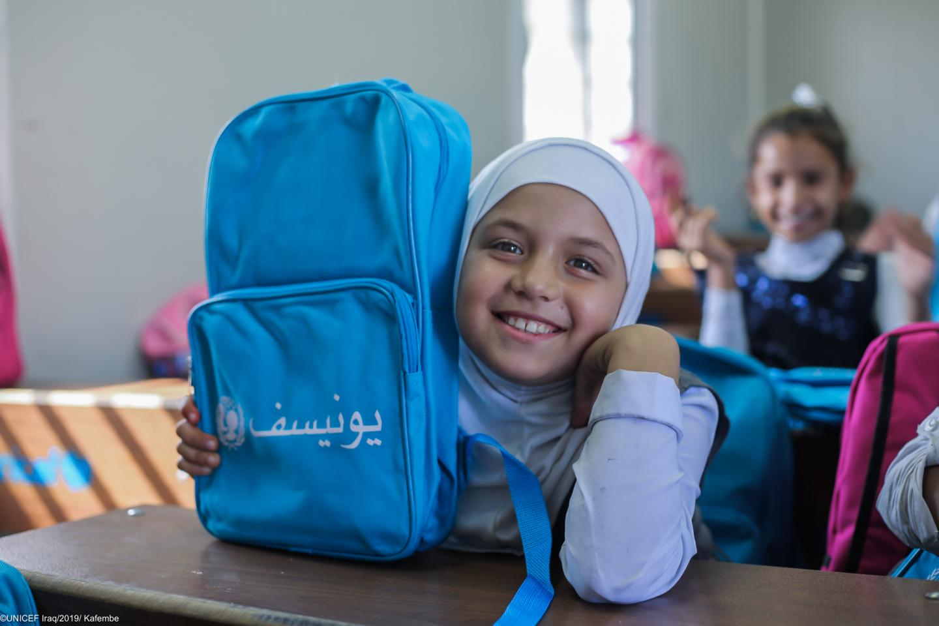
INTEGRATED RESULTS FRAMEWORK
PROSPECTS 2.0.
ITERATIVE EVALUATION – IRAQ CO (2026)

Slide 2
RATIONALE
PROSPECTS 2.0 is a new phase of the program that keeps improving its planning and monitoring systems to show progress.
Tools such as the global Theory of Change (ToC) have been customized, and the elements defined in the MACP such as the Program Portfolio are complemented by the milestones of the Policy Matrix and by the multi-annual indicators.
Key Challenges Identified in the Iteration 1: October 2024 - February 2025
OPPORTUNITY IDENTIFIED
(In the course of fieldwork in Uganda and Kenya)
These 4 elements complement each other; having a common interface to see how all of them interact and interlink with each other was missing.
“The need to reviewing all existing frameworks, interconnect them and put a strong emphasis on achieving high-level outcomes. Linking activities to policy-level outcomes”
“Lack of clarity in connecting key components of the program, including the policy matrix, theory of change, and results framework”
The iterative evaluation identified in its first iteration this gap and proposes an Integrated Results Framework, where all the elements cohabite and are put in perspective.
“Ensure that our activities are connected to the overarching objectives, emphasizing the importance of demonstrating linkages across different pillars. Not to operate in silos”
This framework can be used:
To better understand and explain the integrated logic of PROSPECTS
To better identify synergies
To better discuss and report on progress
“Limited interconnections across pillars, and the pillar system leading to think in siloes”
“There is a strong emphasis on collaboration between different pillars. This includes joint program documents and coordination meetings. The primary area for improvement is internal coordination among pillars, inter-pillar planning in addition to pillar-specific planning.”
This solution has been very well received, like the “missing piece”, by PROSPECTS UNICEF Coordination team, by the two CO visited during the first iteration (Uganda and Kenya), and by PROSPECTS multilateral partners focal points at headquarters, and country level, including the PROSPECTS Netherlands partner.
The Uganda country team has used this tool for the UNICEF country team meeting and shared it with the PROSPECTS multilateral partners (ILO, UNHCR, WB, IF) to facilitate coordination.
These points were deemed relevant to all the countries by the PROSPECTS UNICEF Coordination team, PROSPECTS multilateral partners focal points at HQ (and country level in the iteration 1 countries), and the PROSPECTS Netherlands partner.

Slide 3
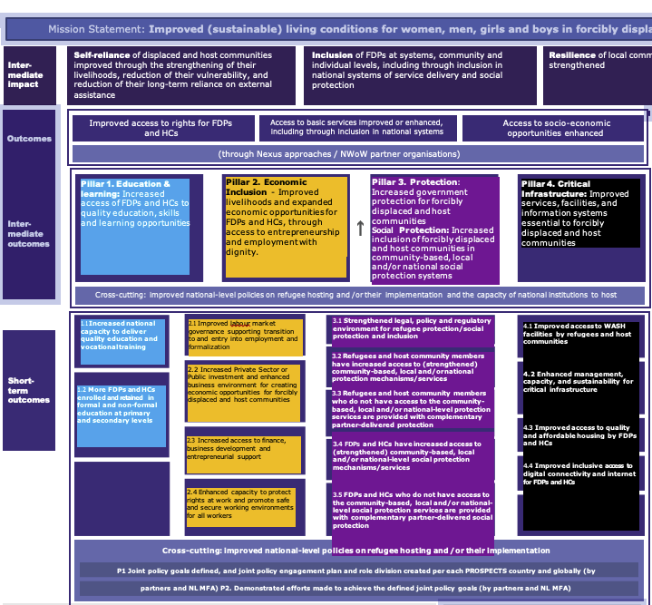
COLOR CODING
We have applied this colour code to the PROSPECTS pillars for the Integrated Framework:
TOC Pillar 1 Education
TOC Pillar 2 Economic
TOC Pillar 3 Protection
TOC Pillar 4 Infrastructure
Pillar 2. Economic Inclusion - Improved livelihoods and expanded economic opportunities for FDPs and HCs, through access to entrepreneurship and employment with dignity.
Pillar 4. Critical Infrastructure: Improved services, facilities, and information systems essential to forcibly displaced and host communities
2.1 Improved labour market governance supporting transition to and entry into employment and formalization
4.1 Improved access to WASH facilities by refugees and host communities
4.2 Enhanced management, capacity, and sustainability for critical infrastructure
4.3 Improved access to quality and affordable housing by FDPs and HCs
4.4 Improved inclusive access to digital connectivity and internet for FDPs and HCs
2.2 Increased Private Sector or Public investment and enhanced business environment for creating economic opportunities for forcibly displaced and host communities
2.3 Increased access to finance,
business development and entrepreneurial support
2.4 Enhanced capacity to protect rights at work and promote safe and secure working environments for all workers

Slide 4
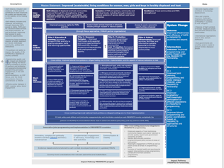
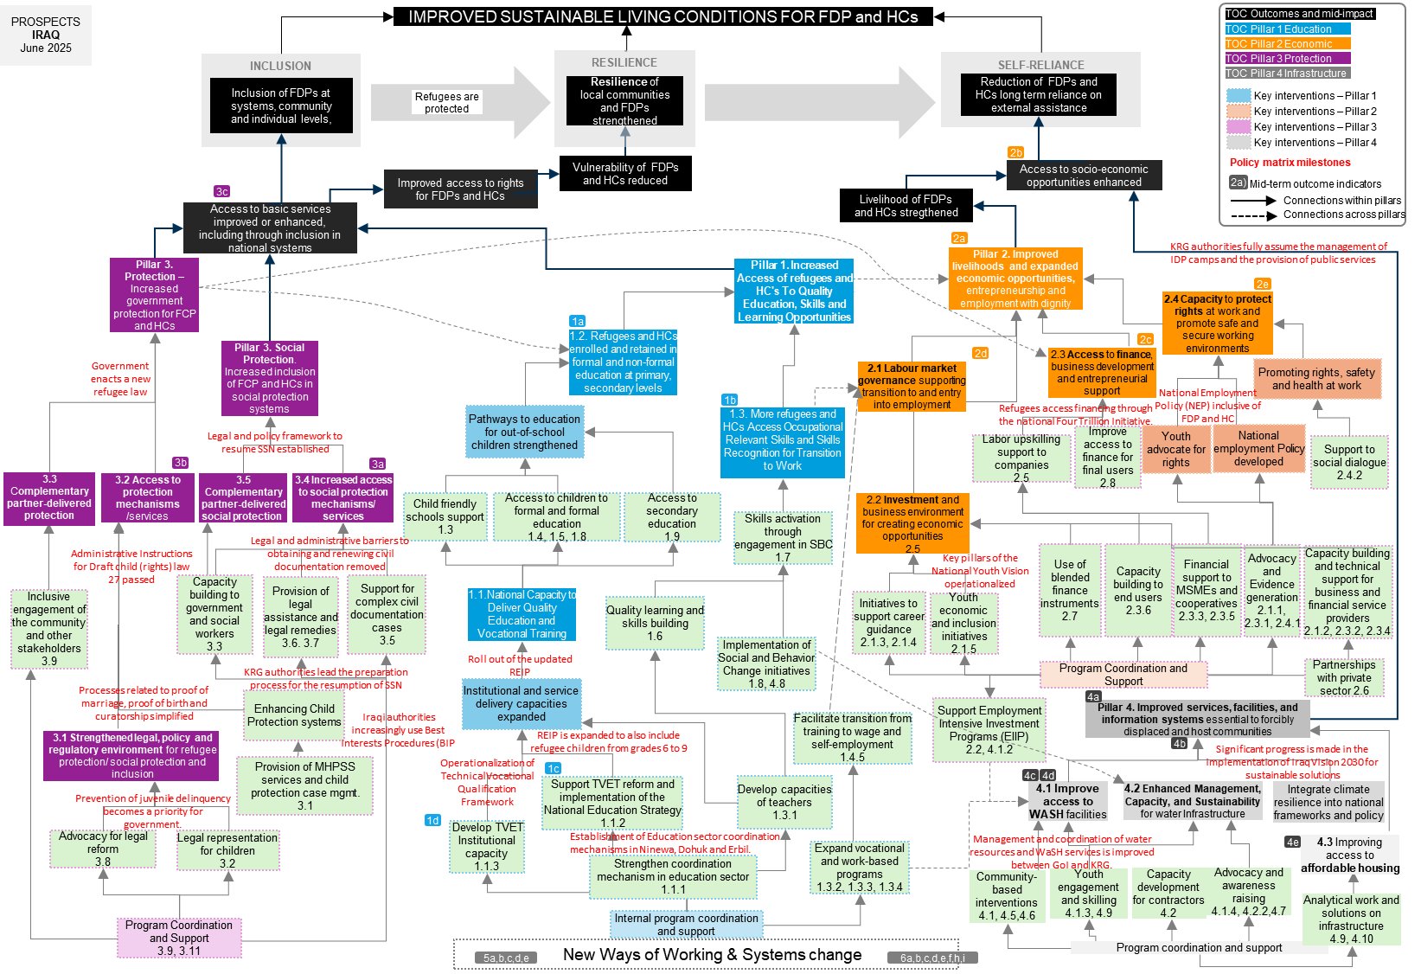
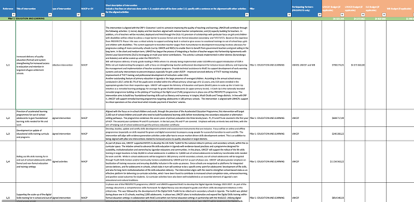
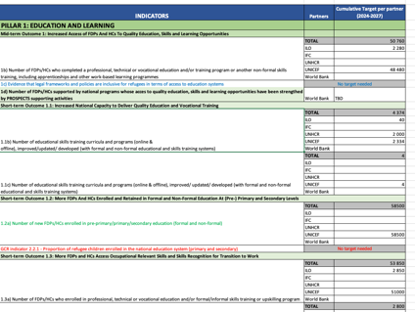

ELEMENTS INTEGRATED IN THIS FRAMEWORK
We have placed the 4 elements in one page:
ToC Global
Programme portfolio
Policy Matrix
Multi-annual targets

Slide 5
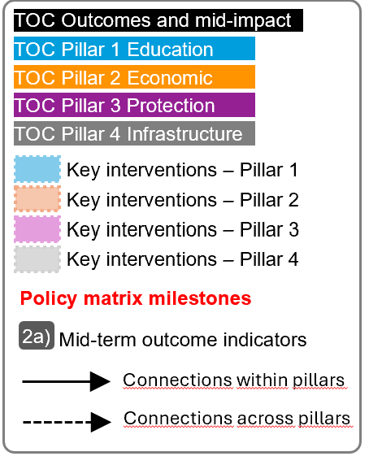
For the next slide:
Please turn to presentation mode
You will find the framework...
… where you can find:
Represent all PROSPECTS outcomes and inter-mediate impact as per the Global Theory of Change
Represent all PROSPECTS short-term outcomes (X.X) , and mid-term outcomes (X) as per the Global Theory of Change
Represent all groups of actions/interventions considered in the MACP 2024-2027 that aim at supporting and contributing to specific areas within each pillar
Represent all relevant policy matrix milestones considered for the period 2024-2027
Represent where the MACP 2024-2027 mid-term outcome indicators sit in the diagram
Click in the presentation icon
so the elements appear progressively

Slide 6
PROSPECTS
IRAQ
March 2026
IMPROVED SUSTAINABLE LIVING CONDITIONS FOR FDP and HCs
TOC Outcomes and mid-impact
TOC Pillar 1 Education
RESILIENCE
TOC Pillar 2 Economic
INCLUSION
SELF-RELIANCE
TOC Pillar 3 Protection
Inclusion of FDPs at systems, community and individual levels,
Resilience of local communities and FDPs strengthened
Reduction of FDPs and HCs long term reliance on external assistance
TOC Pillar 4 Infrastructure
Refugees are protected
Key interventions – Pillar 1
Key interventions – Pillar 2
Key interventions – Pillar 3
2b
Key interventions – Pillar 4
Vulnerability of FDPs and HCs reduced
Access to socio-economic opportunities enhanced
Policy matrix milestones
Improved access to rights for FDPs and HCs
Mid-term outcome indicators
3c
Livelihood of FDPs and HCs stregthened
2a)
Connections within pillars
Access to basic services improved or enhanced, including through inclusion in national systems
Connections across pillars
2a
5.4 KRG authorities fully assume the management of IDP camps and the provision of public services
Pillar 3. Protection – Increased government protection for FCP and HCs
Pillar 2. Improved livelihoods and expanded economic opportunities, entrepreneurship and employment with dignity
1.2. Refugees and HCs enrolled and retained in formal and non-formal education at primary, secondary levels
2e
Pillar 1. Increased Access of refugees and HC's To Quality Education, Skills and Learning Opportunities
2.4 Capacity to protect rights at work and promote safe and secure working environments
1a
2c
Government enacts a new refugee law
Pillar 3. Social Protection. Increased inclusion of FCP and HCs in social protection systems
2d
2.3 Access to finance,
business development and entrepreneurial support
Promoting rights, safety and health at work
2.1 Labour market governance supporting transition to and entry into employment
Pathways to education for out-of-school children strengthened
1b
Refugees access financing through the national Four Trillion Initiative.
National Employment Policy (NEP) inclusive of FDP and HC
Legal and policy framework to resume SSN established
1.3. More refugees and HCs Access Occupational Relevant Skills and Skills Recognition for Transition to Work
Improve access to finance for final users
2.8
Labor upskilling support to companies
2.5
Support to social dialogue
2.4.2
3.3 Complementary partner-delivered protection
3b
3a
3.2 Access to protection mechanisms /services
3.5 Complementary partner-delivered social protection
3.4 Increased access to social protection mechanisms/ services
Child friendly schools support
1.3
Access to children to formal and formal education
1.4, 1.5, 1.8
Access to secondary education
1.9
Skills activation through engagement in SBC
1.7
2.2 Investment and business environment for creating economic opportunities
2.5
1.2 Administrative Instructions for Draft child (rights) law 27 passed
Legal and administrative barriers to obtaining and renewing civil documentation removed
3.3 Pillars of the National Youth Vision operationalized
Key pillars of the National Youth Vision operationalized
Use of blended finance instruments
2.7
Capacity building to end users
2.3.6
Financial support to MSMEs and cooperatives
2.3.3, 2.3.5
Advocacy and Evidence generation
2.1.1, 2.3.1, 2.4.1
Capacity building and technical support for business and financial service providers
2.1.2, 2.3.2, 2.3.4
Inclusive engagement of the community and other stakeholders
3.9
Capacity building to government and social workers
3.3
Provision of legal assistance and legal remedies
3.6. 3.7
Support for complex civil documentation cases
3.5
1.1.National Capacity to Deliver Quality Education and Vocational Training
Initiatives to support career guidance
2.1.3, 2.1.4
Youth economic and inclusion
initiatives
2.1.5
Quality learning and skills building
1.6
Roll out of the updated REIP
Implementation of Social and Behavior Change initiatives 1.8, 4.8
KRG authorities lead the preparation process for the resumption of SSN
Program Coordination and Support
Partnerships with private sector 2.6
1.1 New refugee law in line with international standards
Enhancing Child Protection systems
Institutional and service delivery capacities expanded
Support Employment Intensive Investment Programs (EIIP)
2.2, 4.1.2
4a
Iraqi authorities increasingly use Best Interests Procedures (BIP
Facilitate transition from training to wage and self-employment
1.4.5
Pillar 4. Improved services, facilities, and information systems essential to forcibly displaced and host communities
3.1 Strengthened legal, policy and regulatory environment for refugee protection/ social protection and inclusion
3.1, 3.4 REIP is expanded to also include refugee children from grades 6 to 9
4b
Provision of MHPSS services and child protection case mgmt.
3.1
3.2 Operationalization of Technical Vocational Qualification Framework
5.1 Significant progress is made in the implementation of Iraq Vision 2030 for sustainable solutions
1c
Develop capacities of teachers
1.3.1
4c
4d
1.3 Prevention of juvenile delinquency becomes a priority for government.
Support TVET reform and implementation of the National Education Strategy
1.1.2
4.1 Improve access to WASH facilities
4.2 Enhanced Management, Capacity, and Sustainability for water Infrastructure
Integrate climate resilience into national frameworks and policy
Advocacy for legal reform
3.8
Legal representation for children
3.2
1d
Develop TVET Institutional capacity
1.1.3
5.2 Management and coordination of water resources and WaSH services improved
5.3 Establishment of Education sector coordination mechanisms in Ninewa, Dohuk and Erbil.
Expand vocational and work-based programs
1.3.2, 1.3.3, 1.3.4
4e
4.3 Improving access to affordable housing
Strengthen coordination mechanism in education sector
1.1.1
Community-based interventions
4.1, 4.5,4.6
Youth engagement and skilling 4.1.3, 4.9
Capacity development for contractors
4.2
Advocacy and awareness raising
4.1.4, 4.2.2,4.7
Internal program coordination and support
Analytical work and solutions on infrastructure
4.9, 4.10
Program Coordination and Support
3.9, 3.11
New Ways of Working & Systems change
Program coordination and support
5a,b,c,d,e
6a,b,c,d,e,f,h,i

Slide 7
NOTES
2
High-level outcomes logic
Within the high-level results, Inclusion comes first, to reduce vulnerability and increase resilience, to promote self-reliance.
We tried to link key results to the high-level results for greater clarity on how each of them contribute.
1
Pillars’ logic
As agreed with the MFA, Protection becomes the entry pillar. First, we protect, then we provide access to education, and then we facilitate access to microeconomic activities and the job market (infrastructure would be cross-cutting).
That is the reason why we placed pillar 3 on the left, followed by pillar 1 and 2.
3
Additional mid-level goals
Some goals (not numbered) were added as intermediate steps to explain the cause-effect logic.
4
Pillars’ connections
There are numerous actual connections between pillars that are not reflected in the Global ToC diagram but they are reflected in the IF. We tried to include links connecting results across pillars.
5
Policy Matrix milestones
All milestones shown in the IF, including those more process-oriented.
INDICATORS MAPPING
Only the Mid-Term Outcomes indicators have been mapped, which measure elements of the mid part of the diagram (above short-term outcomes and below impact).
Short-term outcomes indicators could be also mapped under the CO demand.
Most of the indicators of section 5 and 6 of the Multi Annual Mid-term Outcome Indicators (SYSTEMS CHANGE and NWOW and Cross-cutting indicators) seem like strategies indicators (enablers rather than results).
Other comments:
Policy matrix includes expected deadlines
PROSPECTS
IRAQ
June 2025

Slide 8
PRACTICAL USES OF THE INTEGRATED FRAMEWORK
1
Shared understanding
The overall picture of how PROSPECTS work at different levels will contribute to developing a clear and shared understanding of PROSPECTS within UNICEF, across sectors and partners, aligning expectations and roles between them and clarifying vision and strategies.
4
Spot implementation bottlenecks and/or key enablers
The framework adopts a bottom-up approach, and implementers can pinpoint areas of interest and then work backwards to identify potential bottlenecks or opportunities to optimize achievements.
5
Enhance monitoring and evaluation
The framework helps prioritize what to measure by clearly outlining the interconnections between results and the overall line of sight. It can also support contribution analysis by illustrating how programme activities are expected to contribute to overarching goals.
2
Adaptive Management & learning
The framework is a tool for continuous learning and adaptation. It allows teams to test their assumptions and make evidence-based adjustments to their strategies and resource allocation.
3
Coordination & collaboration
The framework can help ensure that interventions are well-coordinated and aligned with overarching goals, while also aiding in identifying opportunities for collaboration.
6
Communication
The framework can be used to communicate the complex logic and strategy of PROSPECTS to diverse audiences, including donors, partners and beneficiaries.
“The integrated framework is designed not only as a conceptual tool to interrogate and possibly refine the design of PROSPECTS, but also as a practical framework that can be applied at various levels.”

Slide 9
Annexes
IRAQ
ASSESSMENT OF THE FRAMEWORK
2
High-level outcomes logic
Within the high level results, Inclusion comes first, to reduce vulnerability and increase resilience, to promote self-reliance.
We tried to link key results to the high-level results for greater clarity on how each of them contribute.
1
Pillars’ logic
As agreed with the MFA, Protection becomes the entry pillar. First, we protect, then we provide access to education, and then we facilitate access to microeconomic activities and the job market (infrastructure would be cross-cutting).
That is the reason why we placed pillar 3 on the left, followed by pillar 1 and 2.
3
Kenya’s MACP
Some pillars have outputs, others just lists of actions/results (that have been group in “outputs”). Policy is clearly embedded, beyond the Policy matrixes
Titles in the Policy matrix
Some key results appear in the milestones grouping (ex. Inclusion in national education, inclusion in GBV mechanisms, access to asylum procedures, etc.)
Pillars’ connections
There are numerous connections between pillars that are not reflected in the Global ToC diagram.
We tried to include links between connecting results across pillars.
INDICATORS MAPPING
Only the Mid-Term Outcomes indicators have been mapped, which measure elements of the mid part of the diagram (above short-term outcomes and below impact).
Short-term outcomes indicators could be also mapped under the CO demand.
Most of the indicators of section 5 and 6 of the framework (SYSTEMS CHANGE and NWOW and Cross-cutting indicators) seem like strategies indicators (enablers rather than results).

Slide 10
PROSPECTS
IRAQ
June 2025
MACP Program Portfolio
Pillar 1: EDUCATION AND LEARNING
1,1 | Local sector coordination and planning
1,1 | Support TVET reform and implementation of the National Education Strategy
1,1 | Strengthen TVET institutional capacity to identify skills demand, implement quality vocational training and work-based learning (WBL), and assess outcomes of skills delivery
1,2 | Child-friendly schools or similar (School Based Management) model
1,3 | Teachers capacity building in life skills, MHPSS and child centred pedagogy and positive discipline
1,3 | Expand vocational training programs in Ninawa and Dohuk, with a focus on youth
1,3 | Expand work-based learning programs with more engagement of the private sector
1,3 | Facilitate transition from training to both wage and self-employment
1,4 | Humanitarian intervention focussing on providing access to formal and non-formal basic education opportunities
1,5 | Support to vulnerable children (out of school or at risk of dropping out) with formal or non-formal education interventions
1,6 | Quality Learning and Skills Building
1,7 | Skills Activation throough Meaningful engagement of youth in social behavior change interventions to promote positive behaviors around education
1,8 | Design and implement social and behavior change interventions including Accountability to affected population mechanisms to increase schools’ enrollment and transition to secondary schools in the effected population
1,8 | Access of refugees and asylum seekers to national basic education system is supported
1,9 | Access to secondary education for Persons of Concern is supported
Pillar 2: ECONOMIC INCLUSION
2,1 | Capacity building and technical support for Industry Associations and Chambers in support of business formalization
2,1 | Job Search Clubs implemented to support career guidance and facilitate youth transitions into employment
2,1 | Provision of career guidance strengthened with stronger linkages introduced to TVET, universities, and private sector employers
2.1 | Economic and Social Inlcusion
2,2 | EIIP approaches and SOPs adopted and integrated into national public works programmes
2,2 | Strengthen social partners engagement in EIIP
2,2 | EIIP green works programmes scaled up
2,3 | Enhanced policy advocacy for financial inclusion of refugees
2,3 | Expanded capacity building interventions for commercial banks and other financial service providers to serve FDPs and HC clients, particularly start-ups
2,3 | Expanded support to business start-ups and existing MSMEs through financial (loan provision through the 4 Trillion initiative) and non-financial support (business management training)
2,3 | Scale up support to microfinance institutions to provide new loan products catered to needs of refugees and IDPs
2,3 | Support the development of the cooperative movement in Iraq, including capacity of cooperatives to serve their members and communities
2,3 | Improve Women Economic Empowerment for female IDPs and Refugees (Capacity Building Program)
2,4 | Youth Rights@ Work expanded and integrated into VT, life skills and employment trainings for young people
2,4 | Social dialogue at the sector level to improve working conditions and introduce collective bargaining mechanisms
2,5 | Labor Upskilling
2,6 | Real sector inteventions
2,7 | Real Sector- Blended Finance
2,8 | Improved access to finance
Pillar 3: PROTECTION AND SOCIAL PROTECTION
3,1 | Child Protection prevention and Response
3,2 | Legal Support to children in conflict with Law
3,3 | System strengthening for child protection
3,4 | Social Behavior change to promote inclusion and protection
3,5 | Access to civil registration and documentation supported
3,6 | Access to legal assistance and legal remedies supported
3,7 | Access to legal assistance and legal remedies supported
3,8 | Policy and strategies developed/strengthened to ensure inclusion of refugees
3,9 | Result monitoring and surveys to measure the inclusion of refugees into national systems
3,10 | Community self-management, representation, and leadership is supported by engaging community across the AGD spectrum
3,11 | MACP Coordination
Pillar 4: CRITICAL INFRASTRUCTURE
4,1 | Improved access to WASH facilities by refugees and host communities
4,1 | Introduce EIIP into WASH infrastructure development-focus on improving sanitation services
4,1 | Improved access to WASH facilities in schools
4,2 | Capacity development programme for small-medium scale contractors
4,1 | Improved access to WASH facilities through young people civic engagments
4,2 | Policy influences and changes
4,5 | Improve access to Gender Responsive WASH services for children in schools
4,6 | Improve access to Gender Responsive WASH services for young people in youth centres
4,7 | Gender Responsive Water Sanitation & Hygiene
4,8 | Design and implement social and behavioral change interventions to enhance resilience and adaptation to climate change and water scarcity in KRI, including young people engagment
4,9 | Inclusive Civic Engagement
4,9 | Re-building for IDPs and Impact Assessment
4,10 | Support to the Governments of Iraq and KRG in achieving durable solutions for IDPs in camps

Slide 11
PROSPECTS
IRAQ
June 2025
POLICY MATRIX
POLICY PRIORITIES | KEY CHALLENGES | KEY MILESTONES | KEY STAKEHOLDERS | SUPPORT THROUGH PROGRAMMING
#1 Policy priority Supporting the Government of Iraq in the development and strengthening of legal frameworks to ensure access to asylum, prevention of refoulement, the prevention of statelessness and adequate protection for refugees, asylum seekers and stateless persons. | The treatment and status of refugees is currently governed by the Political Refugee Act No. 51 of 1971 which is limited in scope and falls short of international norms and practices. Draft child (rights) law 27 lacks clarity on the rules for children in conflict with the law and/or child victims and witnesses. It may need to be complemented by other legal texts and guidance which may lead to a non-harmonized application. The Juvenile Welfare Law No. 76 of 1983 provides inadequate protection for children at risk, and the services are minimally present and not accessed | 1.1 Government of Iraq (GoI) enacts a new refugee law in line with international standards to provide a sound legal framework for refugee protection by 2025 (related to indicative 2023 GRF pledge). 1.2 Federal and KRG authorities pass the Administrative Instructions by mid-2024. 1.3 Prevention of juvenile delinquency becomes a priority for government. | Government of Iraq, MoI, KRG MoI, MoJ, MOLSA, Supreme Judicial Council, State Council, Parliamentarians, UNHCR, UNICEF, UNFPA and OHCHR, CSOs | Advocacy engagement and provision of support to the GoI to enact legal reforms for stronger protection of refugees and individuals at risk of statelessness. Provision of legal assistance to refugees and asylum seekers to ensure respect for rights, including non-refoulement. Strengthen national system for child protection. Children in conflict with the law receive legal representation and counselling to ensure they access their legal rights. Strengthening community self-management, representation, and leadership to improve accountability to affected populations.
#2 Policy Priority Ensuring the protection of IDPs, IDP returnees, stateless/ at risk of statelessness persons by the Government of Iraq, including through supporting the authorities to provide access to core civil documentation | Lack of access to documentation is a major protection issue facing IDPs, IDP returnees and vulnerable local community members, including those with perceived affiliation and stateless/at-risk persons. This limits their ability to benefit from public services and claim their rights. There are challenges with the effective and non-discriminatory implementation of administrative procedures in some areas of Iraq and for certain population groups, including those with perceived affiliations with extremist groups. This affects access to documentation. Iraqi authorities primarily rely on DNA testing to establish proof of lineage for children with complex profiles. This may lead to stigmatization of the mother and child if the pregnancy was a result of gender-based violence or out of wedlock and puts them at risk of not being able to access civil documentation. | Legal and administrative barriers to obtaining and renewing civil documentation are removed by the government and judicial authorities. In this regard, Iraqi authorities will take measures by mid-2024 to ensure that IDPs who are unable to return are exempted from paying VIP fees for the issuance of their Unified ID, and to allow IDPs to apply for civil documents in their areas of displacement. By end 2024, Iraqi authorities increasingly use Best Interests Procedures (BIP) as an alternate to DNA testing for cases involving unaccompanied and separated children with complex profiles. Iraqi authorities simplify and streamline processes related to proof of marriage, proof of birth and curatorship by end 2025. | Government of Iraq, MoI, KRG MoI, MoJ, MOLSA, Supreme Judicial Council, UNHCR, UNICEF, and OHCHR | Provision of legal assistance and other support to IDPs/IDP returnees to access civil documentation, with a focus on complex cases. Engage in advocacy with Federal and KR-I authorities to use Best Interests Procedures as an alternate to DNA testing for unaccompanied and separated children with complex profiles and to facilitate their access to civil documentation.

Slide 12
PROSPECTS
IRAQ
June 2025
POLICY MATRIX
POLICY PRIORITIES | KEY CHALLENGES | KEY MILESTONES | KEY STAKEHOLDERS | SUPPORT THROUGH PROGRAMMING
#3 Policy priority Advancing inclusion of forcibly displaced persons in strengthened national education (and TVET) systems | The roll-out of the Refugee Education Integration Policy (REIP) lacks adequate budget allocation from MoE Outcomes of the TVET strategy still remain outstanding, including unified frameworks for standards and processes, and engagement of the private sector. Implementation of the National Youth Vision 2030 is faced with budget limitations Lack of acceptance of local community towards refugee children in stretched national system. | 3.1 The implementation of REIP is expanded to also include refugee children from grades 6 to 9 by 2027 (related to indicative 2023 GRF pledge on inclusive access of refugees to public services). 3.2 Operationalization of Technical Vocational Qualification Framework and establishing National Occupational Standards 3.3 Key pillars of the National Youth Vision related to skills building, civic engagement and volunteering are operationalized. 3.4 Roll out of the REIP for grade 6th (October 2024); Roll out of the REIP for grade 7th (October 2025); Roll out of the REIP for grade 8th (October 2026); Roll out of the REIP for grade 9th (October 2027) | MoE (FI and KRG), MoLSA, DoLSA Ministry of Youth and Sports, MoP and MoH, UNICEF, ILO, IFC, UNHCR, DoEs | Access of refugees and asylum seekers to national education system (primary and secondary) is supported through full roll-out of REIP. Support TVET reform, strengthen TVET institutional capacity, piloting and expanding recognition of prior learning, work-based learning and apprenticeship programmes. Support to pilot national Sector Skills Councils, with private sector participation Develop capacity of teachers, including in life skills and MHPSS. Support access of vulnerable children to education, including through Alternative Learning Programme, catch-up and remedial classes. Engagement with youth in social and behavior change interventions to increase enrolment in schools and continuity of education. Provision of career support to youth, including among the forcibly displaced to increase access to employment opportunities and entrepreneurship.
#4 Policy priority Increasing self-reliance and socio-economic inclusion of forcibly displaced persons and host community members | The are currently legal and policy barriers for the inclusion of refugees in Social Safety Nets (SSN) especially in the KRG. Startups in Iraq face several challenges in the business environment, particularly in relation to business registration/legal incorporation, and taxation. There is a lack of a policy framework across Iraq to address employment challenges and promote coherence across financial, macroeconomic, industrial, social protection and sectoral policies. The national Four Trillion Initiative, which provides finance to start-ups and small businesses, is not accessible to refugees. | KRG authorities establish legal and policy framework to resume SSN in the KR-I with non-discriminatory inclusion of refugees from different nationalities. In 2024, KRG authorities, particularly the Ministry of Planning (MOP) to lead the preparation process for the resumption of SSN in the KRI, which encompasses conducting fiscal space analysis, legislative analysis, and actuarial analysis. The National Employment Policy (NEP) that is inclusive of both forcibly displaced persons and host community members is adopted by 2024. Refugees gain access to financing through the national Four Trillion Initiative. | MoLSA, MoMD, ILO, UNHCR, UNICEF, WFP, IFC, WB and Central Bank | Capacity-building and support to relevant stakeholders for the implementation of NEP. Capacity development and technical support for Industry Associations and Chambers in support of business formalization Integration of Employment-Intensive Investment Programmes into government infrastructure projects and public investments, and strengthen social partners engagement. Implementation of capacity-building programme to economic empowerment and financial inclusion of IDP and refugee women. Advocacy engagement to promote further financial inclusion of refugees, including through easing 'Know Your Customer' (KYC) requirements and access to loans. Expansion of support to business start-ups and existing MSMEs through financial and non-financial aid.

Slide 13
PROSPECTS
IRAQ
June 2025
POLICY MATRIX
POLICY PRIORITIES | KEY CHALLENGES | KEY MILESTONES | KEY STAKEHOLDERS | SUPPORT THROUGH PROGRAMMING
#5 Policy priority Support GoI and KRG achieve sustainable solutions for forcibly displaced persons and host community members | Rehabilitation of infrastructure damaged/destroyed due to the conflict is essential for sustainable solutions. The water and sanitation infrastructure in Iraq, including WaSH facilities at schools need rehabilitation. The capacity of GoI and KRG in management and coordination of WaSH infrastructure and services needs to be enhanced. Weak capacity of education stakeholders in planning and coordination | 5.1 Significant progress is made in the implementation of Iraq Vision 2030 for sustainable solutions by 2027. 5.2 Management and coordination of water resources and WaSH services is improved between GoI and KRG. 5.3 Establishment of Education sector coordination mechanisms in Ninewa, Dohuk and Erbil. 5.4 KRG authorities fully assume the management of IDP camps and the provision of public services therein, particularly related to healthcare and education by end 2027. | Directorate of Water, Directorate of the Municipalities, Directorate of Sewage, Directorate of Irrigation, Directorate of Education and Directorate of Youth, Ministry of Agriculture and Water Resources, Ministry of Municipalities and Tourism, UNICEF, UNHCR, ILO, IFC, WB, displaced and host community youth, Directorates of Education, Governors' offices | Improve access to climate resilient WaSH services for forcibly displaced people and host communities, including in schools as well as vulnerable and water-stressed areas. Strengthening capacity of GoI and KRG to improve coordination and information sharing for management of water resources and WaSH services. Support government in developing diverse solutions pathways for IDPs in camps, where return to the areas of origin is not possible, local solutions will be supported, including camp consolidation and integration of camps into municipal structures. Support youth participation in design and delivery of critical infrastructure interventions. Conducting impact assessment on access of forcibly displaced persons and host communities to public services as a result of inclusive socio-economic development. The system strengthening component of the programme will support the establishment and functioning of those coordination mechanisms. Such an action might be conducted jointly with other programs/stakeholders.

Slide 14
PROSPECTS
IRAQ
June 2025
MULTI ANNUAL MID-TERM OUTCOME INDICATORS
MID-TERM OUTCOME INDICATORS INCLUDED IN THE MACP
PILLAR 1: EDUCATION AND LEARNING
Mid-term Outcome 1: Increased Access of FDPs And HCs To Quality Education, Skills and Learning Opportunities
1a) Number of FDPs/HCs who completed their primary or secondary education program (formal and non-formal)
1b) Number of FDPs/HCs who completed a professional, technical or vocational education and/or training program or another non-formal skills training, including apprenticeships and other work-based learning programmes
1c) Evidence that legal frameworks and policies are inclusive for refugees in terms of access to education systems
PILLAR 2: ECONOMIC INCLUSION
Mid-term Outcome 2: Improved livelihoods and expanded economic opportunities for FDPs and HCs, through access to entrepreneurship and employment with dignity
2a) Number of new wage employment and/or self-employment (business) opportunities supported by PROSPECTS
2b) Number of FDPs/HC members already employed or self-employed who have either increased their income, enhanced their working conditions or maintained resilient livelihoods
2c) Number of Government institutions, BDS providers, financial institutions, input providers and/or cooperatives that have introduced new services or scaled their service offer for FDPs and HCs
2d) Evidence that legal frameworks and policies are inclusive for refugees in terms of access to labor market and formality
GCR indicator 2.1.1 - Proportion of refugees who have access to decent work by law
PILLAR 3: PROTECTION, SOCIAL PROTECTION AND INCLUSION
3a) Extent of inclusion of FDPs in the social protection system (UNICEF SP Indicator 5.2.1)
GCR indicator 2.1.2 - Proportion of refugees who are able to move freely within the host country
PILLAR 4: CRITICAL INFRASTRUCTURE
Mid-term Outcome 4: Improved Services, Facilities and Information Systems Essential to FDPs and HCs
4a) Evidence that PROSPECTS has contributed to a change in legal frameworks, policies and asylum system related to inclusive critical infrastructure (WASH, housing, digital connectivity) for refugees
4b) Evidence that PROSPECTS contributed to improved services, facilities and information systems essential for FDPs and HCs
4c) Proportion of FDPs/HC members using at least basic drinking water services
4d) Proportion of FDPs/HC members with access to safe household sanitation
4e) Proportion of FDPs and HC living in habitable and affordable housing
SET OF OVERALL MID-TERM OUTCOME INDICATOR FOR PROSPECTS
PILLAR 1: EDUCATION AND LEARNING
Mid-term Outcome 1: Increased Access of FDPs And HCs To Quality Education, Skills and Learning Opportunities
1a) Number of FDPs/HCs who completed their primary or secondary education program (formal and non-formal)
1b) Number of FDPs/HCs who completed a professional, technical or vocational education and/or training program or another non-formal skills training
1c) Evidence on how PROSPECTS has contributed to a change in legal frameworks, policies and asylum system related to access for refugees to education and training systems
1d) Evidence that PROSPECTS contributed to institutional capacity strengthening in relation to inclusion in education and trainings for FDPs and HCs
PILLAR 2: ECONOMIC INCLUSION
Mid-term Outcome 2: Improved livelihoods and expanded economic opportunities for FDPs and HCs, through access to entrepreneurship and employment with dignity
2a) Number of new employment and/or self-employment (business) opportunities supported by PROSPECTS
2b) Number of FDPs/HC members already employed or self-employed who have either increased their income, enhanced their working conditions or maintained resilient livelihoods
2c) Number of Government institutions, BDS providers, financial institutions, input providers and/or cooperatives that have introduced new services or scaled their service offer for FDPs and HCs
2d) Evidence on how PROSPECTS has contributed to a changes in legal frameworks, policies and asylum system related to inclusion of refugees in the labor market and formality
2e) Evidence that PROSPECTS contributed to institutional capacity strengthening in relation to inclusion of FDPs and HCs in the labour market and to improved labour rights
GCR indicator 2.1.1 - Proportion of refugees who have access to decent work by law
PILLAR 3: PROTECTION, SOCIAL PROTECTION AND INCLUSION
Mid-term Outcome 3: Protection: Increased Government Protection for FDPs and HCs. Protection: Increased Government Protection for FDPs and HCs Social Protection: Increased Inclusion of FDPs and HCs In Community-based, Local and/or National Social Protection Systems
3a) Extent of inclusion of FDPs in the social protection system and alignment of national SP system with international standards
3b) Evidence on how PROSPECTS has contributed to strengthened institutional capacity to include protection systems in national and sub-national systems and development planning
3c) Evidence that PROSPECTS contributed to institutional capacity strengthening in relation to inclusion of FDPs and HCs in social protection systems
GCR indicator 2.1.2 - Proportion of refugees who are able to move freely within the host country
PILLAR 4: CRITICAL INFRASTRUCTURE
Mid-term Outcome 4: Improved Services, Facilities and Information Systems Essential to FDPs and HCs
4a) Evidence that PROSPECTS has contributed to a change in legal frameworks, policies and asylum system related to inclusive critical infrastructure (WASH, housing, digital connectivity) for refugees
4b) Evidence that PROSPECTS contributed to improved services, facilities and information systems essential for FDPs and HCs
4c) Proportion of FDPs/HC members using at least basic drinking water services
4d) Proportion of FDPs/HC members with access to safe household sanitation
4e) Proportion of FDPs and HC living in habitable and affordable housing

Slide 15
PROSPECTS
IRAQ
June 2025
MULTI ANNUAL MID-TERM OUTCOME INDICATORS
MID-TERM OUTCOME INDICATORS INCLUDED IN THE MACP
5. SYSTEMS CHANGE and NWOW
Outcome: Improved Effectiveness and Efficiency of DAFD in Prospects Countries and Beyond
5a) Evidence that the Partnership fostered improved responses and innovative ways to address protracted forced displacement in PROSPECTS countries
5b) Perception of change by partners in joint-up planning and programming (strategic alignment, sequencing, layering, integrated interventions) and in the joint implementation experience
5c) Extent to which collective outcome-based interventions are jointly designed and implemented (two or more partners)
5d) Number of shared target geographical areas identified
5e) Number of PROSPECTS beneficiaries receiving services from two partners or more
6. CROSS-CUTTING INDICATORS
6a) Extent to which PROSPECTS interventions contribute to transformative approaches and solutions for youth, gender equality and people with disabilities
6b) Number and % of young people involved in (i) voicing their recommendations, or (ii) taking action in individual or collective civic engagement initiatives, entrepreneurial action, adovacy oppportunites or (iii) providing inputs to agency specific or joint PROSPECTS programming decisions
6c) Extent to which PROSPECTS interventions contribute to climate adaptation of FDPs and vulnerable HC members
6f) Number of platforms, management systems, and/or registration systems improved, updated and/or developed
SET OF OVERALL MID-TERM OUTCOME INDICATOR FOR PROSPECTS
5. SYSTEMS CHANGE and NWOW
Outcome: Improved Effectiveness and Efficiency of DAFD in Prospects Countries and Beyond
5a) Evidence that the Partnership fostered improved responses and innovative ways to address protracted forced displacement in PROSPECTS countries
5b) Perception of change by partners in joint-up planning and programming (strategic alignment, sequencing, layering, integrated interventions) and in the joint implementation experience
5c) Extent to which collective outcome-based interventions are jointly designed and implemented (two or more partners)
5d) Number of shared target geographical areas identified
5e) Number of PROSPECTS beneficiaries receiving services from two partners or more
6. CROSS-CUTTING INDICATORS
6a) Extent to which PROSPECTS interventions contribute to transformative approaches and solutions for youth, gender equality and people with disabilities
6b) Number and % of young people involved in: I) voicing their recommendations, or ii) taking action in individual, or; collective - civic engagement initiatives, entrepreneurial action, advocacy opportunities, or;iii) providing inputs to agency specific or joint prospects programming decisions
6c) Extent to which PROSPECTS interventions contribute to climate adaptation of FDPs and vulnerable HC members
6d) Number of institutions receiving technical assistance or capacity building to improve their services to FDPs and HCs
6e) Number of staff participating in capacity building or training sessions (all pillars)
6d) Number of platforms, management systems, and/or registration systems improved, updated and/or developed
6e) Number & percentage of total interventions classified as promoting/addressing gender equality as a key objective: Not targeted (score 0): the project has not been found to target gender equality Significant (score 1): gender equality is an important and deliberate objective, but not the principal reason for undertaking the project. Principal (score 2): gender equality is the main objective of the project and is fundamental to its design and expected results. The project would not have been undertaken without this gender equality objective.
6h) Number of FDPs and HCs using feedback and response mechanisms to voice concerns or recommendations to improve PROSPECTS programming
6i) Number of plans, strategies, measures, and/or policy recommendations created, enhanced and/or delivered to the government
6f) Number of analytics, reports or data collection efforts completed informing ongoing or pipeline operations and/or contributing to improved evidence and data on poverty, vulnerability, and displacement

