Slide 1

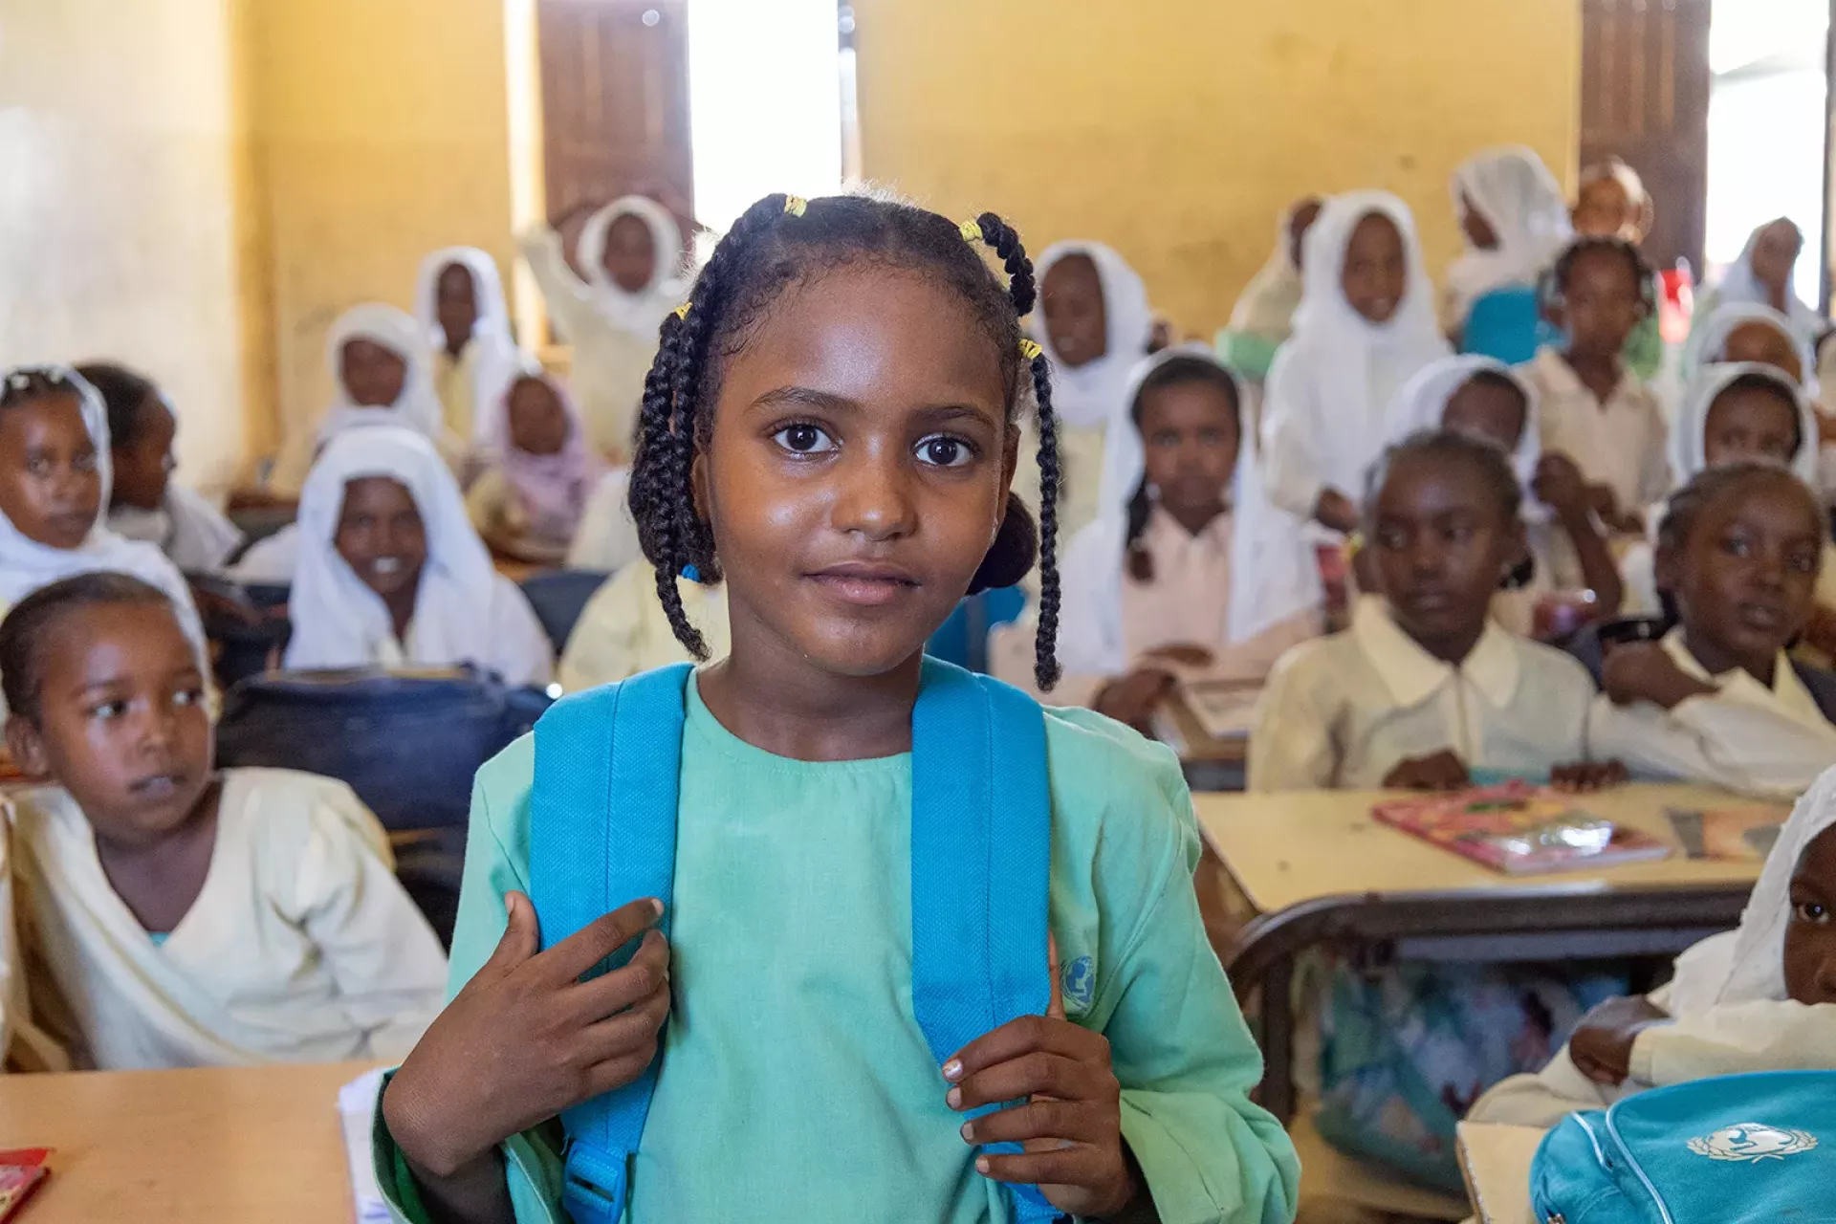
INTEGRATED RESULTS FRAMEWORK
PROSPECTS 2.0.
ITERATIVE EVALUATION – SUDAN CO (2026)

Slide 2
RATIONALE
PROSPECTS 2.0 is a new phase of the program that keeps improving its planning and monitoring systems to show progress.
Tools such as the global Theory of Change (ToC) have been customized, and the elements defined in the MACP such as the Program Portfolio are complemented by the milestones of the Policy Matrix and by the multi-annual indicators.
Key Challenges Identified in the Iteration 1: October 2024 - February 2025
OPPORTUNITY IDENTIFIED
(In the course of fieldwork in Uganda and Kenya)
These 4 elements complement each other; having a common interface to see how all of them interact and interlink with each other was missing.
“The need to reviewing all existing frameworks, interconnect them and put a strong emphasis on achieving high-level outcomes. Linking activities to policy-level outcomes”
“Lack of clarity in connecting key components of the program, including the policy matrix, theory of change, and results framework”
The iterative evaluation identified in its first iteration this gap and proposes an Integrated Results Framework, where all the elements cohabite and are put in perspective.
“Ensure that our activities are connected to the overarching objectives, emphasizing the importance of demonstrating linkages across different pillars. Not to operate in silos”
This framework can be used:
To better understand and explain the integrated logic of PROSPECTS
To better identify synergies
To better discuss and report on progress
“Limited interconnections across pillars, and the pillar system leading to think in siloes”
“There is a strong emphasis on collaboration between different pillars. This includes joint program documents and coordination meetings. The primary area for improvement is internal coordination among pillars, inter-pillar planning in addition to pillar-specific planning.”
This solution has been very well received, like the “missing piece”, by PROSPECTS UNICEF Coordination team, by the two CO visited during the first iteration (Uganda and Kenya), and by PROSPECTS multilateral partners focal points at headquarters, and country level, including the PROSPECTS Netherlands partner.
The Uganda country team has used this tool for the UNICEF country team meeting and shared it with the PROSPECTS multilateral partners (ILO, UNHCR, WB, IF) to facilitate coordination.
These points were deemed relevant to all the countries by the PROSPECTS UNICEF Coordination team, PROSPECTS multilateral partners focal points at HQ (and country level in the iteration 1 countries), and the PROSPECTS Netherlands partner.

Slide 3
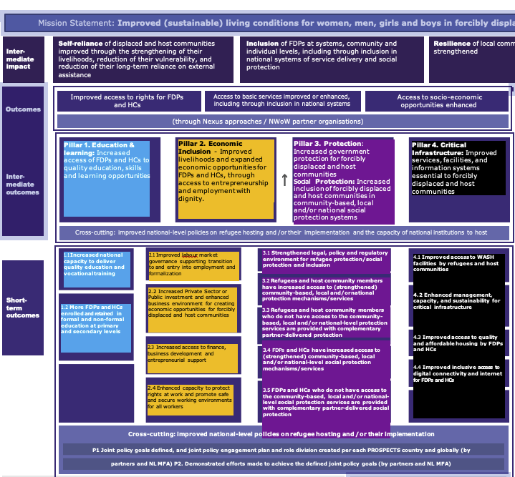
COLOR CODING
We have applied this colour code to the PROSPECTS pillars for the Integrated Framework:
TOC Pillar 1 Education
TOC Pillar 2 Economic
TOC Pillar 3 Protection
TOC Pillar 4 Infrastructure
Pillar 2. Economic Inclusion - Improved livelihoods and expanded economic opportunities for FDPs and HCs, through access to entrepreneurship and employment with dignity.
Pillar 4. Critical Infrastructure: Improved services, facilities, and information systems essential to forcibly displaced and host communities
2.1 Improved labour market governance supporting transition to and entry into employment and formalization
4.1 Improved access to WASH facilities by refugees and host communities
4.2 Enhanced management, capacity, and sustainability for critical infrastructure
4.3 Improved access to quality and affordable housing by FDPs and HCs
4.4 Improved inclusive access to digital connectivity and internet for FDPs and HCs
2.2 Increased Private Sector or Public investment and enhanced business environment for creating economic opportunities for forcibly displaced and host communities
2.3 Increased access to finance,
business development and entrepreneurial support
2.4 Enhanced capacity to protect rights at work and promote safe and secure working environments for all workers

Slide 4
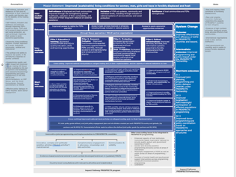
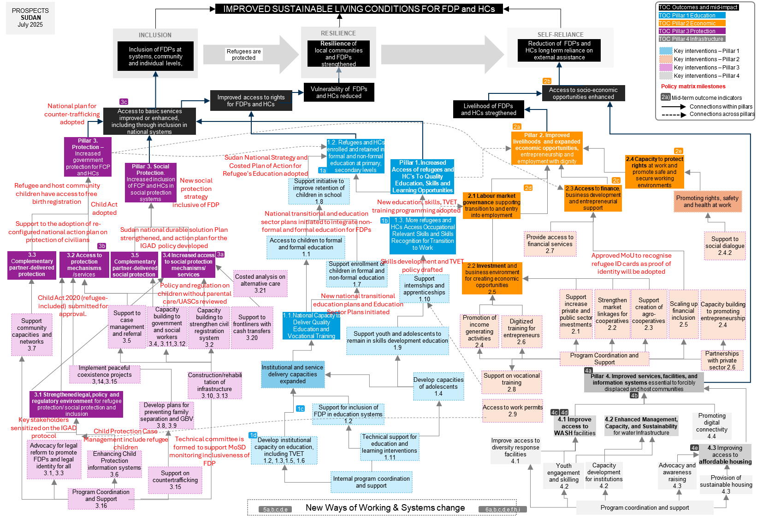
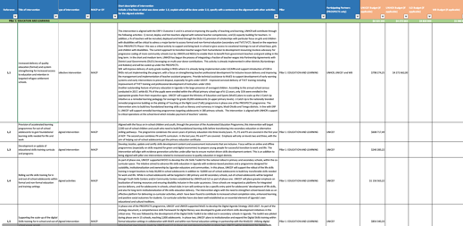
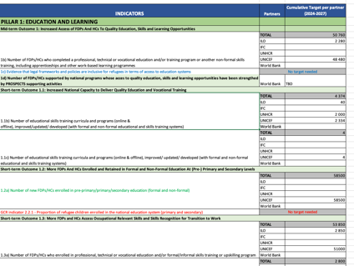

ELEMENTS INTEGRATED IN THIS FRAMEWORK
We have placed the 4 elements in one page:
ToC Global
Programme portfolio
Policy Matrix
Multi-annual targets

Slide 5
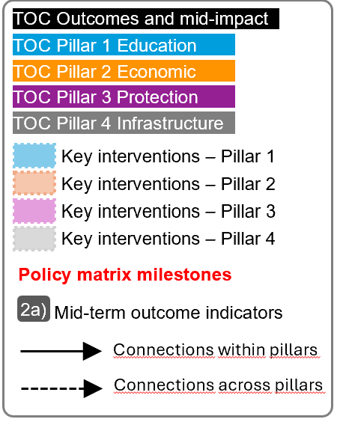
For the next slide:
Please turn to presentation mode
You will find the framework...
… where you can find:
Represent all PROSPECTS outcomes and inter-mediate impact as per the Global Theory of Change
Represent all PROSPECTS short-term outcomes (X.X) , and mid-term outcomes (X) as per the Global Theory of Change
Represent all groups of actions/interventions considered in the MACP 2024-2027 that aim at supporting and contributing to specific areas within each pillar
Represent all relevant policy matrix milestones considered for the period 2024-2027
Represent where the MACP 2024-2027 mid-term outcome indicators sit in the diagram
Click in the presentation icon
so the elements appear progressively

Slide 6
PROSPECTS
SUDAN
March 2026
IMPROVED SUSTAINABLE LIVING CONDITIONS FOR FDP and HCs
TOC Outcomes and mid-impact
TOC Pillar 1 Education
RESILIENCE
TOC Pillar 2 Economic
INCLUSION
SELF-RELIANCE
TOC Pillar 3 Protection
Inclusion of FDPs at systems, community and individual levels,
Resilience of local communities and FDPs strengthened
Reduction of FDPs and HCs long term reliance on external assistance
TOC Pillar 4 Infrastructure
Refugees are protected
Key interventions – Pillar 1
Key interventions – Pillar 2
Key interventions – Pillar 3
2b
Key interventions – Pillar 4
Vulnerability of FDPs and HCs reduced
Access to socio-economic opportunities enhanced
Policy matrix milestones
Improved access to rights for FDPs and HCs
Mid-term outcome indicators
3c
Livelihood of FDPs and HCs stregthened
2a)
Connections within pillars
Access to basic services improved or enhanced, including through inclusion in national systems
Connections across pillars
2a
Pillar 3. Protection – Increased government protection for FCP and HCs
1.2. Refugees and HCs enrolled and retained in formal and non-formal education at primary, secondary levels
Pillar 2. Improved livelihoods and expanded economic opportunities, entrepreneurship and employment with dignity
2e
Pillar 3. Social Protection. Increased inclusion of FCP and HCs in social protection systems
Pillar 1. Increased Access of refugees and HC's To Quality Education, Skills and Learning Opportunities
2.4 Capacity to protect rights at work and promote safe and secure working environments
1a
2c
Refugee and host community children have access to free birth registration
Support initiative to improve retention of children in school
1.8
2d
2.3 Access to finance,
business development and entrepreneurial support
3.4 Child Act adopted
2.5 New education, skills, TVET training programming adopted
2.1 Labour market governance supporting transition to and entry into employment
Promoting rights, safety and health at work
2.2 National transitional and education sector plans initiated to integrate non-formal and formal education for FDPs
1.3. More refugees and HCs Access Occupational Relevant Skills and Skills Recognition for Transition to Work
Support to the adoption of re-configured national action plan on protection of civilians
Sudan national durable solution Plan strengthened, and action plan for the IGAD policy developed
1b
Access to children to formal and formal education
1.1
Provide access to financial services
2.7
Support to social dialogue
2.4.2
3.3 Complementary partner-delivered protection
3b
3.5 Complementary partner-delivered social protection
3.4 Increased access to social protection mechanisms/ services
3a
Approved MoU to recognise refugee ID cards as proof of identity will be adopted
3.2 Access to protection mechanisms /services
Support enrollment of children in formal and non-formal education
1.7
2.4 Skills development and TVET policy drafted
Costed analysis on alternative care
3.21
2.2 Investment and business environment for creating economic opportunities
2.5
3.2 Preparatory work for the revision of Policy and regulation on children without parental care/UASCs
Support internships and apprenticeships
1.10
3.3 Child Act 2020 (refugee-included) submitted for approval.
2.1 New national transitional education plans and Education Sector Plans established
Support increase private and public sector investments
2.1
Strengthen market linkages for cooperatives2.2
Support creation of agro-cooperatives
2.3
Scaling up financial inclusion
2.5
Capacity building to promoting
entrepreneurship
2.4
Support community capacities and networks
3.7
Support to case management and referral
3.5
Capacity building to government and social workers
3.4, 3.11,3.12
Capacity building to strengthen civil registration system
3.2
Support to frontliners with cash transfers
3.20
1.1.National Capacity to Deliver Quality Education and Vocational Training
Promotion of income generating activities
2.4
Digitized training for entrepreneurs
2.6
4.2. MoU to recognise refugee ID cards as proof of identity adopted
Support youth and adolescents to remain in skills development education
1.9
4.1 The new social protection strategy re-introduced for discussion
2.3 National Strategy and Costed Plan of Action for Refugee's Education adopted
Program Coordination and Support
Partnerships with private sector 2.6
Implement peaceful coexistence projects
3,14,3.15
Construction/rehabilitation of infrastructure
3.10, 3.13
Institutional and service delivery capacities expanded
Support on vocational training
2.8
4a
Develop capacities of adolescents
1.4
Pillar 4. Improved services, facilities, and information systems essential to forcibly displaced and host communities
3.1 Strengthened legal, policy and regulatory environment for refugee protection/ social protection and inclusion
Access to work permits
2.9
4b
Key stakeholders sensitized on the IGAD protocol
Develop plans for preventing family separation and GBV
3.8, 3.9
1c
Support for inclusion of FDP in education systems
1.2
4c
4d
Promoting digital connectivity
4.4
3.1 SoPs for Child Protection Case Management include refugee children
4.1 Improve access to WASH facilities
4.2 Enhanced Management, Capacity, and Sustainability for water Infrastructure
1d
Advocacy for legal reform to promote FDPs and legal identity for all
3.1, 3.3
Technical committee is formed to support MoSD monitoring inclusiveness of FDP
Develop institutional capacity on education, including TVET
1.2, 1.3,1.5, 1.6
Technical support for education and learning interventions
1.11
Enhancing Child Protection information systems
3.6
4e
4.3 Improving access to affordable housing
Support on countertrafficking
3.15
Youth engagement and skilling
4.2
Capacity development for institutions
4.2
Advocacy and awareness raising
4.3
Internal program coordination and support
Improve access to diversity response facilities
4.1
Provision of sustainable housing
4.3
Program Coordination and Support
3.16
New Ways of Working & Systems change
Program coordination and support
5a,b,c,d,e
6a,b,c,d,e,f,h,i

Slide 7
NOTES
2
High-level outcomes logic
Within the high-level results, Inclusion comes first, to reduce vulnerability and increase resilience, to promote self-reliance.
We tried to link key results to the high-level results for greater clarity on how each of them contribute.
1
Pillars’ logic
As agreed with the MFA, Protection becomes the entry pillar. First, we protect, then we provide access to education, and then we facilitate access to microeconomic activities and the job market (infrastructure would be cross-cutting).
That is the reason why we placed pillar 3 on the left, followed by pillar 1 and 2.
3
Additional mid-level goals
Some goals (not numbered) were added as intermediate steps to explain the cause-effect logic.
4
Pillars’ connections
There are numerous actual connections between pillars that are not reflected in the Global ToC diagram but they are reflected in the IF. We tried to include links connecting results across pillars.
5
Policy Matrix milestones
All milestones shown in the IF, including those more process-oriented.
INDICATORS MAPPING
Only the Mid-Term Outcomes indicators have been mapped, which measure elements of the mid part of the diagram (above short-term outcomes and below impact).
Short-term outcomes indicators could be also mapped under the CO demand.
Most of the indicators of section 5 and 6 of the Multi Annual Mid-term Outcome Indicators (SYSTEMS CHANGE and NWOW and Cross-cutting indicators) seem like strategies indicators (enablers rather than results).
Other comments:
Policy matrix includes expected deadlines (+)
No all pillars addressed through the policy matrix (-)
PROSPECTS
SUDAN
July 2025

Slide 8
PRACTICAL USES OF THE INTEGRATED FRAMEWORK
1
Shared understanding
The overall picture of how PROSPECTS work at different levels will contribute to developing a clear and shared understanding of PROSPECTS within UNICEF, across sectors and partners, aligning expectations and roles between them and clarifying vision and strategies.
4
Spot implementation bottlenecks and/or key enablers
The framework adopts a bottom-up approach, and implementers can pinpoint areas of interest and then work backwards to identify potential bottlenecks or opportunities to optimize achievements.
5
Enhance monitoring and evaluation
The framework helps prioritize what to measure by clearly outlining the interconnections between results and the overall line of sight. It can also support contribution analysis by illustrating how programme activities are expected to contribute to overarching goals.
2
Adaptive Management & learning
The framework is a tool for continuous learning and adaptation. It allows teams to test their assumptions and make evidence-based adjustments to their strategies and resource allocation.
3
Coordination & collaboration
The framework can help ensure that interventions are well-coordinated and aligned with overarching goals, while also aiding in identifying opportunities for collaboration.
6
Communication
The framework can be used to communicate the complex logic and strategy of PROSPECTS to diverse audiences, including donors, partners and beneficiaries.
“The integrated framework is designed not only as a conceptual tool to interrogate and possibly refine the design of PROSPECTS, but also as a practical framework that can be applied at various levels.”

Slide 9
Annexes
SUDAN
ASSESSMENT OF THE FRAMEWORK
2
High-level outcomes logic
Within the high level results, Inclusion comes first, to reduce vulnerability and increase resilience, to promote self-reliance.
We tried to link key results to the high-level results for greater clarity on how each of them contribute.
1
Pillars’ logic
As agreed with the MFA, Protection becomes the entry pillar. First, we protect, then we provide access to education, and then we facilitate access to microeconomic activities and the job market (infrastructure would be cross-cutting).
That is the reason why we placed pillar 3 on the left, followed by pillar 1 and 2.
3
Kenya’s MACP
Some pillars have outputs, others just lists of actions/results (that have been group in “outputs”). Policy is clearly embedded, beyond the Policy matrixes
Titles in the Policy matrix
Some key results appear in the milestones grouping (ex. Inclusion in national education, inclusion in GBV mechanisms, access to asylum procedures, etc.)
Pillars’ connections
There are numerous connections between pillars that are not reflected in the Global ToC diagram.
We tried to include links between connecting results across pillars.
INDICATORS MAPPING
Only the Mid-Term Outcomes indicators have been mapped, which measure elements of the mid part of the diagram (above short-term outcomes and below impact).
Short-term outcomes indicators could be also mapped under the CO demand.
Most of the indicators of section 5 and 6 of the framework (SYSTEMS CHANGE and NWOW and Cross-cutting indicators) seem like strategies indicators (enablers rather than results).

Slide 10
PROSPECTS
SUDAN
March 2026
MACP Program Portfolio
Pillar 1: EDUCATION AND LEARNING
1,1 | Provide technical support to FDPs/HCs to ensure children access and complete primary formal or Non-Formal Education (NFE) including early learning
1,2 | Provide technical support towards inclusion of refugees into education policies
1,3 | Support the capacity building of relevant government institutions in education
1,4 | Support capacity development of adolescents and young people including meaningful participation and engagement in digital literacy and E-learning opportunities.
1,5 | Capacity development of teachers/facilitators/technical trainers in pedagogy/teaching methodologies and digital education
1,6 | Capacity building for government States and Federal TVET Bureaus on the updating and revision of skills development curricula
1,7 | Support the enrollment of children in pre-primary and primary from FDPs/HCs communities in formal and non-formal education setting
1,8 | Support initiatives to improve retention of children in school
1,9 | Support adolescents and young people enrolled in technical/ skills development education to remain in school
1,10 | Support apprenticeship, work-based learning, and internship opportunities for young people (18-24 years)
1,11 | Technical support for Education and learning intervention
Pillar 2: ECONOMIC INCLUSION
2.1 s | Promote value chain development and EIIP approaches in the targeted areas with potential economic opportunities for FDP and HC.
 | Promote green jobs and livelihoods through green works to improve socio-economic status for refugees and host community
2.2. | Strengthen Market Linkages for the cooperatives to access
2.3 | Institutionalizing BDS in Enterprise Development organizations.
2,4 | Institutionalizing entrepreneurship promotion
2,5 | Scaling up financial inclusion
2,6 | Digitalization for entrepreneurs
2,7 | Provide access to financial services
2,8 | Provision of support towards Vocational training initiatives
2,9 | Provide access to work permits
Pillar 3: PROTECTION AND SOCIAL PROTECTION
3.1 | Joint policy advocacy and review of regulations to promote refugee inclusion into relevant legal and policy frameworks, particularly protection and social protection systems
3,2 | Capacity building and strengthening of civil registration system, including support on rehabilitating/establish and equip civil registry offices to increase inclusive access
3,3 | Promote legal identity for all, including birth registration and legal documentation
3,4 | Strengthening child protection system through support and comprehensive capacity building to the social service workforce, MosD/NCCW and partners including towards establishing a functioning National child protection case management system.
3,5 | Provision and facilitated access to specialized protection services through Case Management & Referral (MHPSS, medical aid, legal aid, FTR/alternative care for UASCs, GBV response etc..) particularly for UASCs, MRM, GBV, VAC cases
3,6 | Inclusive Child Protection Information Management system CPIMS+/Primero integrated nationally and piloted
3,7 | Access to a Protective environment through community-based approach by the establishment/strengthening and capacity building of community structures as Community Based Protection and CP Networks (CBCPN) and community awareness campaigns
3,8 | Develop and roll-out plans for prevention of family separation and alternative care arrangement for UASCs/ children without parental care and children with disability, including through communication strategy, behavioral change campaigns and advocacy, parenting and support to foster families
3. 9 | Gender responsive and age-appropriate prevention, risk mitigation and response to GBV, including FGM and child marriage, including meaningful youth engagement in awareness raising and service dissemination through the adoption of innovative tools to overcome stigma and access barriers (i.e. remote confidential access to counseling for mental health)
3,10 | Construction/rehabilitation or establishment of mobile/semi-permanent gender and diversity responsive community centers and child friendly spaces, including for provision of MHPSS
3,11 | Ensure refugees have continuous access to asylum and fair justice system
3,12 | Capacity building and strengthening of protection/social protection understanding among the law enforcement authorities
3,13 | Access to durable solutions
3,14 | Transitional approach from camps to integrated settlement/cities/municipalities benefiting to both host communities and refugees- modelling camp integrated camp approach in White Nile as well as new planned camp in While Nile
3,15 | Counter-trafficking. Youth meaningful engagement in Peacebuilding and awareness raising on protection risks
3,16 | Technical support for protection intervention
3,19 | Inclusive Social Protection regulation and strategy
3,20 | Support frontline workers with cash transfer to allow maintaining service provision
3,21 | Proof of concept/Costed analysis on alternative care (emergency foster family/community-based arrangements for UASCs and foster families for children without parental care with disabilities )
Pillar 4: CRITICAL INFRASTRUCTURE
4. 1 | Improved access to gender and diversity responsive WASH facilities by refugees and host communities"
4.2 | Capacity building for government institution at state and federal level and Youth on green/climate sensitive water facilities maintenance and waste management
4.3 | Provision of affordable and sustainable housing options
 | Policy advocacy and coordination
4.4 | Youth engaged on resilience and self-empowerment digital connectivity
 | TechnicaL support for WASH intervention

Slide 11
PROSPECTS
SUDAN
March 2026
POLICY MATRIX
POLICY PRIORITIES | KEY CHALLENGES | KEY MILESTONES | KEY STAKEHOLDERS | SUPPORT THROUGH PROGRAMMING
# 1.Refugees enjoy enhanced and unhindered access to asylum, including status determination, birth registration and documentation, inclusion in social services and can access durable solutions | Encampment policy New restrictions on movements for FDPs/curfews in imposed in some locations Low capacity by the relevant government department to carry out registration, Judiciary, civil registry due to displacement of key policy/technical staff Uncertainty in country security in the near future. Lack of enabling environment for durable solution in the countries of origin Conflicting regulation on the age limit for free birth registration and bureaucratic impediments for refugee birth registration | By the end of 2024, relevant entities in the targeted states (Kassala and WN), law enforcement agencies, HAC, CoR, judiciary and immigration officials will be sensitized on the IGAD protocol on free movement. By the end of 2025, the government will adopt a national plan for counter-trafficking which takes into account specific situation of forcibly displaced including newly displaced refugees, protracted refugees, and IDPs, upon re-establishing the functional federal state and relevant line ministry. By the end of 2026, refugee and host community children have access to free birth registration, and regulations on free birth registration for refugees will be aligned with the host community regulations by the government civil registry in line with the Sudan GRF 2019 pledge. By the end of 2026, UNHCR in collaboration with CoR will make significant steps in formulation of the Sudan national durable solution Plan ( IGAD-led) upon the resumptions of the federal state functions by the government of Sudan. By the end of 2027, Prospect partners, in collaboration with the relevant line ministries, have developed an action plan for the implementation of the IGAD regional Refugee Management policy. By the end of 2027, significant steps will be taken towards the adoption of re-configured national action plan on protection of civilians that takes into account specific situation of new refugees, protracted refugees and IDPs. | "CoR, Council of Ministers, Ministry of Interior, Ministry of Social welfare development, IGAD, EU, UNCT country team, UNHRC, UNICREF , ILO | Institutional strengthening of the relevant line ministries - civil registry, judicial and law enforcement agencies at the state and national levels to enhance access to services and rights for FDPs. The main intervention will include capacity building (asylum, child protection, refugee protection), infrastructure upgrades, and equipment. Programming interventions geared at transforming camps into integrated settlements that allow access to social services for both refugees and hosts. Settlements will offer refugees and host communities more opportunities to live independent and productive lives. They create a sense of community and long-term stability and provide shared access to basic services and livelihood opportunities. Settlements also offer opportunities for education and skill-building, which can help refugees become self-sufficient and integrate into their new society. They also offer more privacy and security for refugees. Enhanced community engagement via community networks and refugee/IDP-led organizations. The Propscts will mainly seek to establish/strengthen the networks and their capacity and provide support to ensure their functionality. Capacity development of authorities on international refugee protection and practices to implement relevant provisions under Sudan-South Sudan Solutions Initiate GCR; Country Roadmap Programming support to strengthen inclusive birth registration and ID systems (UNICEF, UNHCR). This will include support to the civil registry to be able to issue civic documents for national and FDPs.
#.2.Access to the national education system for FDPs enhanced through inclusive policy formulation and programming at all levels of MoE . | High-turnover of MoE staff responsible for refugee inclusion at all levels of education Displaced policy/technical federal Ministry of Education officials due to current conflict. Commission of Refugees resistance on advancement of refugee inclusion agenda without parliamentary approval of GCR pledge. Lack of a strategic framework and policy to support the implementation skills programme and TVET in Sudan Lack of updated curricula and certification mechanism with in the skills and TVET system. Uncertainty of the future of Republic of Sudan as an IGAD member state. | 2,1 By the end of 2024, the state MoE education and partner plans and education coordination mechanisms established will include FDPs to catalyze the incorporation of FDs in the national system. 2.2 By the end of 2025, new national transitional education plans and Education Sector Plans initiated by the Local Education Group and MoE at the state and national levels will integrate non-formal and formal education FDPs. 2.4 By the end of 2026, the Revised Sudan National Strategy and Costed Plan of Action for Refugee's Education will will be adopted federal MoE once operational. 2.4 By the end of 2026, a harmonized skills development and TVET Policy will be drafted by Minsitry of of Education and the policy adopted by end of 2027 by development partners, Supreme Council and Technical Vocational Education and the Ministry of Education 2.5 Development partners, state ministries, and the Federal Ministry of Education will adopt a new education, skills, TVET training programming, and financing plan for Sudan, inclusive of FDPs, by the end of 2027. | World Bank, IGAD secretariat Ministry of Education at all level ( federal, state and locality) Ministry of Finance COR ,LEG members ( Donors , INGos and Local NGOs, UNHCR, ILO and UNICEF | Mapping of existing inclusion Practices, policies and laws in basic education and TVET that facilitate or hinder the inclusion of FDPs education in the national system through desk review and documentation of past and present inclusive practices, existing policies and laws and inclusion with a view of identifying advocacy area and development of relevant policies idetified in the milestones. Programming interventions to schools targeting both FDPs and HC after conducting baseline assessment and mapping of the schools. Restoring and revitalizing schools to targetd states to provide non-formal and formal education through PTAs and community sensitization programs and provision of teaching materials, incentive payments alongside advocacy MoE to target initiatives that lead to revamping education services at the state and national levels. Advocate for inclusion on refugee education in new education programming ( Plan, strategies , framework) developed by MoE, donors and partners through mapping out them and taking active role in the development of the plans Support towards reviewing expired MoE of education plans/strategies that had inclusion of FDPs. This includes the Education sector plans at state and national level,

Slide 12
PROSPECTS
SUDAN
March 2026
POLICY MATRIX
POLICY PRIORITIES | KEY CHALLENGES | KEY MILESTONES | KEY STAKEHOLDERS | SUPPORT THROUGH PROGRAMMING
# 3.Policy Priority: Inclusive child protection legislation and systems are in place, including inclusion of refugee children in the Child Protection case management system | The Child Act 2010 is outdated and not aligned with the revised 2019 criminal code. A new Child Act 2020 was drafted by a technical committee led by MoSD/NCCW with UNICEF technical support, but due to the political instability it has not yet been approved Other challenges include: weak social welfare and Ministry of social welfare and development, further weakened by the conflict; displacement and high turn-over of the social service workforce and officials in some states; Lack of resources for service provision, officials not receiving salaries since April 2023; Difficult coordination effort with displaced authorities in some states. Crucial needs on aligning Child Protection Case Management procedures among actors to address the gaps on UASCs identification and assistance | 3.1 By the end of 2024, the Standard Operating Procedures for Child Protection Case Management system will include refugee children, and its functioning will be endorsed by authorities/coordination mechanisms in the target states. 3.2 By the end of 2025, preparatory work to review policy and regulation on children without parental care/UASCs (alternative care) will be finalized and enacted by the end of 2026 by MoSD upon the government's resumption of its legislative function. 3.3 By the end of 2026, support the relevant authorities in re-submitting the proposed Child Act 2020 (refugee-included) for approval. 3.4 By the end of 2027, the government of Sudan will adopt an inclusive revised Child Act upon government resumption of its legislative function. | Ministry of Social Welfare, National and National & State Council for Child Welfare, Ministry of Justice, COR, UNHCR UNICEF | Programme interventions: 1.Support MoSD to re-resume the technical committee that drafted Child Act 2020 and have consultations to either advocate for approval or update if needed (ensuring inclusion is maintained) and re-submit for approval. 2. Technical support provided on policy and regulations review on children without parental care/UASCs alternative care as asked by the MoSD to UNICEF prior to the conflict. 3. On Child Protection Case Management: a) carry out a system assessment including rapid institutional and Social workers/case worker capacity gaps, building on previous mapping; b) UNICEF within the CP AoR to lead SoPs alignment, adaptation and implementation, UNHCR to facilitate adaptation for implementation in refugee camps c) UNICEF to lead National ToT piloted in few states 4. capacity building to roll out the Child Protection case management cascaded for all CP actors in the states. UNHCR to facilitate roll-out in refugee camps with counterparts and partners d) Parallel roll-out of CPIMS+/PRIMERO
# 4.Inclusive Social Protection regulation and strategy in place | Before the war UNICEF supported MoSD to develop a social protection strategy that is inclusive for FDPs, both refugees and IDPs, however in the current context it was not shared the final approved version. " Before the war UNICEF supported MoSD to develop a social protection strategy that is inclusive for FDPs, both refugees and IDPs, however the final approved document was not shared before the current conflict broke out . | 4.1 By the end of 2025, the new social protection strategy that is inclusive of FDPs will be re-introduced for discussion with relevant stakeholders and adopted by MoSD by the end of 2026. 4.2 By the June 2027 a technical committee is formed to support MoSD in the monitoring inclusiveness of FDPs as well as gender and diversity lens. | Ministry of Social Welfare, Ministry of Justice, Ministry of Health, Ministry of Finance | Advocate and support the authorities to ensure social protection regulation and strategy are inclusive for FDPs. This intervention will aim to build on the draft strategy, advocate that the approved version is inclusive of refugees and other FDPs and put the basis for its implementation when the context will allow. Steps: 1. Resume contact with the focal point in the MoSD to verify the approval status of the draft social policy strategy 2. Depending on its status advocate for convening the technical commettee to either proceed with the approval or if already approved developed an implementation plan 3. Provide technical support for ensuring and monitoring inclusiveness of FDPs as well as gender and diversity lens
#. 5. Economic inclusion and strengthened employment opportunities. | Obstacles in accessing finance and capital are a more immediate and tangible barrier than the lack of legal provision for business registration. | By the end of 2026, an approved MoU by COR and Telecoms organisations to recognise refugee ID cards as proof of identity will be adopted | Ministry of Labour (Federal and State levels); Ministry of Finance; Central Bank of Sudan, Telecommunication and Post Regulatory Authority (TPRA) | 1. Provide technical assistance in defining the scope and objectives of the guidelines - outlining what they will cover and the intended outcomes. 2. Facilitate Stakeholder Engagement - Identify and engage relevant stakeholders, including experts, practitioners, policymakers, and end-users and constitute a technical working group to draft the guidelines. 3. Facilitate expert Review and Validation of draft guidelines. 4. Finalize the guidelines. 5. Facilitate for submission for approval and signing. 6. Dissemination

Slide 13
PROSPECTS
SUDAN
March 2026
MULTI ANNUAL MID-TERM OUTCOME INDICATORS
MID-TERM OUTCOME INDICATORS INCLUDED IN THE MACP
PILLAR 1: EDUCATION AND LEARNING
Mid-term Outcome 1: Increased Access of FDPs And HCs To Quality Education, Skills and Learning Opportunities
1a) Number of FDPs/HCs who completed their primary or secondary education program (formal and non-formal)
1b) Number of FDPs/HCs who completed a professional, technical or vocational education and/or training program or another non-formal skills training, including apprenticeships and other work-based learning programmes
1c) Evidence that legal frameworks and policies are inclusive for refugees in terms of access to education systems
PILLAR 2: ECONOMIC INCLUSION
Mid-term Outcome 2: Improved livelihoods and expanded economic opportunities for FDPs and HCs, through access to entrepreneurship and employment with dignity
2a) Number of new wage employment and/or self-employment (business) opportunities supported by PROSPECTS
2b) Number of FDPs/HC members already employed or self-employed who have either increased their income, enhanced their working conditions or maintained resilient livelihoods
2c) Number of Government institutions, BDS providers, financial institutions, input providers and/or cooperatives that have introduced new services or scaled their service offer for FDPs and HCs
2d) Evidence that legal frameworks and policies are inclusive for refugees in terms of access to labor market and formality
GCR indicator 2.1.1 - Proportion of refugees who have access to decent work by law
PILLAR 3: PROTECTION, SOCIAL PROTECTION AND INCLUSION
3a) Extent of inclusion of FDPs in the social protection system (UNICEF SP Indicator 5.2.1)
GCR indicator 2.1.2 - Proportion of refugees who are able to move freely within the host country
PILLAR 4: CRITICAL INFRASTRUCTURE
Mid-term Outcome 4: Improved Services, Facilities and Information Systems Essential to FDPs and HCs
4a) Evidence that PROSPECTS has contributed to a change in legal frameworks, policies and asylum system related to inclusive critical infrastructure (WASH, housing, digital connectivity) for refugees
4b) Evidence that PROSPECTS contributed to improved services, facilities and information systems essential for FDPs and HCs
4c) Proportion of FDPs/HC members using at least basic drinking water services
4d) Proportion of FDPs/HC members with access to safe household sanitation
4e) Proportion of FDPs and HC living in habitable and affordable housing
SET OF OVERALL MID-TERM OUTCOME INDICATOR FOR PROSPECTS
PILLAR 1: EDUCATION AND LEARNING
Mid-term Outcome 1: Increased Access of FDPs And HCs To Quality Education, Skills and Learning Opportunities
1a) Number of FDPs/HCs who completed their primary or secondary education program (formal and non-formal)
1b) Number of FDPs/HCs who completed a professional, technical or vocational education and/or training program or another non-formal skills training
1c) Evidence on how PROSPECTS has contributed to a change in legal frameworks, policies and asylum system related to access for refugees to education and training systems
1d) Evidence that PROSPECTS contributed to institutional capacity strengthening in relation to inclusion in education and trainings for FDPs and HCs
PILLAR 2: ECONOMIC INCLUSION
Mid-term Outcome 2: Improved livelihoods and expanded economic opportunities for FDPs and HCs, through access to entrepreneurship and employment with dignity
2a) Number of new employment and/or self-employment (business) opportunities supported by PROSPECTS
2b) Number of FDPs/HC members already employed or self-employed who have either increased their income, enhanced their working conditions or maintained resilient livelihoods
2c) Number of Government institutions, BDS providers, financial institutions, input providers and/or cooperatives that have introduced new services or scaled their service offer for FDPs and HCs
2d) Evidence on how PROSPECTS has contributed to a changes in legal frameworks, policies and asylum system related to inclusion of refugees in the labor market and formality
2e) Evidence that PROSPECTS contributed to institutional capacity strengthening in relation to inclusion of FDPs and HCs in the labour market and to improved labour rights
GCR indicator 2.1.1 - Proportion of refugees who have access to decent work by law
PILLAR 3: PROTECTION, SOCIAL PROTECTION AND INCLUSION
Mid-term Outcome 3: Protection: Increased Government Protection for FDPs and HCs. Protection: Increased Government Protection for FDPs and HCs Social Protection: Increased Inclusion of FDPs and HCs In Community-based, Local and/or National Social Protection Systems
3a) Extent of inclusion of FDPs in the social protection system and alignment of national SP system with international standards
3b) Evidence on how PROSPECTS has contributed to strengthened institutional capacity to include protection systems in national and sub-national systems and development planning
3c) Evidence that PROSPECTS contributed to institutional capacity strengthening in relation to inclusion of FDPs and HCs in social protection systems
GCR indicator 2.1.2 - Proportion of refugees who are able to move freely within the host country
PILLAR 4: CRITICAL INFRASTRUCTURE
Mid-term Outcome 4: Improved Services, Facilities and Information Systems Essential to FDPs and HCs
4a) Evidence that PROSPECTS has contributed to a change in legal frameworks, policies and asylum system related to inclusive critical infrastructure (WASH, housing, digital connectivity) for refugees
4b) Evidence that PROSPECTS contributed to improved services, facilities and information systems essential for FDPs and HCs
4c) Proportion of FDPs/HC members using at least basic drinking water services
4d) Proportion of FDPs/HC members with access to safe household sanitation
4e) Proportion of FDPs and HC living in habitable and affordable housing

Slide 14
PROSPECTS
SUDAN
March 2026
MULTI ANNUAL MID-TERM OUTCOME INDICATORS
MID-TERM OUTCOME INDICATORS INCLUDED IN THE MACP
5. SYSTEMS CHANGE and NWOW
Outcome: Improved Effectiveness and Efficiency of DAFD in Prospects Countries and Beyond
5a) Evidence that the Partnership fostered improved responses and innovative ways to address protracted forced displacement in PROSPECTS countries
5b) Perception of change by partners in joint-up planning and programming (strategic alignment, sequencing, layering, integrated interventions) and in the joint implementation experience
5c) Extent to which collective outcome-based interventions are jointly designed and implemented (two or more partners)
5d) Number of shared target geographical areas identified
5e) Number of PROSPECTS beneficiaries receiving services from two partners or more
6. CROSS-CUTTING INDICATORS
6a) Extent to which PROSPECTS interventions contribute to transformative approaches and solutions for youth, gender equality and people with disabilities
6b) Number and % of young people involved in (i) voicing their recommendations, or (ii) taking action in individual or collective civic engagement initiatives, entrepreneurial action, adovacy oppportunites or (iii) providing inputs to agency specific or joint PROSPECTS programming decisions
6c) Extent to which PROSPECTS interventions contribute to climate adaptation of FDPs and vulnerable HC members
6f) Number of platforms, management systems, and/or registration systems improved, updated and/or developed
SET OF OVERALL MID-TERM OUTCOME INDICATOR FOR PROSPECTS
5. SYSTEMS CHANGE and NWOW
Outcome: Improved Effectiveness and Efficiency of DAFD in Prospects Countries and Beyond
5a) Evidence that the Partnership fostered improved responses and innovative ways to address protracted forced displacement in PROSPECTS countries
5b) Perception of change by partners in joint-up planning and programming (strategic alignment, sequencing, layering, integrated interventions) and in the joint implementation experience
5c) Extent to which collective outcome-based interventions are jointly designed and implemented (two or more partners)
5d) Number of shared target geographical areas identified
5e) Number of PROSPECTS beneficiaries receiving services from two partners or more
6. CROSS-CUTTING INDICATORS
6a) Extent to which PROSPECTS interventions contribute to transformative approaches and solutions for youth, gender equality and people with disabilities
6b) Number and % of young people involved in: I) voicing their recommendations, or ii) taking action in individual, or; collective - civic engagement initiatives, entrepreneurial action, advocacy opportunities, or;iii) providing inputs to agency specific or joint prospects programming decisions
6c) Extent to which PROSPECTS interventions contribute to climate adaptation of FDPs and vulnerable HC members
6d) Number of institutions receiving technical assistance or capacity building to improve their services to FDPs and HCs
6e) Number of staff participating in capacity building or training sessions (all pillars)
6d) Number of platforms, management systems, and/or registration systems improved, updated and/or developed
6e) Number & percentage of total interventions classified as promoting/addressing gender equality as a key objective: Not targeted (score 0): the project has not been found to target gender equality Significant (score 1): gender equality is an important and deliberate objective, but not the principal reason for undertaking the project. Principal (score 2): gender equality is the main objective of the project and is fundamental to its design and expected results. The project would not have been undertaken without this gender equality objective.
6h) Number of FDPs and HCs using feedback and response mechanisms to voice concerns or recommendations to improve PROSPECTS programming
6i) Number of plans, strategies, measures, and/or policy recommendations created, enhanced and/or delivered to the government
6f) Number of analytics, reports or data collection efforts completed informing ongoing or pipeline operations and/or contributing to improved evidence and data on poverty, vulnerability, and displacement

