Slide 1

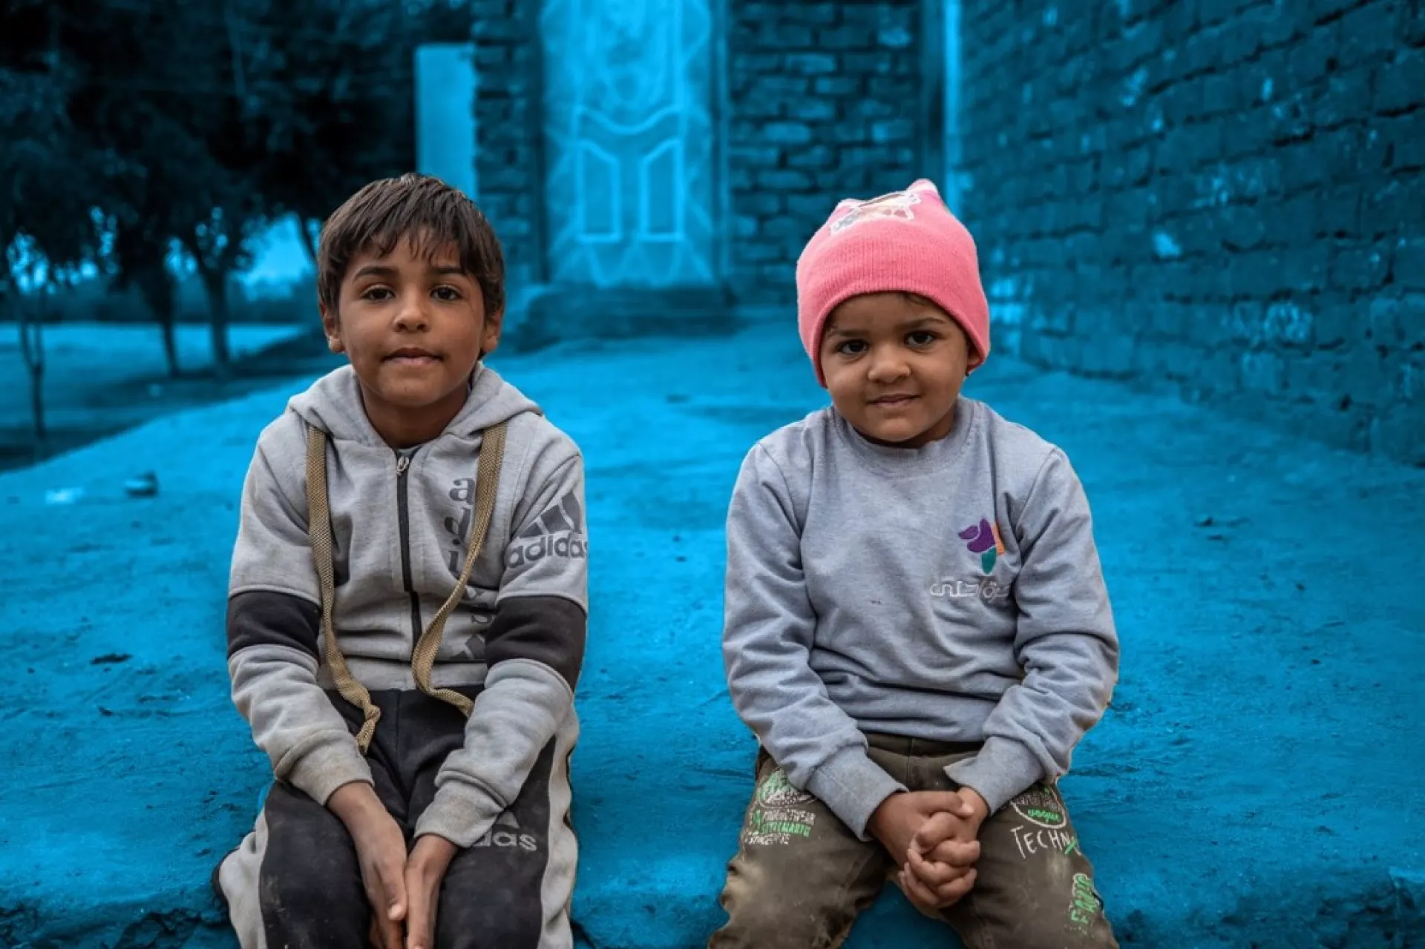
PROSPECTS 2.0. INTEGRATED RESULTS FRAMEWORK
ITERATIVE EVALUATION – EGYPT CO (2026)

Slide 2
RATIONALE
PROSPECTS 2.0 is a new phase of the program that keeps improving its planning and monitoring systems to show progress.
Tools such as the global Theory of Change (ToC) have been customized, and the elements defined in the MACP such as the Program Portfolio are complemented by the milestones of the Policy Matrix and by the multi-annual indicators.
Key Challenges Identified in the Iteration 1: October 2024 - February 2025
OPPORTUNITY IDENTIFIED
(In the course of fieldwork in Uganda and Kenya)
These 4 elements complement each other; having a common interface to see how all of them interact and interlink with each other was missing.
“The need to reviewing all existing frameworks, interconnect them and put a strong emphasis on achieving high-level outcomes. Linking activities to policy-level outcomes”
“Lack of clarity in connecting key components of the program, including the policy matrix, theory of change, and results framework”
The iterative evaluation identified in its first iteration this gap and proposes an Integrated Results Framework, where all the elements cohabite and are put in perspective.
“Ensure that our activities are connected to the overarching objectives, emphasizing the importance of demonstrating linkages across different pillars. Not to operate in silos”
“Limited interconnections across pillars, and the pillar system leading to think in siloes”
This framework can be used:
To better understand and explain the integrated logic of PROSPECTS
To better identify synergies
To better discuss and report on progress
“There is a strong emphasis on collaboration between different pillars. This includes joint program documents and coordination meetings. The primary area for improvement is internal coordination among pillars, inter-pillar planning in addition to pillar-specific planning.”
This solution has been very well received, like the “missing piece”, by PROSPECTS UNICEF Coordination team, by the two CO visited during the first iteration (Uganda and Kenya), and by PROSPECTS multilateral partners focal points at headquarters, and country level, including the PROSPECTS Netherland partner. The Uganda country team has used this tool for the UNICEF country team meeting and shared it with the PROSPECTS multilateral partners (ILO, UNHCR, WB, IF) to facilitate coordination.
These points were deemed relevant to all the countries by the PROSPECTS UNICEF Coordination team, PROSPECTS multilateral partners focal points at HQ (and country level in the iteration 1 countries), and the PROSPECTS Netherlands partner.

Slide 3
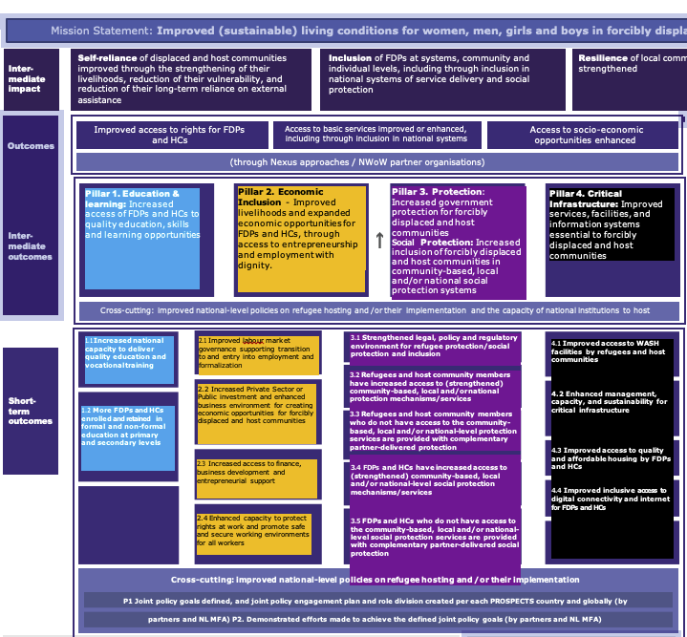
COLOR CODING
We have applied this colour code to the PROSPECTS pillars for the Integrated Framework:
TOC Pillar 1 Education
TOC Pillar 2 Economic
TOC Pillar 3 Protection
TOC Pillar 4 Infrastructure
Pillar 2. Economic Inclusion - Improved livelihoods and expanded economic opportunities for FDPs and HCs, through access to entrepreneurship and employment with dignity.
Pillar 4. Critical Infrastructure: Improved services, facilities, and information systems essential to forcibly displaced and host communities
2.1 Improved labour market governance supporting transition to and entry into employment and formalization
4.1 Improved access to WASH facilities by refugees and host communities
4.2 Enhanced management, capacity, and sustainability for critical infrastructure
4.3 Improved access to quality and affordable housing by FDPs and HCs
4.4 Improved inclusive access to digital connectivity and internet for FDPs and HCs
2.2 Increased Private Sector or Public investment and enhanced business environment for creating economic opportunities for forcibly displaced and host communities
2.3 Increased access to finance,
business development and entrepreneurial support
2.4 Enhanced capacity to protect rights at work and promote safe and secure working environments for all workers

Slide 4
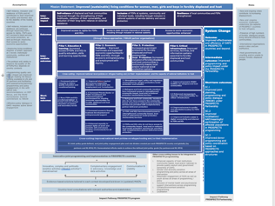
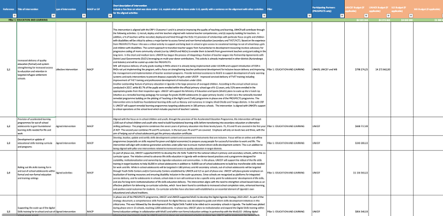
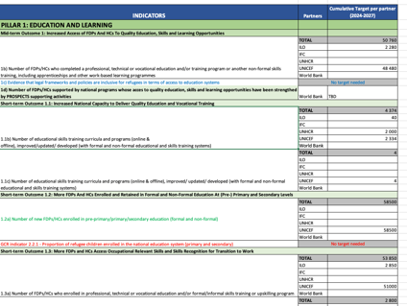

ELEMENTS INTEGRATED IN THIS FRAMEWORK
ToC Global
Programme portfolio
Policy Matrix
Multi-annual targets

Slide 5
PROSPECTS EGYPT
March 2026
IMPROVED SUSTAINABLE LIVING CONDITIONS FOR FDP and HCs
TOC Outcomes and mid-impact
TOC Pillar 1 Education
RESILIENCE
TOC Pillar 2 Economic
INCLUSION
SELF-RELIANCE
TOC Pillar 3 Protection
Inclusion of FDPs at systems, community and individual levels,
Resilience of local communities and FDPs strengthened
Reduction of FDPs and HCs long term reliance on external assistance
TOC Pillar 4 Infrastructure
Refugees are protected
Key interventions – Pillar 1
Key interventions – Pillar 2
Key interventions – Pillar 3
2b
Key interventions – Pillar 4
Vulnerability of FDPs and HCs reduced
Access to socio-economic opportunities enhanced
Policy matrix milestones
Improved access to rights for FDPs and HCs
Mid-term outcome indicators
Access to basic services improved or enhanced, including through inclusion in national systems
Livelihood of FDPs and HCs stregthened
2a)
Connections within pillars
Connections across pillars
3a
Pillar 3. Protection – Increased government protection for FCP and HCs
1a
1.2: More FDPs And HCs Enrolled and Retained in Formal and Non-Formal Education At (Pre-) Primary and Secondary Levels
1b
2.1.2
Skills development to support the transition to the labour market
2a
Pillar 3: PROTECTION AND SOCIAL PROTECTION
Learning in Protective environment
Pillar 2. Improved livelihoods and expanded economic opportunities, entrepreneurship and employment with dignity
3.3 Refugees and HCs Who Do Not Have Access to Protection Services Are Provided with Complementary Partner-delivered Protection
3.5: FDPs and HCs Who Do Not Have Access to the Social Protection Services Are Provided with Complementary Partner-Delivered Social Protection
Improved Access and Safe Learning Environments for FDPs and HCs 1.2.1, 1.2.3
Safe and secure working conditions
2d
2.2: Increased Private Sector or Public Investment and Enhanced Business Environment for Creating Economic Opportunities for FDPs and HCs
2c
2.1.1.
1c
2.1: Improved Labour Market Governance Supporting Transition to and Entry into Employment and Formalization
2.3: Increased Access to Finance, Business Development and Entrepreneurial Support
2.4: Enhanced Capacity to Protect Rights at Work and Promote Safe and Secure Working Environments for All Workers
2.2 Establish community learning spaces in registered NGOs for children with delays with residency
permit insurance.
Pillar 1. Increased Access of refugees and HC's To Quality Education, Skills and Learning Opportunities
Market-Relevant Skills and Practical Experience Acquired 1.3.1, 1.3.2
Egypt Refugee Interagency Contact Center (ERICC) is operational 3.3.1
Inclusive community centers and infrastructure
3.5.1, 3.5.2
Enhanced Capacity of Schools to Deliver Quality Education 1.1.2
1.3: More FDPs and HCs Access Occupational Relevant Skills and Skills Recognition for Transition to Work ​
3.2: Refugees and HCs Have Increased Access To (Strengthened) Community-based, Local and/or National Protection Mechanisms/Services
3.4: FDPs and HCs Have Increased Access To (Strengthened) Community-based, Local and/or National-level Social Protection Mechanisms/Services
Health Insurance and Systemic Inclusion 3.4.1
2.1 Contribute to secure a waiver of valid residency permit
2.3 Implement with MoE and Learning spaces to overcome the over crowdedness
Support to self- and wage-employment through training, job matching and basic needs
2.2.1, 2.2.2
Private sector engagement in inclusive employment 2.2.3
Advocacy and system-level support for financial inclusion
2.3.1, 2.3.2, 2.3.5
Entrepreneurial and financial capacity of FDPs and HCs strengthened 2.3.3, 2.3.4, 2.3.6, 2.3.7
Improved awareness and business capacity for safe working environments
2.4.1, 2.4.2
Formal Recognition of Skills Achieved
1.3.3
Access to employment services and career guidance enhanced 2.1.1, 2.1.2
Standardised employment support systems and outreach established 2.1.3, 2.1.4
Social Assistance and Financial Inclusion 3.4.2, 3.4.3, 3.4.4, 3.4.5
1.1: Increased National Capacity to Deliver Quality Education and Vocational Training
Access to child protection and GBV prevention services 3.2.1, 3.2.2
3.1: Strengthened Legal, Policy and Regulatory Environment for Refugee Protection/ Social Protection and Inclusion
Community-Based Protection, Social Cohesion, and Transition Support 3.4.6, 3.4.7, 3.4.8, 3.4.9, 3.4.10
Inclusive Curriculum and Teacher Professional Development Strengthened 1.1.1, 1.1.2
Youth Centres Upgraded for Learning, Skilling and Engagement 1.1.3, 1.1.4
Program Coordination and Support
The GoE's House of Representatives draft asylum law signed by the President and published in the Official Gazette
Pillar 4. Improved services, facilities, and information systems essential to forcibly displaced and host communities
Registration, Documentation, and Protection Access 3.1.1
Legal Reform, Policy Development, and Institutional Capacity 3.1.2, 3.1.3, 3.1.4
With approval from the GoE, UNHCR launched its online tool, UNHCR Registration Appointment Tool (U-RAT)
4.1: Improved Access to WASH Facilities by FDPs and HCs
4.2: Enhanced Management, Capacity, And Sustainability for Critical Infrastructure
4.3: Improved Access to Quality and Affordable Housing by FDPs and HCs
4.3.1, 4.3.2, 4.3.3, 4.3.4, 4.3.5
4.4: Improved Inclusive Access to Digital Connectivity and Internet for FDPs and HCs
4.4.1, 4.4.2
2.1 Advocacy ongoing with MOE for a waiver of valid residency permit and allow children to be enrolled in schools pending residency issuing
Internal program coordination and support
Improved access to water, sanitation and hygiene (WASH) in school for FDP and HC
Improved connectivity services
Program Coordination and Support
3.9, 3.11
Program coordination and support
New Ways of Working & Systems change
5a,b,c,d,e
6a,b,c,d,e,f

Slide 6
NOTES
High-level outcomes logic
Within the high-level results, Inclusion comes first, to reduce vulnerability and increase resilience, to promote self-reliance. We tried to link key results to the high-level results for greater clarity on how each of them contribute.
2
1
Pillars’ logic
As agreed with the MFA, Protection becomes the entry pillar. First, we protect, then we provide access to education, and then we facilitate access to microeconomic activities and the job market (infrastructure would be cross-cutting).
That is the reason why we placed pillar 3 on the left, followed by pillar 1 and 2.
3
Additional mid-level goals
Some goals (not numbered) were added as mid steps to explain the cause-effect logic. This, although not included explicitly in the results framework, are actually measured.
4
Pillars’ connections
There are numerous connections between pillars that are not reflected in the Global ToC diagram. We tried to include links between connecting results across pillars.
5
Egypt’s Policy Matrix
The policy matrix only includes milestones for pillars 1 Education and 3 Protection and some of them are not formulated as results but as context facts.
INDICATORS MAPPING
Only the Mid-Term Outcomes indicators have been mapped, which measure elements of the mid part of the diagram (above short-term outcomes and below impact).
Short-term outcomes indicators could be also mapped under the CO demand.
Most of the indicators of section 5 and 6 of the framework (SYSTEMS CHANGE and NWOW and Cross-cutting indicators) seem like strategies indicators (enablers rather than results).

Slide 7
PRACTICAL USES OF THE INTEGRATED FRAMEWORK
1
Shared understanding
The overall picture of how PROSPECTS work at different levels will contribute to developing a clear and shared understanding of PROSPECTS within UNICEF, across sectors and partners, aligning expectations and roles between them and clarifying vision and strategies.
4
Spot implementation bottlenecks and/or key enablers
The framework adopts a bottom-up approach, and implementers can pinpoint areas of interest and then work backwards to identify potential bottlenecks or opportunities to optimize achievements.
5
Enhance monitoring and evaluation
The framework helps prioritize what to measure by clearly outlining the interconnections between results and the overall line of sight. It can also support contribution analysis by illustrating how programme activities are expected to contribute to overarching goals.
2
Adaptive Management & learning
The framework is a tool for continuous learning and adaptation. It allows teams to test their assumptions and make evidence-based adjustments to their strategies and resource allocation.
3
Coordination & collaboration
The framework can help ensure that interventions are well-coordinated and aligned with overarching goals, while also aiding in identifying opportunities for collaboration.
6
Communication
The framework can be used to communicate the complex logic and strategy of PROSPECTS to diverse audiences, including donors, partners and beneficiaries.
“The integrated framework is designed not only as a conceptual tool to interrogate and possibly refine the design of PROSPECTS, but also as a practical framework that can be applied at various levels.”

Slide 8
Annexes
EGYPT
ASSESSMENT OF THE FRAMEWORK
2
High-level outcomes logic
Within the high level results, Inclusion comes first, to reduce vulnerability and increase resilience, to promote self-reliance.
We tried to link key results to the high-level results for greater clarity on how each of them contribute.
1
Pillars’ logic
As agreed with the MFA, Protection becomes the entry pillar. First, we protect, then we provide access to education, and then we facilitate access to microeconomic activities and the job market (infrastructure would be cross-cutting).
That is the reason why we placed pillar 3 on the left, followed by pillar 1 and 2.
3
Kenya’s MACP
Some pillars have outputs, others just lists of actions/results (that have been group in “outputs”). Policy is clearly embedded, beyond the Policy matrixes
Titles in the Policy matrix
Some key results appear in the milestones grouping (ex. Inclusion in national education, inclusion in GBV mechanisms, access to asylum procedures, etc.)
Pillars’ connections
There are numerous connections between pillars that are not reflected in the Global ToC diagram.
We tried to include links between connecting results across pillars.
INDICATORS MAPPING
Only the Mid-Term Outcomes indicators have been mapped, which measure elements of the mid part of the diagram (above short-term outcomes and below impact).
Short-term outcomes indicators could be also mapped under the CO demand.
Most of the indicators of section 5 and 6 of the framework (SYSTEMS CHANGE and NWOW and Cross-cutting indicators) seem like strategies indicators (enablers rather than results).

Slide 9
PROSPECTS EGYPT
March 2026
MACP Program Portfolio
Pillar 1: EDUCATION AND LEARNING
1.1: Increased National Capacity to Deliver Quality Education and Vocational Training | 1.1.1 Inclusive national curricula developed for formal and non-formal learning and skilling 1.1.2 Capacity of teachers, trainers/facilitators strengthened through national Continuous Professional Development systems that address inclusion and skills development in formal and non-formal settings 1.1.3: Youth centres transformed into inclusive community learning, skilling and engagement centres 1.1.4 Education Sector Capacity Building (EWG UNICEF & UNHCR)
1.2: More FDPs And HCs Enrolled and Retained in Formal and Non-Formal Education At (Pre-) Primary and Secondary Levels | 1.2.1. FDP children are supported to enrol in formal & non-formal education 1.2.2 Capacity of schools(all types) enhanced to provide quality education for all 1.2.3 Learning settings have strengthened capacities to promote cohesion and peaceful coexistence between FDPs and HC in a protective environment that supports children's access to cross-sectoral services.
1.3: More FDPs and HCs Access Occupational Relevant Skills and Skills Recognition for Transition to Work ​ | 1.3.1 FDPs and HCs acquired market-relevant technical, vocational and digital skills to enhance their employability in the labour market (ILO) 1.3.2 FDPs and HCs acquired hands-on market-relevant and occupation-relevant skills for transition to work (Apprenticeships and internships) (ILO & UNICEF) 1.3.3 FDPs/HCs skills development programs are certified by government partners (UNICEF)
Pillar 2: ECONOMIC INCLUSION
2.1: Improved Labour Market Governance Supporting Transition to and Entry into Employment and Formalization | 2.2.1. Self-employment support to basic needs, entrepreneurship training, seeds funding, networking support. (UNHCR) 2.2.2. Wage employment inclusive profiling platform, support to basic needs, employability training and job matching and placement. (UNHCR) 2.2.3. Private companies adopted the FDP lens and engage more FDPs and HCs in their value chain (IFC). IFC will leverage FCS Africa tools to identify and manage potential risks as part of a conflict-sensitive approach in its activities
2.2: Increased Private Sector or Public Investment and Enhanced Business Environment for Creating Economic Opportunities for FDPs and HCs | 2.2.1. Self-employment support to basic needs, entrepreneurship training, seeds funding, networking support. (UNHCR) 2.2.2. Wage employment inclusive profiling platform, support to basic needs, employability training and job matching and placement. (UNHCR) 2.2.3. Private companies adopted the FDP lens and engage more FDPs and HCs in their value chain (IFC). IFC will leverage FCS Africa tools to identify and manage potential risks as part of a conflict-sensitive approach in its activities
2.3: Increased Access to Finance, Business Development and Entrepreneurial Support | 2.3.1 Advocacy on refugees access to financial and banking services (IFC, ILO and UNHCR) 2.3.2. Central Bank, Commercial Banks, Non-banking Financial Institutes, and Microfinance institutions promote financial inclusion and access for refugees (IFC) 2.3.3 FDPs/HCs adolescents and youth entrepreneurship and social innovation skills are enhanced (UNICEF). 2.3.4 FDPs and HCs supported to develop their entrepreneurial skills to start, improve, scale up, and digitalise their businesses (ILO) 2.3.5 Actual improvements in access to employment and financial inclusion de jure or de facto are ensured through technical coordination meetings among PROSPECTS partners(UNHCR). 2.3.6 FDPs and HCs are capable of managing their finances effectively (ILO) 2.3.7 FDPs and HCs increased their awareness towards freelancing and supported to find freelancing jobs (ILO).
2.4: Enhanced Capacity to Protect Rights at Work and Promote Safe and Secure Working Environments for All Workers | 2.4.1 Awareness raised on safe and secure working conditions for all workers and employers. (ILO) 2.4.2 Businesses supported to provide safe and secure working spaces.(ILO)
Pillar 3: PROTECTION AND SOCIAL PROTECTION
3.1: Strengthened Legal, Policy and Regulatory Environment for Refugee Protection/Social Protection and Inclusion | 3.1.1: Fair and swift access to registration services for all persons potentially in need of international protection (UNHCR) 3.1.2: The Government of Egypt has strengthened capacities to legislate and enforce inclusive and rights-based legal frameworks and policies that promote the rights of refugee and migrant children on the move (UNICEF) 3.1.3: The design for sustainable management and financing for UHIS inclusive of refugees is supported (ILO, UNHCR, UNICEF) 3.1.4: Support the execution of the Asylum Law and the implementation of the UNHCR-GoE transition plan on Registration, Documentation, and Refugee Status Determination (UNHCR)
3.2: Refugees and HCs Have Increased Access To (Strengthened) Community-based, Local and/or National Protection Mechanisms/Services | 3.2.1: Child protection service providers, formal and community-based, at national and subnational levels, have strengthened capacities to provide improved quality prevention and response services for FDPs, children on the move, and host communities (UNICEF) 3.2.2: Parents and Children Camps (UNHCR)
3.3 Refugees and HCs Who Do Not Have Access to the Community-based, Local And/or National-level Protection Services Are Provided with Complementary Partner-delivered Protection | 3.3.1: Egypt Refugee Interagency Contact Center (ERICC) is operational and supports accessible, accountable, and coordinated communication with refugee and asylum-seeker communities (UNHCR)
3.4: FDPs and HCs Have Increased Access To (Strengthened) Community-based, Local and/or National-level Social Protection Mechanisms/Services | 3.4.1: The UHIS is strengthened to include refugees and informal workers, supporting pilot implementation (ILO & UNHCR) 3.4.2: Female Sudanese refugees are supported through cash-for-work and skills development programmes (ILO) 3.4.3: Proof of concept and financing model developed for the inclusion of vulnerable refugee families within the national social assistance programme (UNICEF, UNHCR) 3.4.4: Strengthened implementation of an inclusive national social assistance programme through capacity building, technical support, and peer-to-peer learning (UNICEF) 3.4.5: National social protection system is strengthened to effectively support vulnerable FDP children and families (UNICEF) 3.4.6: Refugees and HCs have increased access to (strengthened) protection services through national and community-based systems (UNHCR) 3.4.7: Inclusive community centers are established to promote social cohesion between FDPs and host communities (UNHCR) 3.4.8: Linkages are developed for graduation from non-contributory social protection systems (UNHCR) 3.4.9: Lessons learned on economic inclusion opportunities are identified in liaison with FORSA (UNHCR) 3.4.10: PROSPECTS activities support access to state-based protection services under the forthcoming Asylum Law (UNHCR)
3.5: FDPs and HCs Who Do Not Have Access to the Community-based, Local and/or National-level Social Protection Services Are Provided with Complementary Partner-Delivered Social Protection | 3.5.1: Inclusive community center activities are implemented, transitioning from digital learning spaces to multi-purpose centers (UNHCR) 3.5.2: Inclusive infrastructure is provided to support access for persons of diverse profiles and needs (UNHCR)
Pillar 4: CRITICAL INFRASTRUCTURE
4.1: Improved Access to WASH Facilities by FDPs and HCs | Improved access to water, sanitation and hygiene (WASH) in school for FDP and HC
4.2: Enhanced Management, Capacity, And Sustainability for Critical Infrastructure | NA
4.3: Improved Access to Quality and Affordable Housing by FDPs and HCs | 4.3.1 Enhanced support to RLOs working on housing in the community. 4.3.2 Legal aid for refugees on housing to address issues including eviction and exploitation that are on the rise since the Sudan situation. 4.3.3 An extension of housing grants. 4.3.4 A mapping of refugee housing and conditions in Greater Cairo. 4.3.5 Advocacy towards a quota of social housing for refugees and asylum-seekers.
4.4: Improved Inclusive Access to Digital Connectivity and Internet for FDPs and HCs | 4.4.1 Access to information on employment related services and connectivity are provided to refugees during reception. (UNHCR). 4.4.2 FDPs and HCs supported with tech tools and equipment through competitions (for example, for those enrolled and completed digital skills development trainings).
Cross-cutting Policy-work | Cross-cutting Policy work and Capacity Development for national partners to better response (market-led interventions) to refugees’ and host communities’ context
Better socio-economic understanding and response to refugees’ and host communities’ context | Knowledge Management and sharing, and Public Events: Better socio-economic understanding and response to refugees’ and host communities’ context
Cross-pillar | Analytical Activities on Spillover Effects of the Sudan Crisis and Inform Dialogue with Partners on Policy options
 | Referral mechanism between partners and programmes

Slide 10
PROSPECTS EGYPT
March 2026
POLICY MATRIX
Policy Priorities | Key challenges | Key milestones | Key stakeholders | Support through programming
1. Identify and pursue the adoption of temporary and long term solutions to the delays in registration of FDPs | • Also, GoE has not given approval for UNHCR to register in Upper Egypt (Aswan), despite various levels of advocacy. Therefore, with UNHCR registration centers are in Greater Cairo and Alexandria, this forces refugees to undertake long, sometimes unsafe, journeys to complete registration, further complicating access. • From July 2024, the GoE changed its immigration policy regarding Syrians, reducing tourist visas from 6 to 3-months without the possibility of renewal in-country. This forces Syrians to exit and re-enter if the seek to continue staying in Egypt. From before July to the present, there has been an 8-fold increase in number of Syrians requesting re-activation of registration files, (average of 7 requests per week to 55 requests per week since July), with UNHCR reopening registration of Syrians on a limited scale, prioritizing based on vulnerabilities '• UNHCR registration remains a vital protection tool with capacities stretched given the demand and services limited to Greater Cairo and Alexandria. The registration process for refugees and asylum seekers has extended to 7 months for the average wait time, while fast-tracking continue to effectively support those most vulnerable with emergency registration on the same day and others supported within one week to two months, depending on their situation. • A very concerning challenge is related to the over 865 days wait-time (as of 04 December 2024), to obtain asylum-based residence through the GoE Immigration. And this has impacted UNHCR-registered refugees and asylum seekers, due to the 30 June GoE Instruction that stipulates only foreigners with valid residency are able to access public services. Additionally, in the fourth quarter of 2024, residency violations has been the number one ground for arrest, which has significantly impacted UNHCR-registered individuals. • With the legislative advancement of the impending Asylum Law in October and November 2024, there will be the entry into force of the Law, with the development of Executive Regulations and bylaws, with an expected transition of Registration and Refugee Status Determination (RSD) responsibilities from UNHCR to the GoE. | - Advocacy ongoing with MOE for a waiver of valid residency permit and allow children to be enrolled in schools pending residency issuing. '- With approval from the GoE, UNHCR launched its online tool, UNHCR Registration Appointment Tool (U-RAT) on 12 August 2023, with 25,000 individual having received their appointments online, as of 28 November. The GoE's House of Representatives approved the draft asylum law on 19 November 2024, for which the signing by the President and its publication in the Official Gazette are the next steps expected in the near future. (A draft version was put online by the media on 19 November.) | Ministry of Education. Ministry of Foreign Affairs. Ministry of Social Solidarity. National Council for Childhood and Motherhood. Central Agency for Public Mobilization and Statistics Ministry of Youth and Sports. - Civil Society | Access to Asylum: With ongoing GoE advocacy on extending registration services to Upper Egypt, UNHR continues with the U-RAT with plans to expand use of the tool and is preparing for the launching the Egypt Refugee Interagency Contact Center (ERICC). Access to asylum-based residency: Advocacy with GoE includes proposing three different ways to improve refugees and asylum seekers' access-- through 1) Digitalizing and decentralizing residency registration to streamline access, potentially reducing travel requirements and speeding up documentation processes. This approach would help refugees complete registration processes closer to their locations and improve access to essential services. 2) Extend the validity of the asylum-based residency period from 6 months to 12 months, which would lessen the load on the GoE Immigration Authority, and also provide refugees and asylum seekers greater opportunities to improve resilience-- to open bank accounts Temporary waivers for residency documentation to enroll in services to help refugees access critical services (health, education CP, etc) while waiting for full documentation. This includes allowing proof of a residency appointment or UNHCR card as interim documentation. 3) Temporary waivers for residency documentation to enrol in services to help refugees access critical services (health, education CP, etc) while waiting for full documentation. This includes allowing proof of a residency appointment or UNHCR card as interim documentation. Asylum Law & UNHCR-GoE Transition regarding Registration, Documentation and RSD: 1) Ongoing advocacy by UNHCR and stakeholders with GoE to ensure that the law is in line with international and regional norms and standards. 2) UNHCR has developed an outline for the GoE, to ensure a smooth transition, highlighting the needs for a roadmap for the GoE's assumption of responsibility of those delegated to UNHCR as per the 1954 Memorandum of Understanding. To that end, UNHCR recommends the GoE plan for a gradual, multi-year-phased transition, that is based on international and regional norms and standards, as well as holistic, sustainable from the outset, and state-owned. 3) Ensure that attention to the Asylum Law is multi-sectoral and is relevant for all aspects of the PROSPECTS programme-- with coordination being undertaken by UNHCR through the Refugee Coordination Model and the UNCT, as well as incorporated within the JPMR.
2. Tackle underlying barriers constraining access to education, namely: Residency and capacity limitations | • Refugee children face high barriers in accessing formal education. Residency documentation is often required for enrollment, and lengthy delays in registration impact children’s school access. • The National Education System's Capacity has constraints, such as overcrowded public schools prioritizing nationals, result in limited educational options for refugees, particularly in areas with high refugee populations like Aswan and Cairo. | 2.1Advocate with MOE for a waiver of valid residency permit and allow children to be enrolled in schools pending residency issuing. 2.2 In the interim, establish community learning spaces in registered NGOs to provide education and learning for children facing delays with residency permit issuance. 2.3 Design and implement with MoE and Learning spaces a meaningful capacity building program to overcome the over crowdedness in areas with high density of refugee families. | Ministry of Education. Ministry of Foreign Affairs. Ministry of Social Solidarity. National Council for Childhood and Motherhood. Central Agency for Public Mobilization and Statistics Ministry of Youth and Sports. | (Related to the above, the challenges related to asylum-based residency.) Temporary waivers for residency documentation: To address immediate enrolment challenges, temporary waivers of residency documentation allow children to use proof of residency appointments or their UNHCR card to enrol in schools while waiting for full residency documentation. Aligning Residency Duration with School Year: Aligning the validity period of residency permits with the school year can help children remain in education consistently without being interrupted by documentation renewals. System strengthening to increase capacity: Building additional classrooms in public schools, particularly in high-demand areas like Aswan and Cairo to alleviate overcrowding. This approach aligns with the government’s direction to expand national systems rather than creating parallel education systems for refugees. Advocacy and provision of information in Refugee Communities: Raise awareness about access to services to help families understand their rights to education and navigate enrolment processes despite documentation delays.
3, Address legal and regulatory constraints on employment and business registration | • Refugees face severe restrictions in accessing formal employment, as there is no clear legal framework allowing them to work. While some advocacy progress has been made with the Ministry of Labour, work permits and legal protections remain limited. • Business registration for refugee-owned enterprises is hampered by bureaucratic and legal barriers, relegating many refugee businesses to the informal sector. This leaves refugee entrepreneurs vulnerable to exploitation and restricts their access to formal financial services and business growth opportunities. | No milestones included in the revised Policy Matrix | - Ministry of Labour - NCCM. - CAPMAS - Ministry of Health. - Ministry of Manpower. - Ministry of Finance - Ministry of Planning and economic development - Development partners & IFIs | Advocacy for simplified business licensing and incentives: To ease access to formal employment and enterprise, advocacy efforts to simplify business licensing processes and create incentives for the formalization of refugee-owned businesses. Engagement with Financial Institutions and Private Sector: Collaborative efforts to address financial regulatory challenges that affect refugees' access to formal banking and financial services. This includes exploring partnerships with financial institutions, like Western Union and the post office, to model inclusive financial practices for refugees. Evidence-based advocacy for employment Inclusion: Evidence-based advocacy with the Ministry of Labour on refugees’ inclusion in the National Employment Strategy. This includes workshops and initiatives to raise awareness and build capacity for refugee employment among policymakers and private sector.
4. Increase the extent to which the national social protection schemes are inclusive for FDPs (T&K and UHI). | • Social protection programs in Egypt are not currently designed to include refugees, limiting their access to health, social welfare, and financial support services. Even though discussions on inclusive social protection have started, the administrative, legal, and policy framework has not yet been adapted to accommodate FDPs. • This exclusion makes refugees particularly vulnerable to economic instability and restricts their resilience in times of crisis. | No milestones included in the revised Policy Matrix | - Ministry of Foreign Affairs. - Ministry of Social Solidarity. - NCCM. - CAPMAS - Ministry of Health. - Ministry of Manpower. - Ministry of Finance - Ministry of Planning and economic development - Development partners & IFIs | Joint, evidence-based advocacy to incorporate refugees into Egypt's social protection system. This includes engaging decision-makers in discussions around expanding health, welfare, and financial services to accommodate refugees. Pilot Inclusion of Refugees in Universal Health Insurance (UHI): An agreement for a pilot program in Ismailia aims to include refugees in Egypt’s UHI system. This pilot can set a precedent for broader inclusion. Engage financial institutions to adapt their services for refugees, to address the gap in financial support services by offering inclusive banking and credit options. Capacity-building efforts target government and NGO staff to equip them with best practices for integrating refugees into social services to develop institutional readiness for more inclusive policies and effective service provision.

Slide 11
PROSPECTS EGYPT
March 2026
MULTI ANNUAL MID-TERM OUTCOME INDICATORS
5. SYSTEMS CHANGE and NWOW
Outcome: Improved Effectiveness and Efficiency of DAFD in Prospects Countries and Beyond
5a) Evidence that the Partnership fostered improved responses and innovative ways to address protracted forced displacement in PROSPECTS countries
5b) Perception of change by partners in joint-up planning and programming (strategic alignment, sequencing, layering, integrated interventions) and in the joint implementation experience
5c) Extent to which collective outcome-based interventions are jointly designed and implemented (two or more partners)
5d) Number of shared target geographical areas identified
5e) Number of PROSPECTS beneficiaries receiving services from two partners or more
6. CROSS-CUTTING INDICATORS
6a) Extent to which PROSPECTS interventions contribute to transformative approaches and solutions for youth, gender equality and people with disabilities
6b) Number and % of young people involved in: I) voicing their recommendations, or ii) taking action in individual, or; collective - civic engagement initiatives, entrepreneurial action, advocacy opportunities, or; iii) providing inputs to agency specific or joint prospects programming decisions
6c) Extent to which PROSPECTS interventions contribute to climate adaptation of FDPs and vulnerable HC members
6d) Number of institutions receiving technical assistance or capacity building to improve their services to FDPs and HCs
6e) Number & percentage of total interventions classified as promoting/addressing gender equality as a key objective: Not targeted (score 0): the project has not been found to target gender equality Significant (score 1): gender equality is an important and deliberate objective, but not the principal reason for undertaking the project. Principal (score 2): gender equality is the main objective of the project and is fundamental to its design and expected results. The project would not have been undertaken without this gender equality objective.
6e) Number of staff participating in capacity building or training sessions (all pillars)
6d f) Number of platforms, management systems, and/or registration systems improved, updated and/or developed
6f) Number of FDPs and HCs using feedback and response mechanisms to voice concerns or recommendations to improve PROSPECTS programming
PILLAR 4: CRITICAL INFRASTRUCTURE
Mid-term Outcome 4: Improved Services, Facilities and Information Systems Essential to FDPs and HCs
4a) Evidence that PROSPECTS contributed to a change in legal frameworks, policies and asylum system related to inclusive critical infrastructure (WASH, housing, digital connectivity) for refugees
4b) Evidence that PROSPECTS contributed to improved services, facilities and information systems essential for FDPs and HCs
Short-term Outcome 4.1: Improved Access to WASH Facilities by FDPs and HCs
4.1a) Number of FDPs/HC members in targeted PROSPECTS communities reached with at least basic sanitation services
4.1b) Number of FDPs/HC members in targeted PROSPECTS communities reached with at least basic water that is safe and available when needed
4.1c) Number of WASH infrastructures built/rehabilitated
4c) Proportion of FDPs/HC members using at least basic drinking water services
4d) Proportion of FDPs/HC members with access to safe household sanitation
4e) Proportion of FDPs and HC living in habitable and affordable housing
4.1d) Number of FDPs/HCs in targeted PROSPECTS communities reached with at least basic hygiene services
Short-term Outcome 4.2: Enhanced Management, Capacity, And Sustainability for Critical Infrastructure
4.2a) Evidence that PROSPECTS contributed to institutional capacity strengthening in relation to services, facilities and information systems essential to FDPs and HCs
Short-term Outcome 4.3: Improved Access to Quality and Affordable Housing by FDPs and HCs
4.3a) Number of people who received shelter and housing assistance
4.3b) Number of housing unit built/rehabilitated
Short-term Outcome 4.4: Improved Inclusive Access to Digital Connectivity and Internet for FDPs and HCs
4.4a) Number of FDPs/HCs with improved access to digital connectivity services
Mid-term Outcome 2: Improved livelihoods and expanded economic opportunities for FDPs and HCs, through access to entrepreneurship and employment with dignity
2a) Number of new wage employment and/or self-employment (business) opportunities supported by PROSPECTS
2b) Number of FDPs/HC members already employed or self-employed who have either increased their income, enhanced their working conditions or maintained resilient livelihoods
2c) Number of Government institutions, BDS providers, financial institutions, input providers and/or cooperatives that have introduced new services or scaled their service offer for FDPs and HCs
2d) Evidence that legal frameworks and policies are inclusive for refugees in terms of access to labor market and formality
GCR indicator 2.1.1 - Proportion of refugees who have access to decent work by law
Short-term Outcome 2.1: Improved Labour Market Governance Supporting Transition to and Entry into Employment and Formalization
2.1a) Number of job seekers using employment services
2.1a) Number of FDPs/HCs who have been issued work permits and/or business registrations (or other relevant operating licenses) with support from prospects
2.1b) Number of FDPs/HCs completing career counselling, JSC, life skills & employability trainings and/or other short-term trainings & support services
Short-term Outcome 2.2: Increased Private Sector or Public Investment and Enhanced Business Environment for Creating Economic Opportunities for FDPs and HCs
2.2a) Value of financing invested and leveraged (US$) in target areas
2.2b) Number of workdays created for FDPs/HCs through labor-intensive investments
Short-term Outcome 2.3: Increased Access to Finance, Business Development and Entrepreneurial Support
2.3a) Number of FDPs/HCs accessing financial services (bank account, loan or another financial product) to support their business/coop with PROSPECTS support
2.3b) Number of FDPs/HCs accessing BDS services or trained on entrepreneurship/ financial education / cooperative development / other business skills
2.3c) Number of FDP/HC market actors trained and/or sensitized to improve linkages to FDPs/HCs and to other market actors for better value chain integration
Short-term Outcome 2.4: Enhanced Capacity to Protect Rights at Work and Promote Safe and Secure Working Environments for All Workers
2.4a) Number of institutions with improved capacities to promote and engage on rights at work with FDPs and HCs.
2.4b) Number of beneficiaries who attended awareness-raising and capacity-building efforts on, among others, addressing informality, rights at work and improving quality and conditions of work
PILLAR 3: PROTECTION, SOCIAL PROTECTION AND INCLUSION
Mid-term Outcome 3: Protection: Increased Government Protection for FDPs and HCs Protection: Increased Government Protection for FDPs and HCs Social Protection: Increased Inclusion of FDPs and HCs In Community-based, Local and/or National Social Protection Systems
3a) Extent of inclusion of FDPs in the social protection system (UNICEF SP Indicator 5.2.1)
GCR indicator 2.1.2 - Proportion of refugees who are able to move freely within the host country
Short-term Outcome 3.1: Strengthened Legal, Policy and Regulatory Environment for Refugee Protection/Social Protection and Inclusion
3.1a) Evidence that legal frameworks and policies are inclusive for refugees in terms of protection
Short-term Outcome 3.2: Refugees and HCs Have Increased Access To (Strengthened) Community-based, Local and/or National Protection Mechanisms/Services
3.2a) Number of refugees and asylum seekers benefitting from national civil status, identity or legal status documentation
3.2b) Number of FDPs and HCs benefitting from national specialized protective services, case management services and mental health and psychosocial support
3.2c) Extent national child protection system is inclusive of refugee children
3.2d) Prospects has provided technical or financial assistance to strengthen the asylum system, in accordance with international standards (yes/no)
Short-term Outcome 3.3 Refugees and HCs Who Do Not Have Access to the Community-based, Local And/or National-level Protection Services Are Provided with Complementary Partner-delivered Protection
3.3a) Number of individuals processed through UNHCR mandate registration and/or refugee status determination procedures
3.3b) Proportion of children at heightened risk who are supported by a Best Interests Procedure
Short-term Outcome 3.4: FDPs and HCs Have Increased Access To (Strengthened) Community-based, Local and/or National-level Social Protection Mechanisms/Services
3.4a) Evidence that (extent to which) social protection legal frameworks and policies are aligned with social security standards and principles, rights based and inclusive for refugees (and host communities)
3.4b) Number of FDPs and HCs benefiting from national social protection schemes
Short-term Outcome 3.5: FDPs and HCs Who Do Not Have Access to the Community-based, Local and/or National-level Social Protection Services Are Provided with Complementary Partner-Delivered Social Protection
3.5a) Number of FDP and HC members supported through PROSPECTS who are receiving partner-led social protection benefits (including cash transfers)
PILLAR 1: EDUCATION AND LEARNING
Mid-term Outcome 1: Increased Access of FDPs And HCs To Quality Education, Skills and Learning Opportunities
1a) Number of FDPs/HCs who completed their primary or secondary education program (formal and non-formal)
1b) Number of FDPs/HCs who completed a professional, technical or vocational education and/or training program or another non-formal skills training
1c) Evidence that legal frameworks and policies are inclusive for refugees in terms of access to education systems
Short-term Outcome 1.1: Increased National Capacity to Deliver Quality Education and Vocational Training
1.1a) Number of teachers/ facilitators/ TVET trainers completing professional development trainings
1.1 b) Number of educational skills training curricula and programs (online & offline), improved/ updated/ developed (with formal and non-formal educational and skills training systems)
Short-term Outcome 1.2: More FDPs And HCs Enrolled and Retained in Formal and Non-Formal Education At (Pre-) Primary and Secondary Levels
1.2a) Number of new FDPs/HCs enrolled in pre-primary/primary/secondary education (formal and non-formal)
1.2b) Number of FDPs/HCs retained in Primary/Secondary Education Program, Including Acceleration Education Programs and Early Childhood Education
1.2c) Number of FDPs/HCs provided with in-kind or financial support to attend educational programs
GCR indicator 2.2.1 - Proportion of refugee children enrolled in the national education system (primary and secondary)
Short-term Outcome 1.3: More FDPs and HCs Access Occupational Relevant Skills and Skills Recognition for Transition to Work
1.3a) Number of FDPs/HCs who enrolled in professional, technical or vocational education and/or formal/informal skills training program
1.3b) Number of FDPs/HCs accessing apprenticeships, internships, fellowships, on-the-job training and work-based learning opportunities and other transition pathways to employability
1.3c) Number of FDPs/HCs’ skills and qualifications recognized (RPL, credential evaluation, micro-credentialing, certification etc.)

