Slide 1


PROSPECTS 2.0. INTEGRATED RESULTS FRAMEWORK
ITERATIVE EVALUATION – KENYA CO (2026)

Slide 2
RATIONALE
PROSPECTS 2.0 is a new phase of the program that keeps improving its planning and monitoring systems to show progress. Tools such as the global Theory of Change (ToC) have been customized, and the elements defined in the joint planning MACP (tab 2) are complemented by the multi-annual indicators (tab 5) and, recently, by the milestones of the Policy Matrix (tab 3).
KEY CHALLENGES IDENTIFIED
“Lack of clarity in connecting key components of the program, including the policy matrix, theory of change, and results framework”
“The need to reviewing all existing frameworks, interconnect them and put a strong emphasis on achieving high-level outcomes. Linking activities to policy-level outcomes”
“Ensure that our activities are connected to the overarching objectives, emphasizing the importance of demonstrating linkages across different pillars. Not to operate in silos”
“Limited interconnections across pillars, and the pillar system leading to think in siloes”
“There is a strong emphasis on collaboration between different pillars. This includes joint program documents and coordination meetings. The primary area for improvement is internal coordination among pillars, inter-pillar planning in addition to pillar-specific planning.”
OPPORTUNITY IDENTIFIED
These 4 elements introduce and complement each other, a common interface to see how all of them interact and complement each other was missing.
The iterative evaluation has identified in its first iteration this gap and proposes an Integrated results framework, where all the elements cohabite and are put in perspective.
This framework can be used:
To better understand and explain the integrated logic of PROSPECTS
To better identify synergies
To better discuss and report on progress

Slide 3
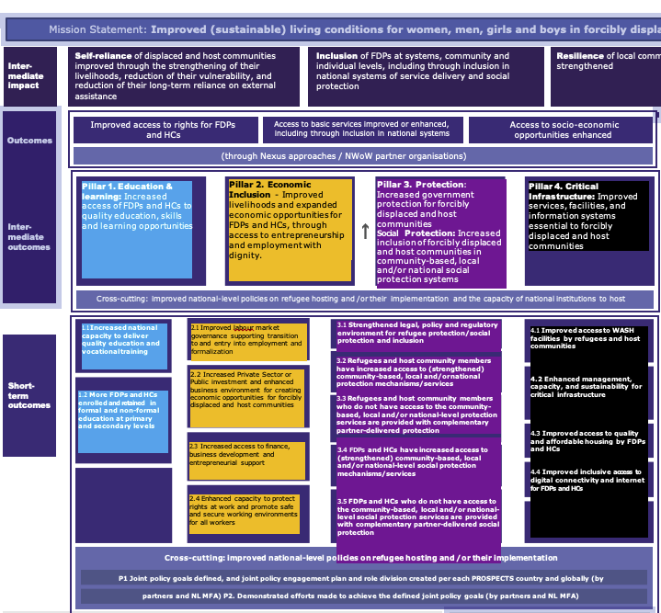
COLOR CODING
We have applied this colour code to the PROSPECTS pillars for the Integrated Framework:
TOC Pillar 1 Education
TOC Pillar 2 Economic
TOC Pillar 3 Protection
TOC Pillar 4 Infrastructure
Pillar 2. Economic Inclusion - Improved livelihoods and expanded economic opportunities for FDPs and HCs, through access to entrepreneurship and employment with dignity.
Pillar 4. Critical Infrastructure: Improved services, facilities, and information systems essential to forcibly displaced and host communities
2.1 Improved labour market governance supporting transition to and entry into employment and formalization
4.1 Improved access to WASH facilities by refugees and host communities
4.2 Enhanced management, capacity, and sustainability for critical infrastructure
4.3 Improved access to quality and affordable housing by FDPs and HCs
4.4 Improved inclusive access to digital connectivity and internet for FDPs and HCs
2.2 Increased Private Sector or Public investment and enhanced business environment for creating economic opportunities for forcibly displaced and host communities
2.3 Increased access to finance,
business development and entrepreneurial support
2.4 Enhanced capacity to protect rights at work and promote safe and secure working environments for all workers

Slide 4
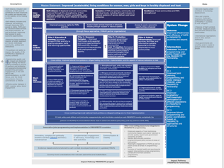
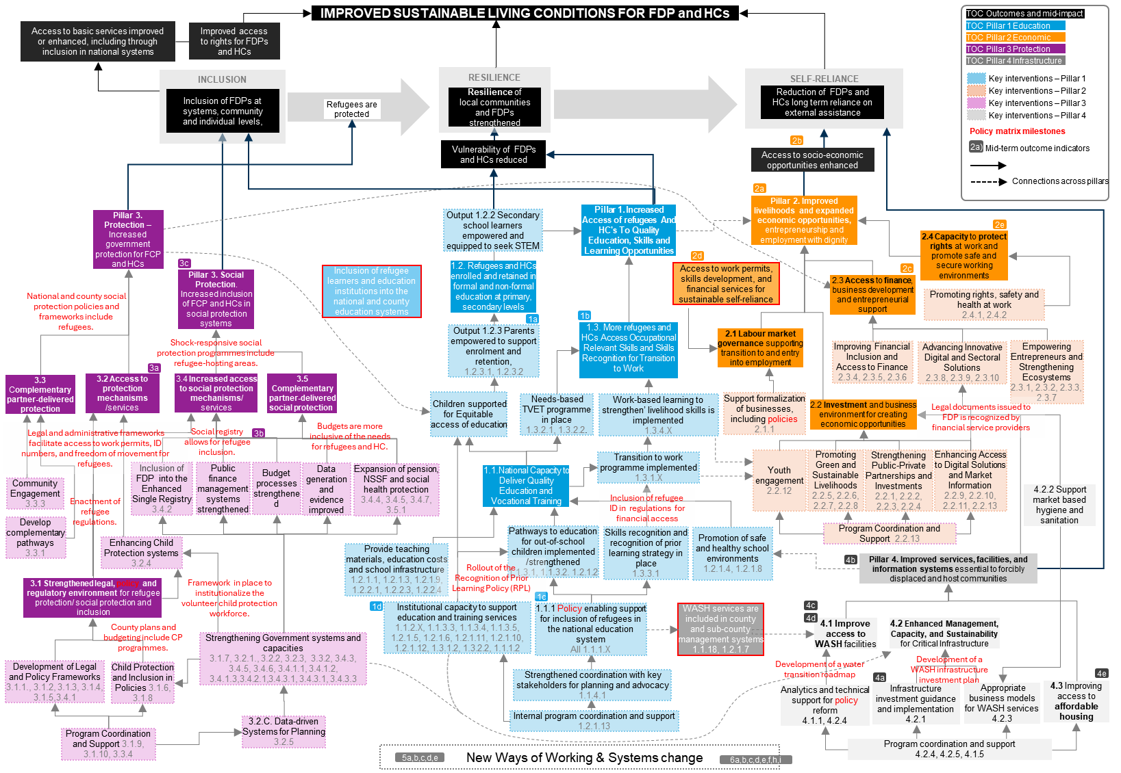
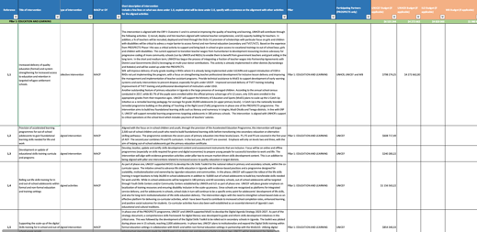
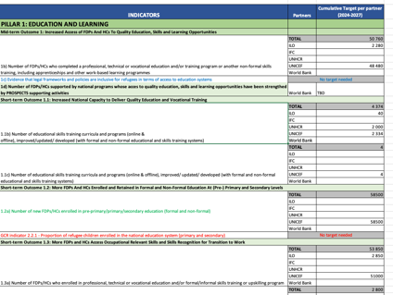

ELEMENTS INTEGRATED IN THIS FRAMEWORK
ToC Global
Programme portfolio
Policy Matrix
Multi-annual targets

Slide 5
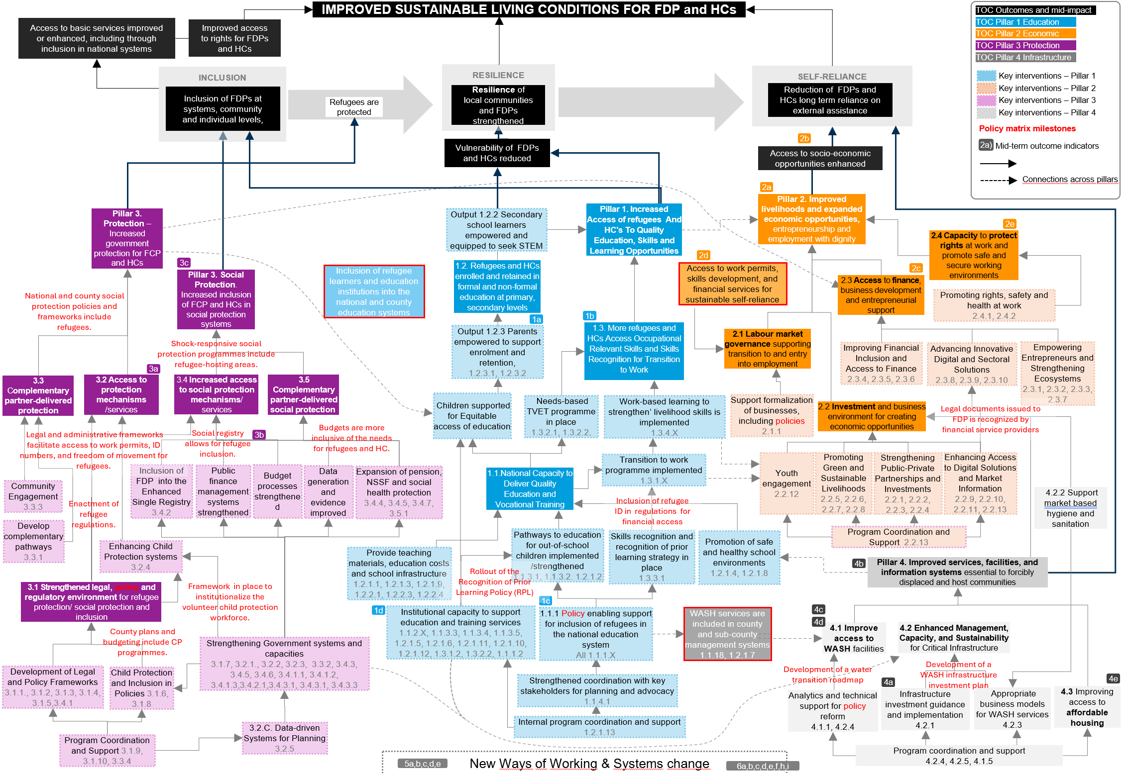
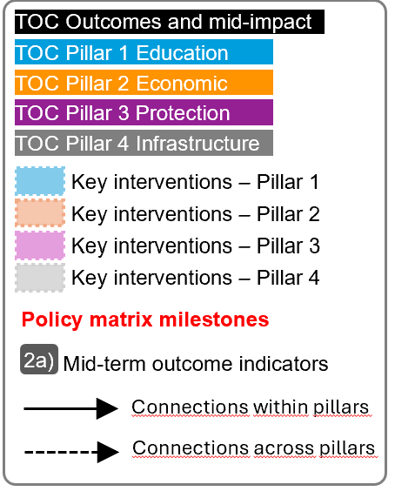
For the next slide:
Please turn to presentation mode
You will find the framework...
… where you can find:
Represent all PROSPECTS outcomes and inter-mediate impact as per the Global Theory of Change
Represent all PROSPECTS short-term outcomes (X.X) , and mid-term outcomes (X) as per the Global Theory of Change
Represent all groups of actions/interventions considered in the MACP 2024-2027 that aim at supporting and contributing to specific areas within each pillar
Represent all relevant policy matrix milestones considered for the period 2024-2027
Represent where the MACP 2024-2027 mid-term outcome indicators sit in the diagram
Click in the presentation icon
so the elements appear progressively

Slide 6
PROSPECTS
KENYA
March 2026
IMPROVED SUSTAINABLE LIVING CONDITIONS FOR FDP and HCs
TOC Outcomes and mid-impact
TOC Pillar 1 Education
RESILIENCE
TOC Pillar 2 Economic
INCLUSION
SELF-RELIANCE
TOC Pillar 3 Protection
Inclusion of FDPs at systems, community and individual levels,
Resilience of local communities and FDPs strengthened
Reduction of FDPs and HCs long term reliance on external assistance
TOC Pillar 4 Infrastructure
Refugees are protected
Key interventions – Pillar 1
Key interventions – Pillar 2
Inclusion of refugee ID in regulations for financial access
Key interventions – Pillar 3
Vulnerability of FDPs and HCs reduced
2b
Key interventions – Pillar 4
Improved access to rights for FDPs and HCs
Access to socio-economic opportunities enhanced
Policy matrix milestones
Mid-term outcome indicators
2a)
3c
Livelihood of FDPs and HCs stregthened
Connections across pillars
Access to basic services improved or enhanced, including through inclusion in national systems
2a
Pillar 3. Protection – Increased government protection for FCP and HCs
Output 1.2.2 Secondary school learners empowered and equipped to seek STEM
Pillar 1. Increased Access of refugees And HC's To Quality Education, Skills and Learning Opportunities
Pillar 2. Improved livelihoods and expanded economic opportunities, entrepreneurship and employment with dignity
2e
2.4 Capacity to protect rights at work and promote safe and secure working environments
Inclusion of refugee learners and education institutions into the national and county education systems
1.2. Refugees and HCs enrolled and retained in formal and non-formal education at primary, secondary levels
2d
Pillar 3. Social Protection. Increased inclusion of FCP and HCs in social protection systems
Access to work permits, skills development, and financial services for sustainable self-reliance
2c
National and county social protection policies and frameworks include refugees.
1b
2.3 Access to finance,
business development and entrepreneurial support
Promoting rights, safety and health at work
2.4.1, 2.4.2
1.3. More refugees and HCs Access Occupational Relevant Skills and Skills Recognition for Transition to Work
1a
5.3 Alignment of refugee processes with national processes to ensure inclusion of refugees within the national child protection system
Output 1.2.3 Parents empowered to support enrolment and retention,
1.2.3.1, 1.2.3.2
2.1 Labour market governance supporting transition to and entry into employment
1.8 Skills recognition and certification, of previous and newly acquired skills, is valid cross-border
Improving Financial Inclusion and Access to Finance
2.3.4, 2.3.5, 2.3.6
Advancing Innovative Digital and Sectoral Solutions
2.3.8, 2.3.9, 2.3.10
Empowering Entrepreneurs and Strengthening Ecosystems
2.3.1, 2.3.2, 2.3.3, 2.3.7
3a
3.4 Increased access to social protection mechanisms/ services
3.5 Complementary partner-delivered social protection
1.1 Strategy for refugee education implemented
3.3 Complementary partner-delivered protection
3.2 Access to protection mechanisms /services
Children supported for Equitable access of education
Needs-based TVET programme in place
1.3.2.1, 1.3.2.2.
Work-based learning to strengthen’ livelihood skills is implemented
1.3.4.X
Support formalization of businesses, including policies
2.1.1
2.2 Investment and business environment for creating economic opportunities
Legal documents issued to FDP is recognized by financial service providers
Legal and administrative frameworks facilitate access to work permits, ID numbers, and freedom of movement for refugees.
Social registry allows for refugee inclusion.
Budgets are more inclusive of the needs for refugees and HC.
3b
1.6 Refugee education costing is included in national and county budgets
Inclusion of FDP into the Enhanced Single Registry 3.4.2
Public finance management systems strengthened
Budget processes strengthened
Data generation and evidence improved
Expansion of pension, NSSF and social health protection
3.4.4, 3.4.5, 3.4.7, 3.5.1
1.1.National Capacity to Deliver Quality Education and Vocational Training
Transition to work programme implemented
1.3.1.X
Youth engagement
2.2.12
Promoting Green and Sustainable Livelihoods
2.2.5, 2.2.6, 2.2.7, 2.2.8
Strengthening Public-Private Partnerships and Investments
2.2.1, 2.2.2, 2.2.3, 2.2.4
Enhancing Access to Digital Solutions and Market Information
2.2.9, 2.2.10, 2.2.11, 2.2.13
Community Engagement
3.3.3
Enactment of refugee regulations.
4.2.2 Support market based hygiene and sanitation
1.2 Policy domestication for inclusion of pre-primary learners implemented
1.3 Education institutions in refugee camps are progressively registered
Develop complementary pathways
3.3.1
Pathways to education for out-of-school children implemented /strengthened
1.1.3.1, 1.1.3.2. 1.2.1.2
Skills recognition and recognition of prior learning strategy in place
1.3.3.1
Promotion of safe and healthy school environments
1.2.1.4, 1.2.1.8
Program Coordination and Support 2.2.13
Enhancing Child Protection systems
3.2.4
5.2 Framework in place to institutionalize the volunteer child protection workforce.
Provide teaching materials, education costs and school infrastructure
1.2.1.1, 1.2.1.3, 1.2.1.9, 1.2.2.1, 1.2.2.3, 1.2.2.4
4b
Pillar 4. Improved services, facilities, and information systems essential to forcibly displaced and host communities
3.1 Strengthened legal, policy and regulatory environment for refugee protection/ social protection and inclusion
1.4 Refugee learners are registered in NEMIS
1.1 Strategy for refugee education inclusion is implemented
1.7 National capacity for coordination of refugee education improved
1d
Institutional capacity to support education and training services
1.1.2.X, 1.1.3.3, 1.1.3.4, 1.1.3.5, 1.2.1.5, 1.2.1.6, 1.2.1.11, 1.2.1.10, 1.2.1.12, 1.3.1.2, 1.3.2.2, 1.1.1.2
1c
WASH services are included in county and sub-county management systems
1.1.18, 1.2.1.7
4c
5.1 County plans and budgeting include CP programmes.
1.1.1 Policy enabling support for inclusion of refugees in the national education system
All 1.1.1.X
4d
4.1 Improve access to WASH facilities
4.2 Enhanced Management, Capacity, and Sustainability for Critical Infrastructure
Strengthening Government systems and capacities
3.1.7, 3.2.1., 3.2.2, 3.2.3, 3.3.2, 3.4.3, 3.4.5, 3.4.6, 3.4.1.1, 3.4.1.2, 3.4.1.3,3.4.2.1,3.4.3.1, 3.4.3.1, 3.4.3.3
Development of Legal and Policy Frameworks 3.1.1., 3.1.2, 3.1.3, 3.1.4, 3.1.5,3.4.1
Child Protection and Inclusion in Policies 3.1.6, 3.1.8
1.5 Deployment of Teacher Service Commission to camp schools
Development of a water transition roadmap
Development of a WASH infrastructure investment plan
Strengthened coordination with key stakeholders for planning and advocacy
1.1.4.1
4a
4e
Analytics and technical support for policy reform
4.1.1, 4.2.4
Infrastructure investment guidance and implementation 4.2.1
Appropriate business models for WASH services
4.2.3
4.3 Improving access to affordable housing
3.2.C. Data-driven Systems for Planning
3.2.5
Internal program coordination and support
1.2.1.13
Program Coordination and Support 3.1.9, 3.1.10, 3.3.4
Program coordination and support
4.2.4, 4.2.5, 4.1.5
New Ways of Working & Systems change
5a,b,c,d,e
6a,b,c,d,e,f,h,i

Slide 7
ASSESSMENT OF THE FRAMEWORK
2
High-level outcomes logic
Within the high-level results, Inclusion comes first, to reduce vulnerability and increase resilience, to promote self-reliance.
We tried to link key results to the high-level results for greater clarity on how each of them contribute.
1
Pillars’ logic
As agreed with the MFA, Protection becomes the entry pillar. First, we protect, then we provide access to education, and then we facilitate access to microeconomic activities and the job market (infrastructure would be cross-cutting).
That is the reason why we placed pillar 3 on the left, followed by pillar 1 and 2.
3
Titles in the Policy matrix
Some key results appear in the milestones grouping (ex. Inclusion in national education, inclusion in GBV mechanisms, access to asylum procedures, access to work permits.)
4
Pillars’ connections
There are numerous connections between pillars that are not reflected in the Global ToC diagram. We tried to include links between connecting results across pillars.
5
Kenya’s MACP
Some pillars have outputs, others just lists of actions/results (that we have grouped in “outputs”). Policy is clearly embedded, beyond the Policy matrixes
Pillar 4
Is cross-cutting and linked to all others three pillars.
INDICATORS MAPPING
Only the Mid-Term Outcomes indicators have been mapped, which measure elements of the mid part of the diagram (above short-term outcomes and below impact).
Short-term outcomes indicators could be also mapped under the CO demand.
Most of the indicators of section 5 and 6 of the framework (SYSTEMS CHANGE and NWOW and Cross-cutting indicators) seem like strategies indicators (enablers rather than results).
6
Number of indicators and policy matrix milestones seems unbalanced in pillar 3 (only 3 indicators - other pillars 5; and 19 milestones)

Slide 8
PRACTICAL USES OF THE INTEGRATED FRAMEWORK
1
Shared understanding
The overall picture of how PROSPECTS work at different levels will contribute to developing a clear and shared understanding of PROSPECTS within UNICEF, across sectors and partners, aligning expectations and roles between them and clarifying vision and strategies.
4
Spot implementation bottlenecks and/or key enablers
The framework adopts a bottom-up approach, and implementers can pinpoint areas of interest and then work backwards to identify potential bottlenecks or opportunities to optimize achievements.
5
Enhance monitoring and evaluation
The framework helps prioritize what to measure by clearly outlining the interconnections between results and the overall line of sight. It can also support contribution analysis by illustrating how programme activities are expected to contribute to overarching goals.
2
Adaptive Management & learning
The framework is a tool for continuous learning and adaptation. It allows teams to test their assumptions and make evidence-based adjustments to their strategies and resource allocation.
3
Coordination & collaboration
The framework can help ensure that interventions are well-coordinated and aligned with overarching goals, while also aiding in identifying opportunities for collaboration.
6
Communication
The framework can be used to communicate the complex logic and strategy of PROSPECTS to diverse audiences, including donors, partners and beneficiaries.
“The integrated framework is designed not only as a conceptual tool to interrogate and possibly refine the design of PROSPECTS, but also as a practical framework that can be applied at various levels.”

Slide 9
Annexes
KENYA
ASSESSMENT OF THE FRAMEWORK
2
High-level outcomes logic
Within the high level results, Inclusion comes first, to reduce vulnerability and increase resilience, to promote self-reliance.
We tried to link key results to the high-level results for greater clarity on how each of them contribute.
1
Pillars’ logic
As agreed with the MFA, Protection becomes the entry pillar. First, we protect, then we provide access to education, and then we facilitate access to microeconomic activities and the job market (infrastructure would be cross-cutting).
That is the reason why we placed pillar 3 on the left, followed by pillar 1 and 2.
3
Kenya’s MACP
Some pillars have outputs, others just lists of actions/results (that have been group in “outputs”). Policy is clearly embedded, beyond the Policy matrixes
Titles in the Policy matrix
Some key results appear in the milestones grouping (ex. Inclusion in national education, inclusion in GBV mechanisms, access to asylum procedures, etc.)
Pillars’ connections
There are numerous connections between pillars that are not reflected in the Global ToC diagram.
We tried to include links between connecting results across pillars.
INDICATORS MAPPING
Only the Mid-Term Outcomes indicators have been mapped, which measure elements of the mid part of the diagram (above short-term outcomes and below impact).
Short-term outcomes indicators could be also mapped under the CO demand.
Most of the indicators of section 5 and 6 of the framework (SYSTEMS CHANGE and NWOW and Cross-cutting indicators) seem like strategies indicators (enablers rather than results).

Slide 10
MACP Program Portfolio
Kenya CO
 | KENYA
MT Outcome 1: | Increased Access of refugees And HC's To Quality Education, Skills and Learning Opportunities
ST Outcome1.1 | Increased National Capacity to Deliver Quality Education and Vocational Training
Output 1.1.1 | Policy enabling support for inclusion of refugees in the national education system
1.1.1 | Draft policy on refugee education and finalise and launch phased costed implementation plan.
1.1.1.2 | Analyse financing framework for inclusion of refugees in national and county budgets and financing systems. Then draft recommendations and implement them.
1.1.1.3 | Implement key policy enablers: i.e. registration of camp-based schools and registration of learners in National Education Management Information System (NEMIS)
1.1.1.4 | Develop key legislation framework to strengthen inclusion of refugee Early Childhood Education in the county government plans
1.1.1.5 | Integration of duksi and madrasa (qur'anic schools) in the formal education system
1.1.1.6 | Support strengthening of the Technical and Vocational Education and Training (TVET) and skills development ecosystem (technical and core/transferable skills)
1.1.1.7 | Update and disseminate the national WASH in Schools policies, data, strategies, standards and guidelines including refugees
1.1.1.8 | Strengthen the coordination and governance of WASH services for schools and communities in refugee and host communities under the leadership of county governments .
Output 1.1.2 | Institutional capacity strengthening to support education and training services for both refugee and host community children in integrated settlements
1.1.2.1 | Build the capacity of the MoE personnel to support the implementation of policy enablers for refugee education
1.1.2.2 | Facilitate critical education personnel and critical equipment for implementation of policy enablers within sub-county education offices
1.1.2.3 | Remunerate teachers and incentive staff in Dadaab, Kakuma, and Kalobeyei
1.1.2.4 | Harmonise and standardize the delivery and implementation of Digital Learning Packages in education and training institutions
1.1.2.5 | Strengthen and expand the digital skills ecosystem to meet evolving industry demands and emerging technologies
1.1.2.6 | In partnership with academia and Vocational training institutions, design certified training programs to youth in refugees and host communities in WASH related skills
Output 1.1.3 | Multiple pathways to education for out-of-school children and young people implemented /strengthened
1.1.3.1 | Collaborate with the MOE in profiling Out of School Children (OOSC) including those with disabilities in the refugee camps
1.1.3.2 | Provide incentive teachers to deliver AEP
1.1.3.3 | Train teachers to deliver Accelerated Education Programmes (AEP)
1.1.3.4 | Operationalize re-entry guidelines and conduct capacity building for stakeholders to promote girls' access to inclusive, quality education.
1.1.3..5 | Review and improve the contextualised curriculum for Social Innovation and capacity build trainers to deliver the social innovation trainings to Young people
Output 1.1.4 | Strengthened coordination between stakeholders to facilitate inclusion/integration of education services for refugee and host community children
1.1.4.1 | Facilitate regular calls, meetings and updates between EiE and REWG stakeholders at county and subcounty level to share information and identify areas for joint advocacy, planning and delivery
Short Outcome 1.2 | Refugees and HCs enrolled and retained in formal and non-formal education at primary, secondary levels
Output 1.2.1 | Children and young people are supported to equitable access of quality and inclusive education opportunities
1.2.1.1 | Provide equipment, assistive devices, learning, and teaching materials in pre-primary, primary, and secondary schools including Acceleration Education Programs
1.2.1.2 | Develop and provide age-appropriate multiple pathways for education for over-aged and out of school girls and boys
1.2.1.3 | Facilitate refugee learners to access national examinations
1.2.1.4 | Promotion of safe school environment through child safeguarding, child protection, PSS activities
1.2.1.5 | Provide support to children with disabilities to ensure their inclusion in schools
1.2.1.6 | Introduce digital attendance application in the refugee camps and host community schools to monitor enrolment and attendance
1.2.1.7 | Generate more evidence and disseminate existing evidence on climate resilient water services to serve refugees, host communities, and schools
1.2.1.8 | Improve WASH facilities in primary schools in host communities to ensure healthy and hygienic environments to prevent school drop outs and prevent outbreaks, including Operation and Maintenance.
1.2.1.9 | Support construction, repair, and refurbishment of classroom to support refugees and host community children.
1.2.1.10 | Support Capacity building and systems strengthening on Hygiene promotion and Menstrual Hygiene Management (MHM) in the Refugees and Host community.
1.2.1.11 | Provide technical assistance and implementation support for results-based school grants, secondary school scholarships, and provision of primary school meals at target camp-based refugee schools as part of the World Bank's Kenya Primary Education Equity in Learning Program (KPEELP), implemented by the MoE.
1.2.1.12 | Conduct a needs assessment to assess the challenges and constraints to provision of secondary education for refugee and host community children and review ongoing pilots by the MoE and partners to address out-of-school children as part of the preparation of the World Bank's Kenya Secondary Education Quality Improvement Project (SEEQIP) .
1.2.1.13 | Strengthening impact of WB projects, policy dialogue, partnerships, and coordination
Output 1.2.2 | Secondary school learners empowered and equipped to seek STEM as future direction for learning and work
1.2.2.1 | Provide teaching and learning materials and equipment for STEM subject-specific materials in schools
1.2.2.2 | Support student inclination towards STEM and climate change education and facilitate school-level projects among adolescent girls and boys, including those with disabilities
1.2.2.3 | Improve infrastructure to support STEM delivery in secondary schools including virtual laboratories
1.2.2.4 | Support last-mile school connectivity for improved STEM education and establish a digital school of excellence
Output 1.2.3 | Parents and community members are engaged and empowered to support enrolment and retention of children and young people in quality and inclusive education and training opportunities
1.2.3.1 | Build the capacity of PTAs, and BOMs on participatory school management and governance
1.2.3.2 | Sensitize and create awareness among parents and community members to support enrolment and retention of children and young people in quality and inclusive education and training opportunities
Short term Outcome 1.3 | More refugees and HCs Access Occupational Relevant Skills and Skills Recognition for Transition to Work
Output 1.3.1 | Transition to work programme for refugee and host community girls and boys implemented
1.3.1.1 | Expand digital skills training and equip young people with digital skills by establishing/ strengthening the Youth centres/Hubs in the refugee hosting areas to support young people access spaces and internet connectivity to promote the digital learning to earning pathway
1.3.1.2 | Support integrated skills development and mentorship and career guidance, including green skills, for youth in employability and entrepreneurship, including piloting ECE skilling in underserved communities to enhance school readiness.
1.3.1.3 | Support capacity building of youth to engage in WASH related entrepreneurship (MHM reusable pads, duka safi, soap making, Operation and maintenance of water supply services, plumbing, green skills, drinking water treatment, masonry)
1.3.1.4 | Support social innovation initiatives by young people (those in school and outside school ) through skills training, seed funding and mentorship for commercialization of their innovations to promote transition into employability/entrepreneurship in the different sectors including digital, blue, green and orange economy.
Output 1.3.2 | Needs-based TVET programme in place
1.3.2.1 | Support local TVET institutions to develop and deliver market-relevant skills development programmes
1.3.2.2 | Modernization of TVET through digitalization
Output 1.3.3: | Skills recognition and recognition of prior learning strategy in place for host communities and refugees
1.3.3.1 | Enhance access to an improved and strengthened skills recognition and Recognition of Prior Learning (RPL) system
Output 1.3.4: | Work-based learning to strengthen refugee and host communities’ livelihood skills are implemented
1.3.4.1 | Implementation of work-based learning to strengthen skills acquired by refugee and host communities (including apprenticeships)
1.3.4.2 | Recruit Youth on the Move (Yoma) Fellows in the refugee camps
1.3.4.3 | Programme Coordination and Management
1.3.4.4 | Technical support by Education Personnel
1.3.4.5 | Technical staff support, programme management, and oversight
2.2.12 | Support meaningful youth engagement strategies

Slide 11
MACP Program Portfolio
Kenya CO
 | KENYA
Mid-term Outcome 2: | Improved Livelihoods and Expanded Economic Opportunities for refugees and HCs
Short-term Outcome 2.1: | Improved Labour Market Governance Supporting Transition to and Entry into Employment and Formalization
2.1.1 | Support transition of enterprises from informality to formalization and strengthening of Business Support Institutions (BSIs)
Short-term Outcome 2.2: | Increased Private Sector or Public Investment and Enhanced Business Environment for Creating Economic Opportunities for refugees and HCs
2.2.1 | Design and test an outcome-based partnership model with social enterprises to increase employment and economic opportunities by harnessing the private sector under the World Bank financed Kenya NYOTA project (National Youth Opportunities Towards Advancement Project)
2.2.2 | Design and launch a KKCF-type intervention in Dadaab
2.2.3 | KKCF no-cost extension
2.2.4 | Strengthening the Employment-Intensive Investment Programme (EIIP) Systems and Approach adoption at national and county levels
2.2.5 | Management of invasive Prosopis tree species through utilization for decent green jobs creation and social economic development of refugees and host communities
2.2.6 | Promoting green jobs creation for refugee and host community youth
2.2.7 | Strengthening market based livelihoods in selected value chains for refugees and host communities
2.2.8 | Sustainable jobs creation in the leather value chain
2.2.9 | Provision of labour market information in collaboration with National and County labour market actors including job seeker profiling and job matching
2.2.10 | Institutionalization of digital Job Search Clubs (JSCs) in Kenya's employment ecosystem
2.2.11 | Provision of digital Jobs Intermediation Services in Kenya
2.2.13 | Technical staff support, programme management, and oversight
Short-term Outcome 2.3: | Increased Access to Finance, Business Development and Entrepreneurial Support
2.3.1 | Design and test the delivery of an entrepreneurship support package for refugee and host community youth under the World Bank financed Kenya NYOTA project (National Youth Opportunities Towards Advancement Project)
2.3.2 | Entrepreneurship skills development through strengthening Business Development Services (BDS) provision for refugees and host communities using ILO tools
2.3.3 | Strengthening impact of WB projects, policy dialogue, partnerships, and coordination
2.3.4 | Enhancing access to finance for refugees and host communities (Investment)
2.3.5 | Enhancing access to finance for refugees and host communities (Advisory)
2.3.6 | Financial inclusion for refugees and host communities
2.3.7 | Strengthening cooperatives ecosystem in Kenya for the benefit of host communities and refugees.
2.3.8 | Provision of digital solutions for enterprises
2.3.9 | Supporting the care economy
2.3.10 | SCORE model for productivity enhancement
Short-term Outcome 2.4: | Enhanced Capacity to Protect Rights at Work and Promote Safe and Secure Working Environments for All Workers
2.4.1 | Enhancing fundamental principles and rights at work
2.4.2 | Promoting safety and health at the workplace
 | KENYA
4.1.1 | Strengthening Integrated WASH Service Delivery in Refugee hosting Counties of Kenya under the proposed Kenya Water, Sanitation and Hygiene (K-WASH) project
4.2.1 | Support to the development of host community and refugee municipalities under the Second Kenya Urban Support Program (KUSP2)
4.2.2 | Support market based hygiene and sanitation in refugee camps and host communities: including capacity building of young people (graduates and drop outs).
4.2.3 | Disseminate and support the implementation of appropriate business models for the provision of regulated WASH services in refugee and host communities.
4.2.4 | Capacity building of partners on ESS in programs/projects benefiting refugees and host communities (capacity building of government and implementing partners)
 | Technical support by WASH Personnel
4.1.5 | Strengthening impact of WB projects, policy dialogue, partnerships, and coordination
4.3.1 | Improving access to affordable housing for refugees and host communities

Slide 12
MACP Program Portfolio
Kenya CO
 | KENYA
Mid-term Outcome 3: | (1)Protection: Increased Government Protection for refugees and HCs; (2) Social Protection: Increased Inclusion of refugees and HCs In Community-based, Local and/or National Social Protection Systems
ST Outcome 3.1: | Strengthened Legal, Policy and Regulatory Environment for Refugee Protection/Social Protection and Inclusion
3.1.1 | Knowledge, Analytics, and Policy for Forced Displacement in Kenya (KAP-FD)
3.1.2 | Support to the Government toward the development of Refugee Regulations
3.1.3 | Support to the Refugee Advisory Committee
3.1.4 | Support the government plans to extend social health protection universally, including with respect to non-nationals
3.1.5 | Support inclusive policies and sustainable financing of the extension of social protection to workers in the informal and rural economy, including non-nationals
3.1.6 | Engage and promote the centrality of child protection in development, review and implementation of legal and policy frameworks such as the Shirika plan, GISEDP, KISEDP, Turkana and Garissa County policy and budget including national legal and policy frameworks to enhance inclusion of refugees in the national child protection system.
3.1.7 | Strengthen capacity of County Officials in Turkana and Garissa and enhance advocacy with policy making personnel from the national treasury, County Government, Council of Governors and the Parliamentary Committees on child sensitive budgeting and ensuring refugees have access to services within the national child protection system.
3.1.8 | Support the national and county Governments to institutionalize child protection volunteers through the development of normative frameworks and exploring financing modality.​
3.1.9 | Strengthening impact of World Bank projects, policy dialogue, partnerships, and coordination
3.1.10 | Technical staff support, programme management, and oversight
ST Outcome 3.2: | Refugees and HCs Have Increased Access To (Strengthened) Community-based, Local and/or National Protection Mechanisms/Services
3.2.1 | Support to government registration and documentation procedures
3.2.2 | Support to government refugee status determination procedures
3.2.3 | Strengthened integrated service delivery and capacity of the child protection workforce and allied workers (teachers, health care workers, justice professionals) from the refugee camps in Dadaab, Kakuma/Kalobeyei and host community in Turkana and Garissa to address various child protection issues including positive parenting, online safety for learners accessing digital skills, GBV, access to justice, birth registration, and MHPSS.
3.2.4 | Model county child protection systems including case management, coordination, referral protocols, service mapping across social welfare, GBV, education, health, social protection, and justice sectors in Garissa and Turkana (alignment with county model development in Turkana funded by another grant).
3.2.5 | Strengthen case management and information management systems for evidence-based planning to address child protection issues and GBV
ST Outcome 3.3 | Refugees and HCs Who Do Not Have Access to the Community-based, Local And/or National-level Protection Services Are Provided with Complementary Partner-delivered Protection
3.3.1 | Facilitate access to complementary pathways
3.3.2 | Vulnerable boys, girls, women, and adolescents in the refugee camps of Dadaab and Kakuma/Kalobeyei and host communities in Turkana and Garissa are protected through a comprehensive package of quality gender-responsive, disability-inclusive, ​and age-appropriate protection services​ and age-appropriate child protection and GBV services including GBV risk mitigation within critical infrastructure and vulnerable children have access to safe learning opportunities and skills development to enhance protective environment for children and young people
3.3.3 | Community and youth engagement to prevent and mitigate violence against children, SEA and GBV and address social norms and harmful practices.
3.3.4 | Technical support by UNICEF Child Protection personnel including Youth on the Move fellows
ST Outcome 3.4: | refugees and HCs Have Increased Access To (Strengthened) Community-based, Local and/or National-level Social Protection Mechanisms/Services
3.4.1 | Support the development of an inclusive SP legislative framework in Kenya
3.4.2 | Support the Integration of the forcibly displaced and stateless persons into the Enhanced Single Registry (ESR) in Kenya
3.4.3 | Technical assistance for the consolidation of social assistance and gender integration into social protection programmes
3.4.4 | Support the expansion of the 70-plus pension pilot
3.4.5 | Support to piloting and further scale-up of refugees and migrants in informal sector in Haba Haba scheme
3.4.6 | Support the Directorate of Social Development in the integration of refugees in related social development services
3.4.7 | Support Integration of forcibly displaced and stateless persons into the NHIF
Output 3.4.1 | Public Finance Management Systems are strengthened at the County Level
3.4.1.1 | Technical support in budget process to ensure adequate allocation and efficient use of resources in the sectors i.e. education, WASH, Child Protection and Social Protection.
3.4.1.2 | Technical assistance to carry out county Level finance analysis for advocacy to inform policy, planning and budgeting.
3.4.1.3 | Technical assistance to catalyse coordination group on public finance and development.
Output 3.4.2 | Participation in the budget processes and programmes is strengthened
3.4.2.1 | Technical assistance to strengthen local voices ( refugees, host communities, women, youth and PWDs) in policy, planning, budgeting and implementation.
Output 3.4.3 | Data generation and evidence is improved
3.4.3.1 | Technical support to county and national level capacities to develop inclusive statistics.
3.4.3.2 | Social Policy Technical Support Costs
3.4.3.3 | Pilot and scale-up of maternity cash benefit scheme
Short-term Outcome 3.5: | refugees and HCs Who Do Not Have Access to the Community-based, Local and/or National-level Social Protection Services Are Provided with Complementary Partner-Delivered Social Protection
3.5.1 | Pilot-aligned social protection programmes

Slide 13
POLICY MATRIX
Kenya CO
Policy Priorities | Key challenges | Key milestones | Key stakeholders | Support through programming
PP1 - Inclusion of refugee learners and education institutions into the national and county education systems on par with nationals | - Parallel system financed by humanitarian and development partners. While use of the Kenyan curriculum and access to national examination is granted, camp schools are not registered by the MoE and do not benefit from overall MoE monitoring, capitation grants, or teacher deployment. A draft policy on inclusion of refugees in the national education system has not been finalised. - The large backlog in refugee status determination, estimated to reach 200,000 by 2024, and the exclusion of certain groups from the process (notably LGBTIQ+ and onward movers from other countries of asylum), prevents these individuals from fully accessing education, training, and livelihoods opportunities and prevents them from contributing to the local economy and accessing third country solutions, leaving them increasingly reliant on humanitarian assistance. | 1.1 Strategy for refugee education inclusion (including costed plan) is finalised and implemented. 1.2 Policy domestication for inclusion of pre-primary learners into County ECDE policy. 1.3 Education institutions in refugee camps are progressively registered by the MoE. 1.4 Refugee learners are registered in NEMIS. 1.5 Deployment of Teacher Service Commission head teachers and teachers to camp schools. 1.6 Refugee education costing is included in national and county budgets (and supported by development actors). 1.7 National capacity for coordination of refugee education is improved. 1.8 Skills recognition and certification, of previous and newly acquired skills, is valid cross-border. | - Government: MoE and DRS - GPE - UNHCR,UNICEF, UNESCO, ILO, WB - Education Cannot Wait - Refugee education implementing partners (LWF,FCA, WIK, JRS) | - Technical, financial and logistical support to overcome the barriers that are preventing the inclusion of refugees into the national education system, such as policy dialogue, capacity building for MOE staff at the national and county levels, integration of refugee education components within national plans, including the national Education Sector Strategic Plan (NESSP), logistical support for county MoE to increase ownership and oversight of the programme in the refugee camps, linkages between education coordination platforms (i.e. refugee education and EPDCG), sensitization of different stakeholders on refugee education issues. - Preparatory support for the upcoming World Bank financed Secondary Education Quality Improvement Project (SEEQIP) interventions supporting refugees and host communities. -Technical support to the MoE to strengthen inclusion of refugees at the primary school level as part of the ongoing Kenya Primary Education Equity in Learning Project (KPEELP) in Dadaab and Kakuma/Kalobeyei.
PP2-Access to work permits, skills development, and financial services for sustainable self-reliance | - The Refugees Act, 2021 does not address refugee work permits fully: the issuance of Class M work permits falls under the Citizenship and Immigration Act, and issuance is challenging as it is contingent upon an offer of employment by a specific employer and will only be issued if immigration authorities are satisfied that no Kenyan can take that job; issuance also incurs high fees for legal support, although the work permit itself is issued free of charge; passports are generally required, which most refugees do not possess. - The Refugees Act maintains the encampment policy and the current draft policy framework lacks clarity on refugees' and asylum-seekers' freedom of movement, which is crucial to their ability to access employment and self-employment where demand for skills and opportunities for business are highest and can contribute most to the local economy. - Limited legal awareness and legal information by employers, refugees, and national and county authorities on refugees' right to work. - Lack of cross-border regional skills recognition framework to allow for recognition of new and existing skills to be applied in CoA and upon return. - Difficult naturalisation process (fees, requirements) prohibits even long-term qualified refugees (who may have been born in country and received all schooling and training in the country) from accessing Kenyan citizenship thus preventing them from participating in labour force. - Financial Inclusion barriers: refugee documents do not meet Know-Your-Customer requirements to access financial services including SIM card registration and mobile money. | - Inclusion of refugee identification documents in Know-Your-Customer (KYC) regulations for improved financial access by refugees. This will ensure the acceptance of refugee documents by financial and telecommunications institutions as adequate for KYC regulations. - Legal and administrative frameworks are amended as necessary to facilitate easy access to work permits, KRA personal identification numbers, driving licenses and increased freedom of movement for refugees. - Operationalization and rollout of the Recognition of Prior Learning Policy (RPL) including strengthening the capacities of refugee and HC trainers and stakeholders on RPL | - Government: DRS, Ministry of Labour, Ministry of Interior -UNHCR - ILO - IFC, WB, AfDB - DP - NL - IGAD for skills recognition across borders/qualification framework - Kenya Central Bank, Financial Sector Deepening Kenya, Communication Authority of Kenya, mobile network operators, GSM Association, Financial Service Providers, Association for Microfinance Institutions, Kenya National Chamber of Commerce and Industry | - Hold consultative meetings with the Central Bank of Kenya and other regulators on compliance of refugee IDs with KYC requirements. - Continued joint advocacy by partners and other actors to ensure the government enacts the Refugee Act regulations to address key barriers relating to documentation and freedom of movement to facilitate financial inclusion and self-reliance. - Awareness creation of Telecoms and Financial institutions on financial inclusion for refugees. - Targeted financial and technical support for the rollout of RPL in refugee-hosting counties.
PP3- Refugees and asylum-seekers have access to fair and efficient asylum procedures and documentation | - Refugee Regulations to guide implementation of the Refugees Act, 2021 remain pending - Significant refugee status determination (RSD) backlog, estimated to reach 200,000 by 2024 - Government reluctance to introduce simplified RSD procedures - Limited staff capacity for registration and RSD - SOPs not followed (file management, documentation) leading to lengthy delays - Reports of fraud and corruption in the asylum process - RSD backlog leading to onward movement - Suspension of RSD processing of asylum-seekers with an LGBTI profile - Asylum-seekers unable to depart on complementary pathways - Refugees and asylum-seekers unable to access financial services and opportunities for self-reliance due to lack of accepted documentation | - Enactment of Refugee Regulations - Agreement on simplified RSD procedures - Reduction of RSD backlog and improved processing timeframes - Operationalisation of RSD timelines as per Refugees Act - Asylum-seekers allowed to depart on complementary pathways without having to undergo RSD - Processing of LGBTI caseload resumed - SOPs updated, training provided and monitoring mechanism put in place - Unique Personal Identifier introduced by the Government, and all refugees and asylum-seekers are included - Government documentation issued to refugees and asylum-seekers is recognized by financial service providers | - Government: Department of Refugee Services, Directorate of Immigration, National Registration Bureau - Members of Parliament - UNHCR - NGO: Refugee Consortium of Kenya - Donors: United States, Denmark, Netherlands, European Union - Private sector: financial service providers | - Technical and financial support by relevant actors, awareness raising on duty bearers on the regulations - Advocacy with the Government by Partners and other actors to ensure the Regulations are enacted and address key issues relating to freedom of movement and access to documentation to facilitate financial inclusion and self-reliance. - Support from financial service providers and telecommunications companies to ensure refugee documentation is included in "know-your-customer" regulations

Slide 14
POLICY MATRIX
Kenya CO
Policy Priorities | Key challenges | Key milestones | Key stakeholders | Support through programming
PP4 - Inclusion of refugees into national and county social protection systems | - Current social protection systems are limited and cover only a small portion of nationals, making extension to refugees difficult. - Current social protection legislation does not yet include refugees. - The refugee database and social registry are not interoperable (and the social registry does not include refugee households). - Need for alignment of humanitarian programmes with national social protection programmes. - Lack of coordination between development partners, UN and CSOs on development and emergency programmes for refugees and host communities, including financing. - Lack of consolidation and use of data on refugees and host communities by county governments. - National and county budget documents are not inclusive of refugees and do not adequately and efficiently target resources to the most vulnerable (children, women, youth, persons with disability). | - Hold a consultative meeting with the Ministry of Health to ensure the newly enacted Social Health Insurance Framework extends to refugees. National and county social protection policies and frameworks include refugees. - Social registry allows for refugee inclusion. - Shock-responsive social protection programmes include refugee hosting areas. - Funding support is secured to support refugee inclusion into national and county social protection programmes. - Improved coordination on service delivery between development partners, UN, CSOs and Government. - Budget processes in Turkana and Garissa counties are more inclusive of the needs of refugees and host communities (children, women, youth, persons with disability). - engage the county government towards including refugees in their statistics | - Government: DRS, Ministry of Labour and Social Protection, Ministry of Health, National Treasury, State Department of Economic Planning, Kenya National Bureau of Statistics. - County Government: Department for Economic Planning, Department of Donor Coordination, Office of the County Secretary, County Assemblies - Turkana University, Garissa University, Kenya Institute for Public Policy Research and Analysis. - UNHCR, ILO, UNICEF, WFP, UNFPA - WB | - Partners will continue to advocate for increased inclusion and access by refugees to national social protection schemes, including through institutional strengthening of social protection actors, notably SHIF and NSSF. - Extension of social protection programmes to the informal and rural economies and maternity income protection will be taken forth with pilots in refugee hosting areas. - Advocacy on access to documentation and access to financial services will continue with all partners as an enabler for social protection. - Comprehensive financial and poverty data analysis will be undertaken across the targeted sectors of education, child protection, WASH and social protection. This analysis will subsequently be applied to enhance capacities of Turkana and Garissa Counties to strengthen their statistics, M&E and budgeting offices.
PP5 - Inclusion of refugees into national child protection and GBV systems | - Disconnected humanitarian-development systems combined with cuts and even worse projections in humanitarian financing for child protection, GBV and general protection – creating large numbers of cases to fall out of protection systems affecting self-reliance and resilience. - Political willingness to include refugees in national systems but this is very weak at the district level in terms of access to justice, birth registration and social services. - Humanitarian protection reporting pathways, case management systems and referral pathways are not anchored in national systems. - No strong development partner engagement in justice, social services, and child protection systems strengthening in refugee hosting areas, and limited coordination among humanitarian-development partners on systems strengthening. - Limited financing for child protection and GBV programs at county and national level. - Lack of normative frameworks for child protection volunteers makes it impossible to get the related cost (e.g., stipends) to be budgeted. | 5.1 County Integrated Development Plans and annual and multi-year budgeting for related ministries and departments are inclusive of child protection programmes. 5.2 A clear framework is in place to institutionalize the volunteer child protection workforce. 5.3 Progress towards alignment of refugee processes with national processes to ensure inclusion of refugees within the national child protection system. | - Directorate of Children Services, county governments, Department of Refugee Services, Ministry of Gender; National Treasury -UNHCR | - Technical and financial Support. This will be done through working with the national and County governments on public financing for child protection to enhance their investment in the child protection services for all children including refugee children. Further, support will be provided to establish a normative framework to guide both the national and county governments on the institutionalization and financing for the volunteer child protection workforce to enhance standardization and quality of services for all children both at host community and refugee population. To ensure anchorage of child protection reporting pathways, case management systems and referral pathways, UNICEF and UNHCR will work with the line ministries in particular the Directorate of Children Services to ensure the processes align with the national system including support to review and strengthening of the information management systems. Continuous advocacy, capacity building and system diagnostics will be prioritized to ensure achievement of the milestones.
PP6 -WASH services to refugees and host communities are included in national management systems | - The provision of water and sanitation services in Kakuma and Dadaab are largely dependent on international humanitarian and development assistance. - Whereas water is a local resource, benefitting refugees and hosting communities, the services are not regulated and do not follow national policies on water and sanitation (payment for the operation and maintenance of services, for example). - This service model is not sustainable and may lead to service disruptions in case of lack of funding. | - Development of a WASH infrastructure investment plan for 1-2 integrated settlements/municipalities. - Development of a water transition roadmap that outlines the process and actions that need to be undertaken to move from the current parallel service delivery model to the integrated model. | - Garissa and Turkana county governments - Kakuma and Dadaab municipalities - WASH service regulator: WASREB MoWSI - DRS Private sector WB, UNICEF, UNHCR | - Review current WASH service delivery models and develop scenarios defining the structure and the potential benefits of an integrated refugee-host community service model. - Preparation of costed investments for WASH infrastructure for the proposed refugee-host communities integrated settlement areas in Dadaab and Kakuma/Kalobeyei. - Technical assistance and training to county government on utility services delivery modelling. - Leveraging national programs like K-WASH to support water infrastructure needs. - Supporting effective sectoral coordination and periodisation - Support the county governments of Garissa and Turkana to establish regulated service delivery models for WASH, inclusive of refugees and host communities, as per the KISEDP and GISEDP.

Slide 15
MULTI ANNUAL MID-TERM OUTCOME INDICATORS
Kenya CO
Global PROSPECTS results framework CO
INDICATORS
PILLAR 1: EDUCATION AND LEARNING
Mid-term Outcome 1: Increased Access of FDPs And HCs To Quality Education, Skills and Learning Opportunities
1a) missing?
1b) Number of FDPs/HCs who completed a professional, technical or vocational education and/or training program or another non-formal skills training, including apprenticeships and other work-based learning programmes
1c) Evidence that legal frameworks and policies are inclusive for refugees in terms of access to education systems
1d) Number of FDPs/HCs supported by national programs whose acces to quality education, skills and learning opportunities have been strengthed by PROSPECTS supporting activities
PILLAR 2: ECONOMIC INCLUSION
Mid-term Outcome 2: Improved livelihoods and expanded economic opportunities for FDPs and HCs, through access to entrepreneurship and employment with dignity
2a) Number of new wage employment and/or self-employment (business) opportunities supported by PROSPECTS
2b) Number of FDPs/HC members already employed or self-employed who have either increased their income, enhanced their working conditions or maintained resilient livelihoods
2c) Number of Government institutions, BDS providers, financial institutions, input providers and/or cooperatives that have introduced new services or scaled their service offer for FDPs and HCs
GCR indicator 2.1.1 - Proportion of refugees who have access to decent work by law
PILLAR 3: PROTECTION, SOCIAL PROTECTION AND INCLUSION
3a) Extent of inclusion of FDPs in the social protection system (UNICEF SP Indicator 5.2.1)
GCR indicator 2.1.2 - Proportion of refugees who are able to move freely within the host country
3.1a) Evidence that legal frameworks and policies are inclusive for refugees in terms of protection
PILLAR 4: CRITICAL INFRASTRUCTURE
Mid-term Outcome 4: Improved Services, Facilities and Information Systems Essential to FDPs and HCs
4a) Evidence that legislative and policy frameworks related to critical infrastructure (WASH, housing, digital connectivity) are inclusive of FDPs
4c) Proportion of FDPs/HC members using at least basic drinking water services
PILLAR 1: EDUCATION AND LEARNING
Mid-term Outcome 1: Increased Access of FDPs And HCs To Quality Education, Skills and Learning Opportunities
1a) Number of FDPs/HCs who completed their primary or secondary education program (formal and non-formal)
1b) Number of FDPs/HCs who completed a professional, technical or vocational education and/or training program or another non-formal skills training
1c) Evidence on how PROSPECTS has contributed to a change in legal frameworks, policies and asylum system related to access for refugees to education and training systems
1d) Evidence that PROSPECTS contributed to institutional capacity strengthening in relation to inclusion in education and trainings for FDPs and HCs
PILLAR 2: ECONOMIC INCLUSION
Mid-term Outcome 2: Improved livelihoods and expanded economic opportunities for FDPs and HCs, through access to entrepreneurship and employment with dignity
2a) Number of new employment and/or self-employment (business) opportunities supported by PROSPECTS
2b) Number of FDPs/HC members already employed or self-employed who have either increased their income, enhanced their working conditions or maintained resilient livelihoods
2c) Number of Government institutions, BDS providers, financial institutions, input providers and/or cooperatives that have introduced new services or scaled their service offer for FDPs and HCs
2d) Evidence on how PROSPECTS has contributed to a changes in legal frameworks, policies and asylum system related to inclusion of refugees in the labor market and formality
2e) Evidence that PROSPECTS contributed to institutional capacity strengthening in relation to inclusion of FDPs and HCs in the labour market and to improved labour rights
GCR indicator 2.1.1 - Proportion of refugees who have access to decent work by law
PILLAR 3: PROTECTION, SOCIAL PROTECTION AND INCLUSION
Mid-term Outcome 3: Protection: Increased Government Protection for FDPs and HCs. Protection: Increased Government Protection for FDPs and HCs Social Protection: Increased Inclusion of FDPs and HCs In Community-based, Local and/or National Social Protection Systems
3a) Extent of inclusion of FDPs in the social protection system and alignment of national SP system with international standards
3b) Evidence on how PROSPECTS has contributed to strengthened institutional capacity to include protection systems in national and sub-national systems and development planning
3c) Evidence that PROSPECTS contributed to institutional capacity strengthening in relation to inclusion of FDPs and HCs in social protection systems
GCR indicator 2.1.2 - Proportion of refugees who are able to move freely within the host country
PILLAR 4: CRITICAL INFRASTRUCTURE
Mid-term Outcome 4: Improved Services, Facilities and Information Systems Essential to FDPs and HCs
4a) Evidence that PROSPECTS has contributed to a change in legal frameworks, policies and asylum system related to inclusive critical infrastructure (WASH, housing, digital connectivity) for refugees
4b) Evidence that PROSPECTS contributed to improved services, facilities and information systems essential for FDPs and HCs
4c) Proportion of FDPs/HC members using at least basic drinking water services
4d) Proportion of FDPs/HC members with access to safe household sanitation
4e) Proportion of FDPs and HC living in habitable and affordable housing

Slide 16
MULTI ANNUAL MID-TERM OUTCOME INDICATORS
Kenya CO
Global PROSPECTS results framework CO
INDICATORS
5. SYSTEMS CHANGE and NWOW
Outcome: Improved Effectiveness and Efficiency of DAFD in Prospects Countries and Beyond
5a) Evidence that the Partnership fostered improved responses and innovative ways to address protracted forced displacement in PROSPECTS countries
5b) Perception of change by partners in joint-up planning and programming (strategic alignment, sequencing, layering, integrated interventions) and in the joint implementation experience
5c) Extent to which collective outcome-based interventions are jointly designed and implemented (two or more partners)
5d) Number of shared target geographical areas identified
5e) Number of PROSPECTS beneficiaries receiving services from two partners or more
6. CROSS-CUTTING INDICATORS
6a) Extent to which PROSPECTS interventions contribute to transformative approaches and solutions for youth, gender equality and people with disabilities
6b) Number and % of young people involved in (i) voicing their recommendations, or (ii) taking action in individual or collective civic engagement initiatives, entrepreneurial action, adovacy oppportunites or (iii) providing inputs to agency specific or joint PROSPECTS programming decisions
6c) Extent to which PROSPECTS interventions contribute to climate adaptation of FDPs and vulnerable HC members
6f) Number of platforms, management systems, and/or registration systems improved, updated and/or developed
5. SYSTEMS CHANGE and NWOW
Outcome: Improved Effectiveness and Efficiency of DAFD in Prospects Countries and Beyond
5a) Evidence that the Partnership fostered improved responses and innovative ways to address protracted forced displacement in PROSPECTS countries
5b) Perception of change by partners in joint-up planning and programming (strategic alignment, sequencing, layering, integrated interventions) and in the joint implementation experience
5c) Extent to which collective outcome-based interventions are jointly designed and implemented (two or more partners)
5d) Number of shared target geographical areas identified
5e) Number of PROSPECTS beneficiaries receiving services from two partners or more
6. CROSS-CUTTING INDICATORS
6a) Extent to which PROSPECTS interventions contribute to transformative approaches and solutions for youth, gender equality and people with disabilities
6b) Number and % of young people involved in: I) voicing their recommendations, or ii) taking action in individual, or; collective - civic engagement initiatives, entrepreneurial action, advocacy opportunities, or;iii) providing inputs to agency specific or joint prospects programming decisions
6c) Extent to which PROSPECTS interventions contribute to climate adaptation of FDPs and vulnerable HC members
6d) Number of institutions receiving technical assistance or capacity building to improve their services to FDPs and HCs
6e) Number of staff participating in capacity building or training sessions (all pillars)
6d) Number of platforms, management systems, and/or registration systems improved, updated and/or developed
6e) Number & percentage of total interventions classified as promoting/addressing gender equality as a key objective: Not targeted (score 0): the project has not been found to target gender equality Significant (score 1): gender equality is an important and deliberate objective, but not the principal reason for undertaking the project. Principal (score 2): gender equality is the main objective of the project and is fundamental to its design and expected results. The project would not have been undertaken without this gender equality objective.
6h) Number of FDPs and HCs using feedback and response mechanisms to voice concerns or recommendations to improve PROSPECTS programming
6i) Number of plans, strategies, measures, and/or policy recommendations created, enhanced and/or delivered to the government
6f) Number of analytics, reports or data collection efforts completed informing ongoing or pipeline operations and/or contributing to improved evidence and data on poverty, vulnerability, and displacement

