Slide 1


PROSPECTS 2.0. INTEGRATED RESULTS FRAMEWORK
ITERATIVE EVALUATION OF UNICEF IN PROSPECTS – UGANDA CO (2026)

Slide 2
RATIONALE
PROSPECTS 2.0 is a new phase of the program that keeps improving its planning and monitoring systems to show progress. Tools such as the global ToC has been customised in CO like Uganda, and the elements defined in the joint planning MACP (tab 2), are complemented by the multi-annual indicators (tab 5) and recently by the milestones of the Policy Matrix (tab 3).
KEY CHALLENGES IDENTIFIED
“Lack of clarity in connecting key components of the program, including the policy matrix, theory of change, and results framework”
“The need to reviewing all existing frameworks, interconnect them and put a strong emphasis on achieving high-level outcomes. Linking activities to policy-level outcomes”
“It is essential to clarify what specific data is required to monitor the sequence of services provided by different agencies to users”
“Emphasis should be shifted towards high-level outcomes, allowing for more comprehensive consideration of program goals”
“Ensure that our activities are connected to the overarching objectives, emphasizing the importance of demonstrating linkages across different pillars. Not to operate in silos”
OPPORTUNITY IDENTIFIED
These 5 elements introduce and complement each other, a common interface to see how all of them interact and complement each other was missing.
The iterative evaluation has identified in its first iteration this gap and proposes an Integrated results framework, where all the elements cohabite and are put in perspective.
This framework can be used:
To better understand and explain the integrated logic of PROSPECTS
To better identify synergies
To better discuss and report on progress

Slide 3
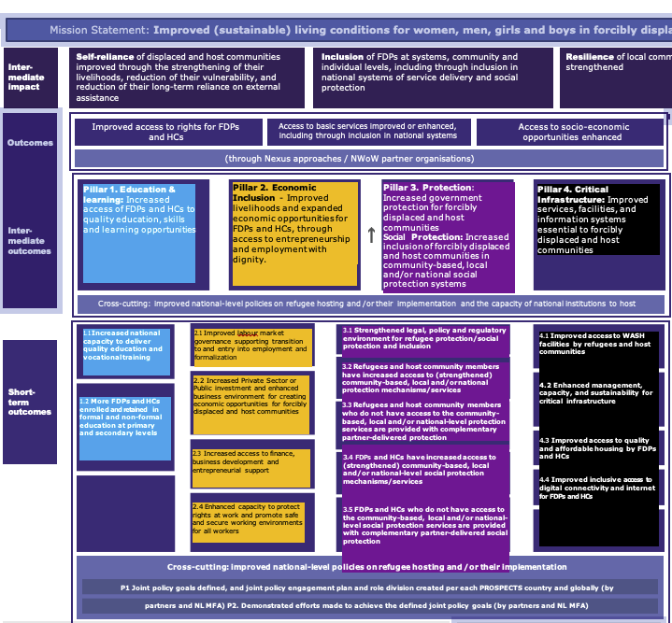
COLOR CODING
We have applied this colour code to the PROSPECTS pillars for the Integrated Framework:
TOC Pillar 1 Education
TOC Pillar 2 Economic
TOC Pillar 3 Protection
TOC Pillar 4 Infrastructure
Pillar 2. Economic Inclusion - Improved livelihoods and expanded economic opportunities for FDPs and HCs, through access to entrepreneurship and employment with dignity.
Pillar 4. Critical Infrastructure: Improved services, facilities, and information systems essential to forcibly displaced and host communities
2.1 Improved labour market governance supporting transition to and entry into employment and formalization
4.1 Improved access to WASH facilities by refugees and host communities
4.2 Enhanced management, capacity, and sustainability for critical infrastructure
4.3 Improved access to quality and affordable housing by FDPs and HCs
4.4 Improved inclusive access to digital connectivity and internet for FDPs and HCs
2.2 Increased Private Sector or Public investment and enhanced business environment for creating economic opportunities for forcibly displaced and host communities
2.3 Increased access to finance,
business development and entrepreneurial support
2.4 Enhanced capacity to protect rights at work and promote safe and secure working environments for all workers

Slide 4
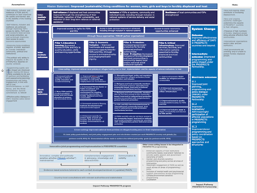
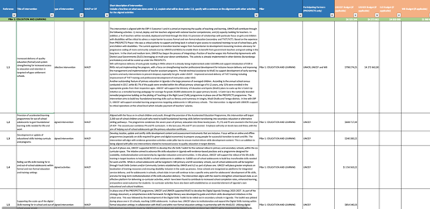
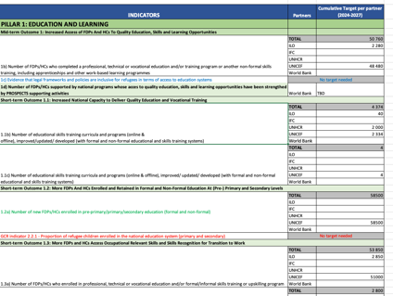
ELEMENTS INTEGRATED IN THIS FRAMEWORK
ToC Global
ToC Uganda
Tab 2 Programme portfolio
Tab 3 Policy Matrix
Tab 5 Multi-annual targets

Slide 5
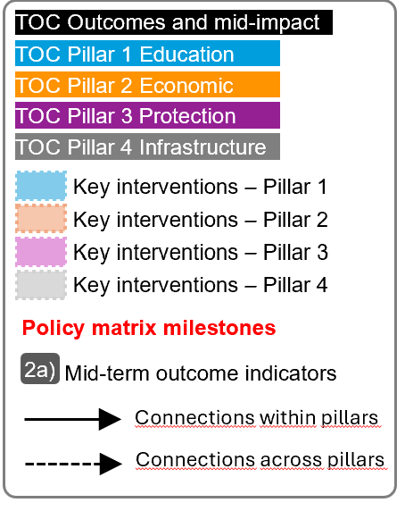
For the next slide:
Please turn to presentation mode
You will find the framework...
… where you can find:
Represent all PROSPECTS outcomes and inter-mediate impact as per the Global Theory of Change
Represent all PROSPECTS short-term outcomes (X.X) , and mid-term outcomes (X) as per the Global Theory of Change
Represent all groups of actions/interventions considered in the Uganda MACP 2024-2027 that aim at supporting and contribute to specific areas within each pillar
Represent all relevant policy matrix milestones considered for the period 2024-2027
Represent where the Uganda MACP 2024-2027 mid-term outcome indicators sit in the diagram
Click in the presentation icon
so the elements appear progressively

Slide 6
PROSPECTS
UGANDA
March 2026
IMPROVED SUSTAINABLE LIVING CONDITIONS FOR FDP and HCs
TOC Outcomes and mid-impact
TOC Pillar 1 Education
RESILIENCE
TOC Pillar 2 Economic
Resilience of local communities and FDPs strengthened
TOC Pillar 3 Protection
TOC Pillar 4 Infrastructure
INCLUSION
SELF-RELIANCE
Key interventions – Pillar 1
Key interventions – Pillar 2
Inclusion of FDPs at systems, community and individual levels,
Reduction of FDPs and HCs long term reliance on external assistance
Increased commitment to support return and/or third country solutions
Key interventions – Pillar 3
Key interventions – Pillar 4
Policy matrix milestones
Vulnerability of FDPs and HCs reduced
Mid-term outcome indicators
2a)
Connections within pillars
6c)
Connections across pillars
Refugees are protected
2.1.2.
2.3 Transition strategy operationalized
Improved access to rights for FDPs and HCs
Incorporation of key inclusion and refugee protection priorities
Access to basic services improved or enhanced, including through inclusion in national systems
5e
6a)
Access to socio-economic opportunities enhanced
Pillar 3. Protection – Increased government protection for FCP and HCs
3a)
Improve education outcomes
Pillar 3. Social Protection. Increased inclusion of FCP and HCs in social protection systems
1.2 More enrolled and retained in education at school
Livelihood of FDPs and HCs stregthened
Protection issues integrated in national programmes
Inclusion of refugees in the national education system
2
2a)
2b)
4
3.4
Infrastructure andregistration shortcomings addresssed
Pillar 2. Improved livelihoods and expanded economic opportunities, entrepreneurship and employment with dignity
Pillar 4. Improved services, facilities, and information systems essential to forcibly displaced and host communities
Refugees included in NSSF on voluntary savings
PROTECTION
SOCIAL PROTECTION
1
Pillar 1. Increased access of FDPs and HCs to quality education, skills and learning opportunities
Improved employability
JLIRP integrated in DDP
2.2 Review of the National Strategy on Coverage Extension
1b)
National Employment Policy and Regulations adopted
Refugees access ID cards
3.5 Complementary partner-delivered social protection
3.1 EMIS is functional
RSD) / registration
shortcomings addressed
3.3 Complementary partner-delivered protection
3.2 Access to protection mechanisms /services
1c)
1.1 Capacity to deliver quality education and vocational training
ERP II implemented
DEVELOP CAPACITIES ON RIGHTS OF WORK
MACP 2.6, 2.7
2.4 Capacity to protect rights at work and promote safe and secure working environments
4.2 Enhanced management, capacity, and sustainability for critical infrastructure
4.3 Improved access to quality and affordable housing by FDPs and HCs (?)
3.4 Access to social protection mechanisms/ services
2.1.1.
3.3 Adopted
TVET act
2.2 Investment and business environment for creating economic opportunities
Digital referral pathways broaden access to services
4.1 Improved access to WASH facilities by refugees and host communities
Refugees included in national statistics
3.1a)
6b)
ADVOCACY EFFORTS
MACP 1.12, 1.13, 2.8, 2.9, 2.11, 3,4, 3.5
2c)
4.4 Improved inclusive access to digital connectivity and internet for FDPs and HCs
2.6 Refugee Status Determination (RSD) Guidelines Operationalized.
3.1 Strengthened legal, policy and regulatory environment for refugee protection/ social protection and inclusion
2.5 National Social Protection Strategy operationalized
3.2 Digital Agenda Strategy operationalized
2.1 Labour market governance supporting transition to and entry into employment
PROVIDE INTERNSHIP & APPRENTICESHIP
MACP 1.8, 1.9
4c)
EVIDENCE GENERATION & DIGITAL INFRASTRUCTURE
MACP 4.1, 4.5, 4.6, 4.10
CRITICAL INFRASTRUCTURE (REGISTRATION FACILITIES )
MACP 4.7
Transition strategy for WASH implemented
CP and GBV actions and justice delivery models prioritized by the government
2.1 Engagement in NDP IV and relevant Programme Implementation Action Plans
3.5
Analytics finalised
ACTIONS TO IMPROVE LABOUR MARKET GOVERNANCE
MACP 2.1
MSME strategy developed
PROVIDE JOB-SPECIFIC & VOCATIONAL SKILLS
MACP 1.7, 1.14
4a)
SUPPORT TO COVERAGE OF SOCIAL PROTECTION SYSTEMS
MACP 3.12
1d)
SUPPORT TO SCALE UP PUBLIC EMPLOYMENT PROGRAMMES
MACP 2.3
2.3 Access to finance,
business development and entrepreneurial support
PROVIDE TRANSFERABLE SKILLS
MACP 1.6, 1.5, 1.4, 1.3
SUPPORT TO ASYLUM SYSTEM AND DOCUMENTATION
MACP 3.6, 3.7, 3.10, 3.11
Roadmap for refugee water schemes developed
6f)
SUPPORT STREGTHENING LEGAL POLICY FRAMEWORKS
MACP 3.1, 3.3
PROVIDE FOUNDATIONAL LEARNING SKILLS
MACP 1.2
SUPPORT TO INCREASE ACCESS TO BUSINESS DEVELOPMENT SERVICES
MACP 2.4, 2.5 (a,b), 2.8, 2.10
SUPPORT TO SAFETY FROM VIOLENCE AND EXPLOITATION
MACP 3.8, 3.9, 3.12
DEVELOPMENT OF PROTOCOLS FOR SOCIAL SAFEGUARDS AND RISKS
MACP 3.2
STREGTHENING TEACHERS & SYSTEMS
MACP 1.1, 1. 10, 1. 11
ENHANCE BUSINESS ENVIRONMENT FOR PUBLIC AND PRIVATE INVESTMENT MACP 2.2, 4.8
LEVERAGING CRITICAL INFRASTRUCTURE (WASH )
MACP 4.2, 4.3, 4.4
SANITATION APPROACH AND CAMPAIGNS
MACP 4.9
New Ways of Working & Systems change
5
5a)
5b)
5c)
5d)

Slide 7
ASSESSMENT OF THE FRAMEWORK
1
Pillars’ logic
The entry point of the logic seems to be Protection. First, we protect, then we provide access to education, and then we facilitate access to microeconomic activities and the job market (infrastructure would be cross-cutting).
That is the reason why we placed pillar 3 on the left, followed by pillar 1 and 2.
2
Pillars’ connections
There are numerous connections between pillars that are not reflected in the Global ToC diagram.
We tried to include links between connecting results across pillars.
3
Key results made explicit
M&E tools are a simplification of the logic and expected results. However, rebuilding the results framework, some key results were implicit.
We included 4 key results that seem central to the logic and confluence of pillars (ex. FDP are protected, children and youth are included in the education system, better education outcomes, better employability).
INDICATORS MAPPING
Only the Mid-Term Outcomes indicators have been mapped, which measure elements of the mid part of the diagram (above short-term outcomes and below impact).
Short-term outcomes indicators could be also mapped under the CO demand.
Most of the indicators of section 5 and 6 of the framework (SYSTEMS CHANGE and NWOW and Cross-cutting indicators) seem like strategies indicators (enablers rather than results).

Slide 8
PRACTICAL USES OF THE INTEGRATED FRAMEWORK
1
Shared understanding
The overall picture on how PROSPECTS work at different levels will contribute to develop a clear and shared understanding of PROSPECTS within UNICEF and across partners, aligning expectations and roles between them and clarifying vision and strategies.
4
Spot implementation bottlenecks and/or key enablers
The framework adopts a bottom-up approach, and implementers can pinpoint areas of interest and then work backwards to identify potential bottlenecks or opportunities to optimize achievements.
5
Enhance monitoring and evaluation
The framework helps prioritize what to measure by clearly outlining the interconnections between results. It can also support contribution analysis by illustrating how programme activities are expected to contribute to overarching goals.
2
Adaptive Management & learning
The framework is a tool for continuous learning and adaptation. It allows teams to test their assumptions and make evidence-based adjustments to their strategies and resource allocation.
3
Coordination & collaboration
The framework can help ensure that interventions are well-coordinated and aligned with overarching goals, while also aiding in identifying opportunities for collaboration.
6
Communication
The framework can be used to communicate the complex logic and strategy of PROSPECTS to diverse audiences, including donors, partners, and beneficiaries.
“The integrated framework is designed not only as a theoretical tool to improve the design of PROSPECTS but also as a practical framework that can be applied at various levels.”

Slide 9
SUGGESTED NEXT STEPS
1
INTERNAL DISCUSSION AND VALIDATION OF THE FRAMEWORK
2
ORGANIZE PRESENTATION TO UGANDA PARTNERS AND MFA
3
THINKING AND DOCUMENTING USES
Evaluation manager: Eduard Bonet ebonet@unicef.org
Evaluation team: Salvador Bustamante, Sara Vaca (Artival)
Evaluation UNICEF PROSPECTS focal point: Innocent Kaba inkaba@unicef.org

Slide 10
ANNEXES
The following are the main tools/data sets used to develop the integrated framework

Slide 11
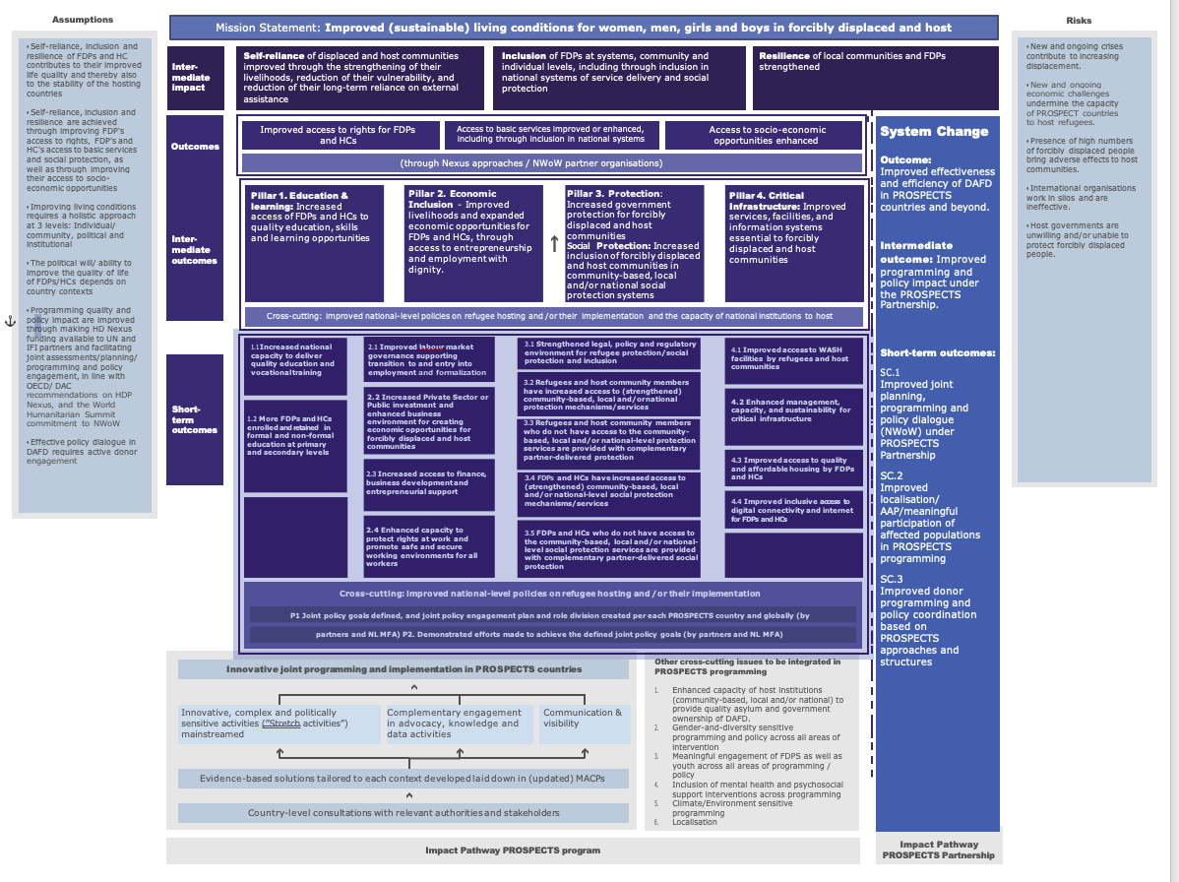
PROSPECTS
UGANDA
March 2026
PROSPECT General Theory of change

Slide 12
PROSPECTS
UGANDA
March 2026

Slide 13
PROSPECTS
UGANDA
March 2026
POLICY MATRIX
Pillar/Theme | Policy Priorities (only areas that relate to the work of more than one PROSPECTS agency) | Key challenges and barriers to implementation corresponding policy priorities | Key milestones (By 2027, PROSPECTS programme will contribute to achieving the below milestones) | Key stakeholders | Support through programming
Overall Refugee Policy/CRRF | Policy priority 1. The proposed National Refugee Policy (NRP) addresses key issues of service integration, self reliance and livelihoods, among others, and maintains a progressive open-door policy to refugees. | *Uganda does not have a unified policy on refugee administration despite having one of the most liberal legal regimes for the international protection of refugees under the Refugees Act (2006) and the Refugees Regulations (2010) implemented through various approaches and initiatives, *The Country is formulating a national refugee policy (NRP) against a backdrop of unprecedented increases in the number of refugees, challenges of “stretched country refugee-accommodating capacity,” and government questioning the “sustainability of the refugee self-reliance model,” posing a potential threat of the NRP shrinking the progressive refugee regime in the country. *The draft NRP offers limited forward-looking responses to the emerging complex problems of self reliance, urban refugees, service integration, local integration and complementary pathways. For complementyary pathways and through a strengthening linkages betwen education, livelihood and self-reliance, complementary pathways will foster further resilience, human capital development, and further Uganda as a leader in refugee-inclusive development at the global level. | *2024: Partners review and share technical analysis and proposals for draft policy improvement in respective areas (ILO, UNHCR, IFC, WB, UNICEF) *2024: Partners review briefs and provide joint commentary to GoU on the issues of self-reliance, service integration, livelihoods and durable solutions to GoU (UNHCR,UNICEF, WB, IFC, ILO) *2025: Partners utilize commentary for sustained dialogue with GoU individually and/or jointly) (UNHCR,UNICEF, WB, IFC, ILO) *2027: Partners document progress and revise commentary script *2027: Partners use revised commentary for sustained dialogue with GoU individually and/or jointly) (UNHCR,UNICEF, WB, IFC, ILO) *2027: Policy enacted, printed and disseminated (UNHCR, WB, IFC, ILO, NL MFA – in cooperation with other donors etc.) | Government: OPM, MoLG, MinFin, OP, Cabinet, Parliament UN & IFIs: UNHCR, WB, IFC, ILO,UNICEF WHO, UNFPA, UNDP and other DPs Coordination Fora- National Partnership Forum , LGDPF | Policy analysis (technical and political) to inform joint advocacy; (UNHCR, ILO, UNICEF, World Bank & IFC) Policy dialogue regarding issues of self reliance, urban refugees, service integration, local integration and complementary pathways among others (UNHCR, WB, IFC, ILO) Technical policy formulation support to GoU to strengthen areas of concern including implementation plans (UNHCR, ILO, UNICEF, World Bank & IFC)
Education and learning | Policy priority 3. Inclusion in the national education and training system | - The implementation of the Education Response Plan II (ERP II) requires investment and commitment by the Government of Uganda and key development actors to achieve its stipulated outcomes and results. - Challenges faced by the MoES in rolling out the Education Management Information System (EMIS) persist with delays in securing the GPE funding, which is expected to bridge this gap. - Despite the approval of the Education Digital Agenda Strategy by the Minister of Education and Sports, implemenation of key interventions will require technical and financial support. - The Technical and Vocational Education and Training (TVET) Policy was developed in 2019, and it provides for 1) a review of the TVET Act and other related laws; 2) the establishment of the TVET council; and 3) the operationalisation of the Skills Development Fund. However, some of these aspects of the policy require a legal framework (Act of Parliament) to guide its implementation. - Refugees are challenge with costs and procedures of issue of certificate conversion/equation especially for refugees from non English speaking countries | Milestones related to the implementation of ERP II and broader scope it brings for integration of refugees in the mainstream education system 3.1 EMIS 2026: EMIS is functioning with refugee data included 2027. EMIS includes a majority of refugee schools in the system 3.2 Digital Agenda Strategy 2024: Digital Agenda Strategy launched by the Minister of Education and Sports and planning for implementation is initiated and includes a focus on host and refugee children and adolescents 2025: Costed roadmap for the implementation of the Digital Agenda Strategy developed with digital learning and skilling for refugees included. 2026: Costed roadmap implemented with digital learning and skilling for refugees included. 3.3 TVET Policy 2025: TVET Council established for the operationalisation of the Skills Development Fund 2026: Skills Development Fund operationalised and also benefitted refugees by ensuring that it has regulations that includes and provides needs-based skills for refugees. 2027: TVET Act is adopted and includes provisions for refugee skilling 2026: Development of a national qualification framework that supports equating of refugee qualification 3.4 Other 2025: PROSPECTS analytics finalsed that will directly support implementation of ERP2 through WB financed operations - USEEP, UgIFT and ULEARN. 2027: Infrastructure and HR RSD / registration shortcomings addresssed and sustainability strategy developed by 2027. | Government: MoES, MoGLSD and OPM Development agencies: UNICEF, UNHCR, ILO, Save the Children, GPE in addition to other actors | - UNHCR and UNICEF to support the implementation of ERP II interventions and ensure learning and skilling opportunities are provided to the most marginalized children and youth from refugees and host communities - UNICEF and ILO to support the operationlization of the Digital Agenda Strategy by supporting the development and implementation of a costed roadmap, with focus on building refugees' and host communities' digital competencies needed for life, active citizenship and decent work. - UNICEF, WB and ILO to mobilize private sector partners to invest in the improvemenet of digital infrastructure in line with the Digital Agenda Strategy. - ILO to facilitate engagement meetings of the relevant stakeholders (MoGLSD &MoES) to input into the processes that lead to the legal framework to guide the implementation of the TVET policy. ILO will also build capacity of the stakeholders to meaningfully engage in these processes through training programmes on TVET policy implementation - WB and UNICEF to ensure implementation of ERP II priorities by supporting the effectiveness of national education programs integrating refugees including: DRDIP, USEEP, UgIFT and ULEARN
Economic Inclusion | Policy priority 4. Roll out of the Jobs and Livelihood Integrated Response Plan (JILRP) (2020/21-2024/25) | *JLIRP is a stand-alone plan which is not anchored on national development plan and is not part of the sector plans of the Ministries, Departments, and Agencies (MDAs) which are the traditional government funding mechanisms. *There is no funding attached to the plan by the Ministry of Gender Labour and Social Development (MGLSD) or other MDAs to support its implementation. *Delayed implementation of the JLIRP *limited capacity of MGLSD both financially, and in terms of human resources to convene and coordinate the implementation of all the pillars with the MDAs and LDGs *Insufficient collaboration/ coordination among the partners leading to duplication and ineffective programs. | *2024/25 –refugee hosting districts integrate the JLIRP into their development plan and budget to facilitate refugee access to technical services and key factors of production such as farmland and capital in line with the CRRF agenda (UNHCR, ILO, UNICEF, WB) *2024 – the capacity of the JLIRP secretariat is strengthened for coordination, alignment and harmonization of interventions and approaches (UNHCR,ILO, WB) *2025-Through dialogue and advocacy with OPM/Immigration, administrative barriers to the issue of work permits for refugees resolved (UNHCR, ILO) . *2025 - Strengthen district coordination and engagement with refugee leadership structures (UNHCR, ILO, UNICEF) *2025 - Operationalization of the private sector engagement strategy to complement the JLIRP in income and employment generation for self-reliance (WB, IFC, UNHCR, ILO, UNICEF). *2025 – comprehensive review to evaluate the JLIRP five-year implementation and performance. Based on this assessment, recommendations for extending the plan in line with NDPIV will be provided (UNHCR, ILO, NL) | - Government: MGLSD, OPM, MoLG, MoE, MAAIF, MoH, - UNHCR, ILO, WB -Livelihood and Resilience sector working group | Technical and financial support to refugee hosting districts to undertake an integration process of the JLIRP into their DDP and budget Capacity building workshop for refugee hosting districts on policy integration process with MGLSD and NPA Capacity building of the JLIRP Secretariat by supporting the placement of program officers for technical support and coordination Advocacy for Government departments and donors, particularly development donors, to provide the resources for the JLIRP.

Slide 14
PROSPECTS
UGANDA
March 2026
POLICY MATRIX
Pillar/Theme | Policy Priorities (only areas that relate to the work of more than one PROSPECTS agency) | Key challenges and barriers to implementation corresponding policy priorities | Key milestones (By 2027, PROSPECTS programme will contribute to achieving the below milestones) | Key stakeholders | Support through programming
Protection | Policy priority 2. Inclusion of critical areas of refugee protection, Social Protection and self- reliance (such as asylum, digital identity management and documentation capacity, jobs and livelihoods, social protection, education, and related matters) in national and local development plans and programmes. | *Critical areas for refugee protection and self-reliance (such as asylum, digital identity management and documentation capacity, jobs and livelihoods, social protection, education, and related matters are not integrated or addressed in national development plans and programmes or dedicated refugee sector response plans. *Government led systems (child protection, GBV, social protection, and justice) do not consistently serve refugees and asylum seekers. *While the GoU and local civil society organizations are dedicated to making child protection and GBV services universally accessible, constrained human and financial resources within the national system have hampered its capacity to extend protection services to refugees. *Work permits for refugees cannot be stamped on refugee identity documents, but need to be stamped on refugee Convention Travel Documents (CTDs). This policy requirement affects the right to work for refugees who do not hold CTDs, which are themselves not easily acquired by refugees due to the application fees for a CTD (220,000 UGX equivalent 62 USD). | 2.1 2024 – Dialogue and engagement with National Planning Authority and relevant programmes to include critical areas for refugee self reliance and protection in the draft NDP IV and relevant Programme Implementation Action Plans (PIAPs) (ILO, UNICEF, WB, UNHCR, NL MFA and other donors). 2.2 2024 - Review of the National Strategy on Coverage Extension to the Informal Economy to Include Refugees and HC and Costing of the National Strategy on Coverage Extension (ILO, UNICEF, UNHCR, WB) *2025- rollout of the National Strategy on Coverage Extension to the Informal Economy (ILO, UNICEF, WB) 2.3 2024 - Transition Strategy for health, education and water services from humanitarian into national systems is developed (UNICEF, UNHCR, WB) 2.4 2025- key CP GBV CBP inclusion priorities in MGLSD frameworks, NDPIV, Governance and Security Programme, Administration of Justice Programme, the Human Capital Development Programme, District Development Plans and operational budgets (UNICEF, UNHCR, WB) *2025- Service Integration Strategy for protection services is developed (UNHCR, UNICEF, ILO, WB) *2025 – High level policy discussions for action on the Transition Strategy. (UNHCR, WB, UNICEF) *2027- NDP IV, selected PIAPs and DDPs tracking and reporting progress relating to inclusion of FDPs. 2.5 2025 The national social protection strategy operationalized. * 2025 Guidance note developed and implemented. *2025 Refugee Status Determination (RSD) Guidelines Operationalized. | -Government: NPA and relevant programs – Human Capital Development committee UN & IFIs: UNHCR,UNICEF, IFC, ILO, WB Livelihood and Resilience sector working group - implementing and operating partners | Technical, financial, and logistical support to the National Planning Authority to mainstream critical areas for refugee protection and self-reliance in Uganda’s NDP IV (ILO, Capacity building of NDPIV programme working groups (HCD among others) aimed at enhancing the capacities to systematically integrate and mainstream critical areas for refugee protection and self-reliance in the development and budgeting processes of the Program Implementation Action Plans (PIAPs) and Strategic Plans (ILO, UNICEF) Technical and Financial support to the MGLSD to support the operationalization of the various social protection policy frameworks (ILO, UNICEF, WB) Technical, financial and logistical support to KCCA, MoGLSD and OPM to address barriers to inclusion of refugees into GBV/CP service delivery systems(UNHCR, WB, UNICEF) Joint policy dialogues for uptake of key CP GBV CBP inclusion priorities in MGLSD frameworks, NDPIV, Governance and Security Programme, Administration of Justice Programme, the Human Capital Development Programme, District Development Plans and operational budgets (UNICEF, UNHCR, WB) Policy level discussions to popularize the transition strategy for health, education and water services (UNICEF, UNHCR, WB) Technical guidance to improve the protection sensitivity of social safeguards and risk mitigation protocols (WB, UNHCR, UNICEF)

Slide 15
MACP Program Portfolio
1,1 | Increased delivery of quality education (formal) and increased access to education and retention in targeted refugee settlement schools.
1,2 | Provision of accelerated learning programmes for out-of-school adolescents to gain foundational learning skills needed for life and work
1,3 | Development or update of educational skills training curricula and programs
1,4 | Rolling out life skills training for in and out-of-school adolescents within formal and non-formal education and training settings
1,5 | Supporting the scale-up of the digital Skills training for in-school and out-of-school young people
1,6 | MACP1.6 Transferable and life skills package for young people expanded through co-curricular and non-formal education programme.
1,7 | MACP1.7 Modeling job-specific training programmes for out-of-school adolescents
1,8 | MACP1.8 Inclusive formal intership and apprenticeship programme
1,9 | MACP1.9 Skills recognition systems strengthened
1,10 | MACP1.10 System of foreign certificate recognition strengthened and digitalised
1,11 | MACP1.11 Strengthening Access and Quality for Learning and Skills in Uganda’s Refugee Hosting Districts
1,12 | MACP1.12 Strengtening impact of WB projects, policy dialogue and CRRF coordination
1,13 | MACP1.13 Promoting meaningful engagement of young people on the move
1,14 | MACP1.14 Access to market relevant vocational, and skills training for refugees, and host communicties with a focus on young people increased.
2,1 | MACP2.1. Improved labour market governance to facilitate transition from learning to earning
2,2 | MACP2.2 Enhanced business environment for public, and private investment to ignite inclusive economic opportunities for refugees and host communities.
2,3 | MACP2.3 Expanded Public employment programmes scaled and capacity of government and partners strengthened to design, implement Employment Intensive public works that create decent work opportunities for refugees and host communities
2,4 | MACP2.4 Increased access to financial and non-financial Business Development Services to foster inclusive economic opportunities for refugees and host communities.
2.5 (a) | MACP2.5a Increased access to financial and non-financial Business Development Services to foster inclusive economic opportunities for refugees and host communities.
2.5 (b) | MACP2.5b IFC- Blended Finance Facility for Uganda
2,6 | MACP2.6 Improved capacity of partner institutions to promote and engage on rights at work for refugees, and Host communities
2,7 | MACP2.7 Awareness raised and capacity built among refugees and host communities on rights at work
2,8 | MACP2.8 Enhancing value chain resilience, fostering market linkages, developing financial products to manage recurrent shocks, and strengthening financial skills of youth and women, in host and refugee communities
2,9 | MACP2.9 Building Resilience of Refugee Women Entrepreneurs in Uganda
2,10 | MACP2.10 Building the resilience of Refugees and Host communities to Climate Change and declining Food Ration in Uganda through economic empowerment and capacity building
2,11 | MACP2.11 Strengtening impact of WB projects, policy dialogue and CRRF coordination
4,8 | MACP4.8 Strengtening impact of WB projects, policy dialogue and CRRF coordination
3,1 | MACP3.1 Inclusion of CP, GBV and CBP refugee and host community priorities in National and Local Development Policies, Programmes and Planning
3,2 | MACP3.2 Inclusive Social Safeguards and Social Risk Management Protocols are Developed and Implemented
3,3 | MACP3.3 Strengthening of policies and implementation for third country opportunities
3,4 | MACP3.4 Generating Evidence to Inform Learning and Policy Advocacy
3,5 | MACP3.5 Relevant national policies and strategies are strengthened to include social protection for refugees
3,6 | MACP3.6 Strengthening Birth Registration and Issuance of Certificates
3,7 | MACP3.7 Strengthen asylum system and civil registration institutions
3,8 | MACP3.8 Strengthening Government ownership for CP / GBV through improved capacities, alignment and integration of local government and humanitarian systems
3,9 | MACP3.9 Localization CP GBV Systems
3.10 | MACP3.10 Streamlining and Harmonizing MIS
3,11 | MACP3.11 Mandate Refugee Status Determination procedures
3,12 | MACP3.12 Complementary CP Services including Best Interests Procedures (BIA and BID)
3,13 | MACP3.13 Increased coverage of refugees and HCs into national social protection schemes
4.1 | eDirectory and eReferral Pathways
4,2 | Government and private sector actors supported to establish and extend irrigation systems for farmers engaged in agricultural value chains
4,3 | Community Centers phase II
4,4 | Rehabilitation/upgrade of schools and non-formal education centers including WASH facilities and Establishment of ICT labs in schools
4,5 | Government engaged to extend digital infrastructure to enhance access to digital connectivity services, for refugee and host communities
4,6 | Long term sustained water services for refugee settlements and host communities in Uganda
4,7 | Rehabilitation and construction (including electrification) of Registration Facilities in Kampala, Imvepi, Rhino and Nakivale
4,9 | Implement Market Based Sanitation approach and Hygiene Promoition campaigns in target districts to support both host communities and FDPs
4,10 | Roll out of integrated WASH Management Information System in targte disitrcts of Isingiro, Terego and Madi Okollo

Slide 16
PROSPECTS
UGANDA
March 2026
MULTI ANNUAL MID-TERM OUTCOME INDICATORS
INDICATORS
PILLAR 1: EDUCATION AND LEARNING
Mid-term Outcome 1: Increased Access of FDPs And HCs To Quality Education, Skills and Learning Opportunities
1a) missing?
1b) Number of FDPs/HCs who completed a professional, technical or vocational education and/or training program or another non-formal skills training, including apprenticeships and other work-based learning programmes
1c) Evidence that legal frameworks and policies are inclusive for refugees in terms of access to education systems
1d) Number of FDPs/HCs supported by national programs whose acces to quality education, skills and learning opportunities have been strengthed by PROSPECTS supporting activities
PILLAR 2: ECONOMIC INCLUSION
Mid-term Outcome 2: Improved livelihoods and expanded economic opportunities for FDPs and HCs, through access to entrepreneurship and employment with dignity
2a) Number of new wage employment and/or self-employment (business) opportunities supported by PROSPECTS
2b) Number of FDPs/HC members already employed or self-employed who have either increased their income, enhanced their working conditions or maintained resilient livelihoods
2c) Number of Government institutions, BDS providers, financial institutions, input providers and/or cooperatives that have introduced new services or scaled their service offer for FDPs and HCs
GCR indicator 2.1.1 - Proportion of refugees who have access to decent work by law
PILLAR 3: PROTECTION, SOCIAL PROTECTION AND INCLUSION
3a) Extent of inclusion of FDPs in the social protection system (UNICEF SP Indicator 5.2.1)
GCR indicator 2.1.2 - Proportion of refugees who are able to move freely within the host country
3.1a) Evidence that legal frameworks and policies are inclusive for refugees in terms of protection
PILLAR 4: CRITICAL INFRASTRUCTURE
Mid-term Outcome 4: Improved Services, Facilities and Information Systems Essential to FDPs and HCs
4a) Evidence that legislative and policy frameworks related to critical infrastructure (WASH, housing, digital connectivity) are inclusive of FDPs
4c) Proportion of FDPs/HC members using at least basic drinking water services
5. SYSTEMS CHANGE and NWOW
Outcome: Improved Effectiveness and Efficiency of DAFD in Prospects Countries and Beyond
5a) Evidence that the Partnership fostered improved responses and innovative ways to address protracted forced displacement in PROSPECTS countries
5b) Perception of change by partners in joint-up planning and programming (strategic alignment, sequencing, layering, integrated interventions) and in the joint implementation experience
5c) Extent to which collective outcome-based interventions are jointly designed and implemented (two or more partners)
5d) Number of shared target geographical areas identified
5e) Number of PROSPECTS beneficiaries receiving services from two partners or more
6. CROSS-CUTTING INDICATORS
6a) Extent to which PROSPECTS interventions contribute to transformative approaches and solutions for youth, gender equality and people with disabilities
6b) Number and % of young people involved in (i) voicing their recommendations, or (ii) taking action in individual or collective civic engagement initiatives, entrepreneurial action, adovacy oppportunites or (iii) providing inputs to agency specific or joint PROSPECTS programming decisions
6c) Extent to which PROSPECTS interventions contribute to climate adaptation of FDPs and vulnerable HC members
6f) Number of platforms, management systems, and/or registration systems improved, updated and/or developed

