Slide 1


INTEGRATED RESULTS FRAMEWORK
PROSPECTS 2.0.
ITERATIVE EVALUATION – LEBANON CO (2026)

Slide 2
RATIONALE
PROSPECTS 2.0 is a new phase of the program that keeps improving its planning and monitoring systems to show progress.
Tools such as the global Theory of Change (ToC) have been customized, and the elements defined in the MACP such as the Program Portfolio are complemented by the milestones of the Policy Matrix and by the multi-annual indicators.
Key Challenges Identified in the Iteration 1: October 2024 - February 2025
OPPORTUNITY IDENTIFIED
(In the course of fieldwork in Uganda and Kenya)
These 4 elements complement each other; having a common interface to see how all of them interact and interlink with each other was missing.
“The need to reviewing all existing frameworks, interconnect them and put a strong emphasis on achieving high-level outcomes. Linking activities to policy-level outcomes”
“Lack of clarity in connecting key components of the program, including the policy matrix, theory of change, and results framework”
The iterative evaluation identified in its first iteration this gap and proposes an Integrated Results Framework, where all the elements cohabite and are put in perspective.
“Ensure that our activities are connected to the overarching objectives, emphasizing the importance of demonstrating linkages across different pillars. Not to operate in silos”
“Limited interconnections across pillars, and the pillar system leading to think in siloes”
This framework can be used:
To better understand and explain the integrated logic of PROSPECTS
To better identify synergies
To better discuss and report on progress
“There is a strong emphasis on collaboration between different pillars. This includes joint program documents and coordination meetings. The primary area for improvement is internal coordination among pillars, inter-pillar planning in addition to pillar-specific planning.”
This solution has been very well received, like the “missing piece”, by PROSPECTS UNICEF Coordination team, by the two CO visited during the first iteration (Uganda and Kenya), and by PROSPECTS multilateral partners focal points at headquarters, and country level, including the PROSPECTS Netherlands partner. The Uganda country team has used this tool for the UNICEF country team meeting and shared it with the PROSPECTS multilateral partners (ILO, UNHCR, WB, IF) to facilitate coordination.
These points were deemed relevant to all the countries by the PROSPECTS UNICEF Coordination team, PROSPECTS multilateral partners focal points at HQ (and country level in the iteration 1 countries), and the PROSPECTS Netherlands partner.

Slide 3
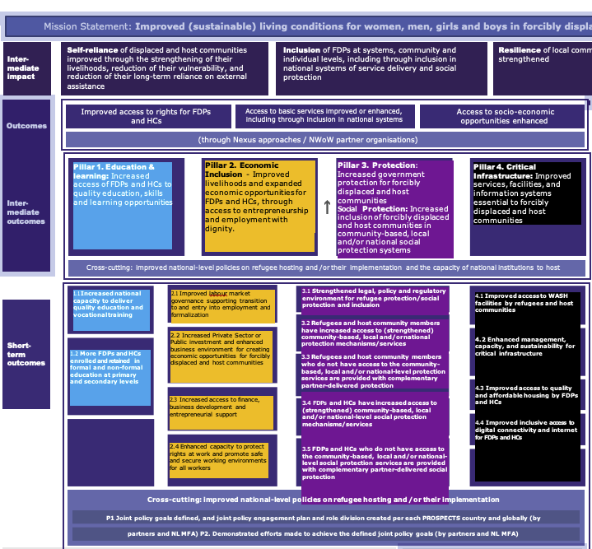
COLOR CODING
We have applied this colour code to the PROSPECTS pillars for the Integrated Framework:
TOC Pillar 1 Education
TOC Pillar 2 Economic
TOC Pillar 3 Protection
TOC Pillar 4 Infrastructure
Pillar 2. Economic Inclusion - Improved livelihoods and expanded economic opportunities for FDPs and HCs, through access to entrepreneurship and employment with dignity.
Pillar 4. Critical Infrastructure: Improved services, facilities, and information systems essential to forcibly displaced and host communities
2.1 Improved labour market governance supporting transition to and entry into employment and formalization
4.1 Improved access to WASH facilities by refugees and host communities
4.2 Enhanced management, capacity, and sustainability for critical infrastructure
4.3 Improved access to quality and affordable housing by FDPs and HCs
4.4 Improved inclusive access to digital connectivity and internet for FDPs and HCs
2.2 Increased Private Sector or Public investment and enhanced business environment for creating economic opportunities for forcibly displaced and host communities
2.3 Increased access to finance,
business development and entrepreneurial support
2.4 Enhanced capacity to protect rights at work and promote safe and secure working environments for all workers

Slide 4
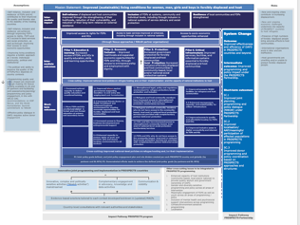
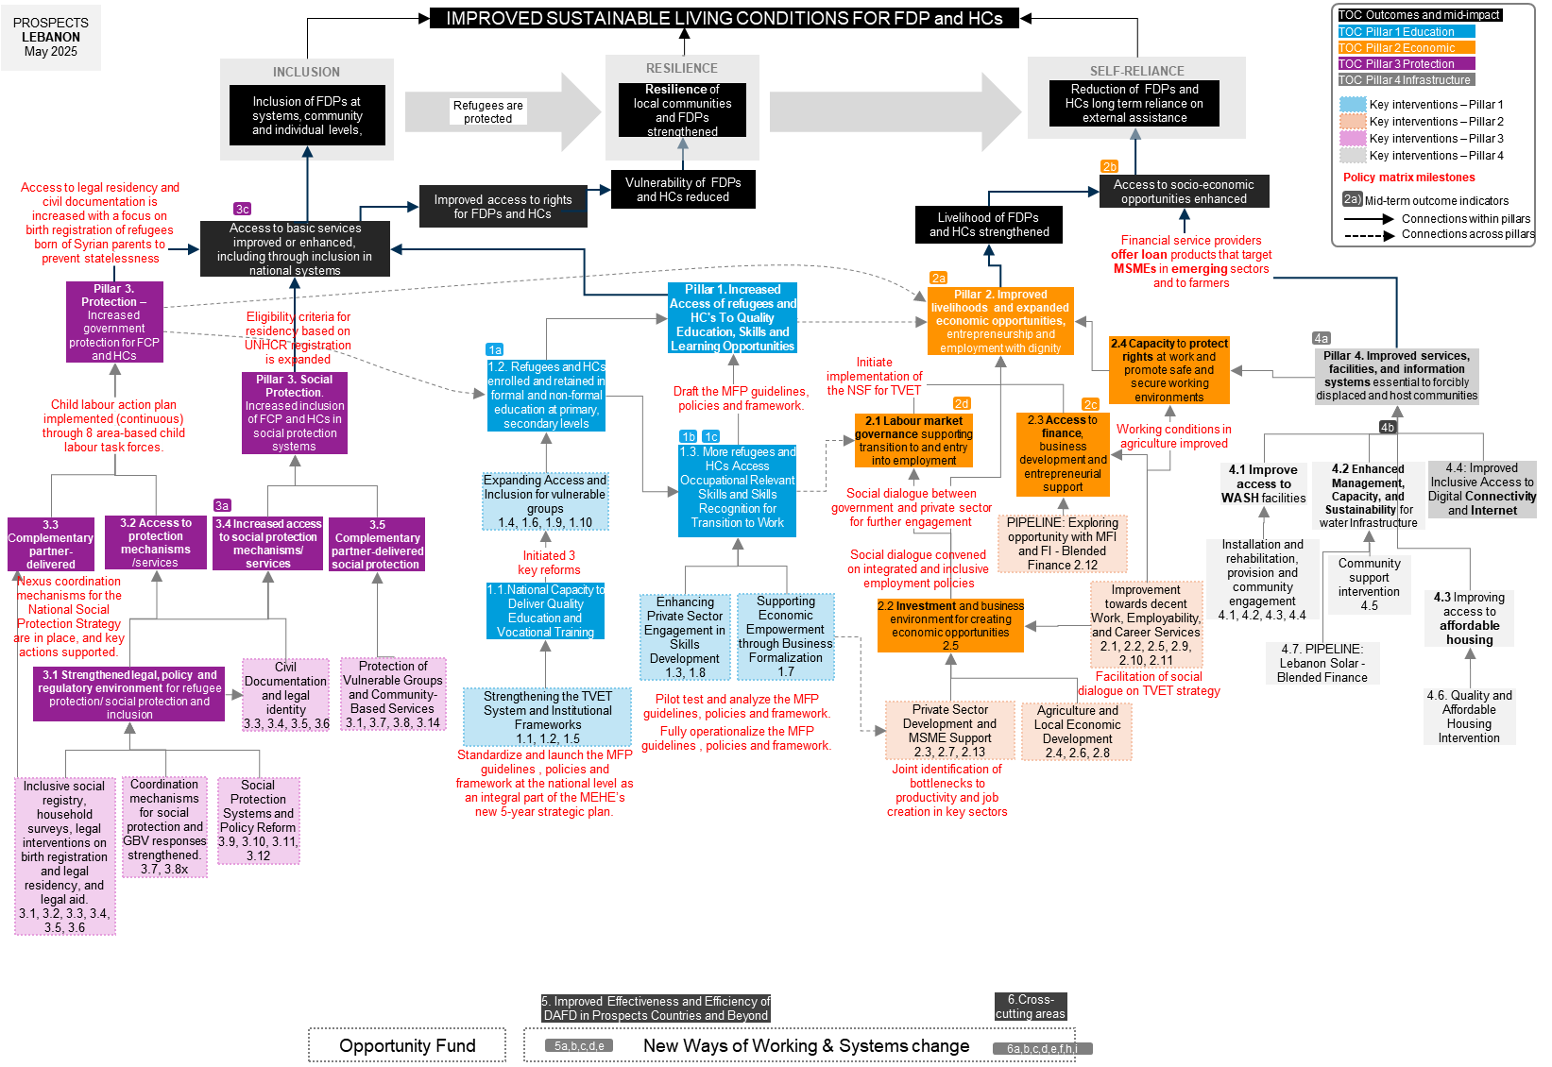
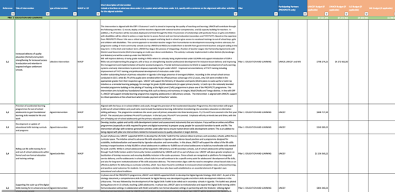
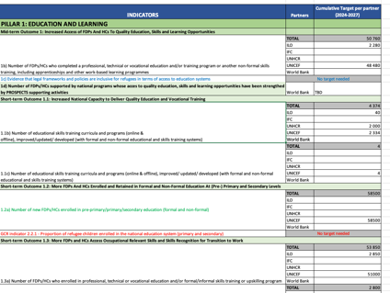

ELEMENTS INTEGRATED IN THIS FRAMEWORK
We have placed the 4 elements in one page:
ToC Global
Programme portfolio
Policy Matrix
Multi-annual targets

Slide 5
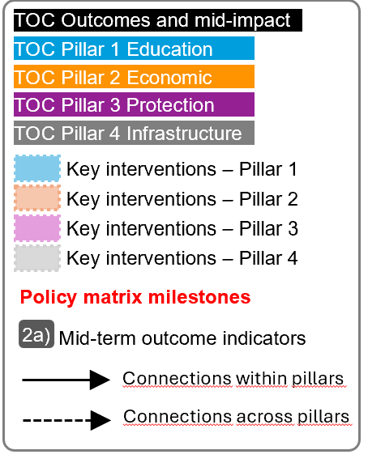
For the next slide:
Please turn to presentation mode
You will find the framework...
… where you can find:
Represent all PROSPECTS outcomes and inter-mediate impact as per the Global Theory of Change
Represent all PROSPECTS short-term outcomes (X.X) , and mid-term outcomes (X) as per the Global Theory of Change
Represent all groups of actions/interventions considered in the MACP 2024-2027 that aim at supporting and contributing to specific areas within each pillar
Represent all relevant policy matrix milestones considered for the period 2024-2027
Represent where the MACP 2024-2027 mid-term outcome indicators sit in the diagram
Click in the presentation icon
so the elements appear progressively

Slide 6
PROSPECTS
LEBANON
March 2026
IMPROVED SUSTAINABLE LIVING CONDITIONS FOR FDP and HCs
TOC Outcomes and mid-impact
TOC Pillar 1 Education
RESILIENCE
TOC Pillar 2 Economic
INCLUSION
SELF-RELIANCE
TOC Pillar 3 Protection
Inclusion of FDPs at systems, community and individual levels,
Resilience of local communities and FDPs strengthened
Reduction of FDPs and HCs long term reliance on external assistance
TOC Pillar 4 Infrastructure
Refugees are protected
Key interventions – Pillar 1
Key interventions – Pillar 2
Key interventions – Pillar 3
2b
Key interventions – Pillar 4
Vulnerability of FDPs and HCs reduced
Access to socio-economic opportunities enhanced
Policy matrix milestones
Improved access to rights for FDPs and HCs
Mid-term outcome indicators
Access to legal residency and civil documentation is increased
3c
Livelihood of FDPs and HCs strengthened
2a)
Connections within pillars
Access to basic services improved or enhanced, including through inclusion in national systems
Financial service providers offer loan products that target MSMEs in emerging sectors and to farmers
Connections across pillars
Pillar 3. Protection – Increased government protection for FCP and HCs
Pillar 1. Increased Access of refugees and HC's To Quality Education, Skills and Learning Opportunities
2a
Eligibility criteria for residency based on UNHCR registration is expanded
Pillar 2. Improved livelihoods and expanded economic opportunities, entrepreneurship and employment with dignity
1a
2.4 Capacity to protect rights at work and promote safe and secure working environments
4a
1.2. Refugees and HCs enrolled and retained in formal and non-formal education at primary, secondary levels
Initiate implementation of the NSF for TVET
Pillar 4. Improved services, facilities, and information systems essential to forcibly displaced and host communities
5.6 Child labour action plan implemented (continuous) through 8 area-based child labour task forces.
Pillar 3. Social Protection. Increased inclusion of FCP and HCs in social protection systems
1.3. More refugees and HCs Access Occupational Relevant Skills and Skills Recognition for Transition to Work
2d
2c
1b
1c
2.1 Labour market governance supporting transition to and entry into employment
2.3 Access to finance,
business development and entrepreneurial support
Working conditions in agriculture improved
4b
5.3. Social welfare workforce and systems strengthened
Expanding Access and Inclusion for vulnerable groups
1.4, 1.6, 1.9, 1.10
4.1 Improve access to WASH facilities
4.2 Enhanced Management, Capacity, and Sustainability for water Infrastructure
4.4: Improved Inclusive Access to Digital Connectivity and Internet
3a
1.5. Standardize and launch the MFP guidelines , policies and framework
Social dialogue between government and private sector for further engagement
3.3 Complementary partner-delivered protection
3.2 Access to protection mechanisms /services
3.4 Increased access to social protection mechanisms/ services
3.5 Complementary partner-delivered social protection
PIPELINE: Exploring opportunity with MFI and FI - Blended Finance 2.12
1.1. Initiated 3 key reforms
1.4. Fully operationalize the MFP guidelines , policies and framework.
Social dialogue convened on integrated and inclusive employment policies
Installation and rehabilitation, provision and community engagement
4.1, 4.2, 4.3, 4.4
Community support intervention
4.5
5.4. Child labour task forces expanded
* Support to sustainable financing of inclusive and gender-responsive social protection
1.1.National Capacity to Deliver Quality Education and Vocational Training
Enhancing Private Sector Engagement in Skills Development
1.3, 1.8
Supporting Economic Empowerment through Business Formalization
1.7
2.2 Investment and business environment for creating economic opportunities
2.5
Improvement towards decent Work, Employability, and Career Services
2.1, 2.2, 2.5, 2.9, 2.10, 2.11
4.3 Improving access to affordable housing
6.1 Nexus coordination mechanisms for the NSPS in place and supported.
Civil Documentation and legal identity
3.3, 3.4, 3.5, 3.6
Protection of Vulnerable Groups and Community-Based Services
3.1, 3.7, 3.8, 3.14
4.7. PIPELINE: Lebanon Solar - Blended Finance
3.1 Strengthened legal, policy and regulatory environment for refugee protection/ social protection and inclusion
Facilitation of social dialogue on TVET strategy
4.6. Quality and Affordable Housing Intervention
Strengthening the TVET System and Institutional Frameworks
1.1, 1.2, 1.5
Private Sector Development and MSME Support
2.3, 2.7, 2.13
Agriculture and Local Economic Development
2.4, 2.6, 2.8
5.2. System for data collection, monitoring, and reporting
1.3.Pilot test and analyze the MFP guidelines, policies and framework.
Inclusive social registry, household surveys, legal interventions on birth registration and legal residency, and legal aid.
3.1, 3.2, 3.3, 3.4, 3.5, 3.6
Coordination mechanisms for social protection and GBV responses strengthened.
3.7, 3.8x
Social Protection Systems and Policy Reform
3.9, 3.10, 3.11, 3.12
Joint identification of bottlenecks to productivity and job creation in key sectors
5.1. Amendments to Law 422 and SOPs on Diversion/ Alternative Correctional Measures developed
1.2. Draft the MFP guidelines, policies and framework.
Program coordination and support
Program coordination and support
Program Coordination and Support
5.5. MHPSS sub strategy endorsed
6.2. Contribution to Lebanon´s country’s social registry and national databases (MIS)
Program Coordination and Support
5. Improved Effectiveness and Efficiency of DAFD in Prospects Countries and Beyond
New Ways of Working & Systems change
6.Cross-cutting areas
5a,b,c,d,e
6a,b,c,d,e,f,h,i

Slide 7
NOTES
1
Pillars’ logic
As agreed with the MFA, Protection becomes the entry pillar. First, we protect, then we provide access to education, and then we facilitate access to microeconomic activities and the job market (infrastructure would be cross-cutting).
That is the reason why we placed pillar 3 on the left, followed by pillar 1 and 2.
High-level outcomes logic
Within the high-level results, Inclusion comes first, to reduce vulnerability and increase resilience, to promote self-reliance.
We tried to link key results to the high-level results for greater clarity on how each of them contribute.
2
3
Pillars’ connections
There are some connections between pillars that are not reflected in the Global ToC diagram but they are reflected in the IF. We tried to include links connecting results across pillars.
4
Lebanon’s MACP
The Program Portfolio does not include Mid-term and Short-term outcomes; it just lists actions/ results that we have grouped according to the Multi-annual mid-term outcomes indicators matrix.
5
Policy matrix
Pillar 3 Protection includes 19 milestones in the Policy matrix that have been grouped in 4 statements for clarity reasons (see all the milestones in slide 12).
INDICATORS MAPPING
Only the Mid-Term Outcomes indicators have been mapped, which measure elements of the mid part of the diagram (above short-term outcomes and below impact).
Short-term outcomes indicators could be also mapped under the CO demand.
Most of the indicators of section 5 and 6 of the Multi Annual Mid-term Outcome Indicators (SYSTEMS CHANGE and NWOW and Cross-cutting indicators) seem like strategies indicators (enablers rather than results).
Other comments:
Policy matrix includes expected deadlines (+)
Policy matrix includes more strategies than results (-)
Indirect links among pillars are observed
PROSPECTS LEBANON
May 2025

Slide 8
PRACTICAL USES OF THE INTEGRATED FRAMEWORK
1
Shared understanding
The overall picture of how PROSPECTS work at different levels will contribute to developing a clear and shared understanding of PROSPECTS within UNICEF, across sectors and partners, aligning expectations and roles between them and clarifying vision and strategies.
4
Spot implementation bottlenecks and/or key enablers
The framework adopts a bottom-up approach, and implementers can pinpoint areas of interest and then work backwards to identify potential bottlenecks or opportunities to optimize achievements.
5
Enhance monitoring and evaluation
The framework helps prioritize what to measure by clearly outlining the interconnections between results and the overall line of sight. It can also support contribution analysis by illustrating how programme activities are expected to contribute to overarching goals.
2
Adaptive Management & learning
The framework is a tool for continuous learning and adaptation. It allows teams to test their assumptions and make evidence-based adjustments to their strategies and resource allocation.
3
Coordination & collaboration
The framework can help ensure that interventions are well-coordinated and aligned with overarching goals, while also aiding in identifying opportunities for collaboration.
6
Communication
The framework can be used to communicate the complex logic and strategy of PROSPECTS to diverse audiences, including donors, partners and beneficiaries.
“The integrated framework is designed not only as a conceptual tool to interrogate and possibly refine the design of PROSPECTS, but also as a practical framework that can be applied at various levels.”

Slide 9
Annexes
LEBANON
ASSESSMENT OF THE FRAMEWORK
2
High-level outcomes logic
Within the high level results, Inclusion comes first, to reduce vulnerability and increase resilience, to promote self-reliance.
We tried to link key results to the high-level results for greater clarity on how each of them contribute.
1
Pillars’ logic
As agreed with the MFA, Protection becomes the entry pillar. First, we protect, then we provide access to education, and then we facilitate access to microeconomic activities and the job market (infrastructure would be cross-cutting).
That is the reason why we placed pillar 3 on the left, followed by pillar 1 and 2.
3
Kenya’s MACP
Some pillars have outputs, others just lists of actions/results (that have been group in “outputs”). Policy is clearly embedded, beyond the Policy matrixes
Titles in the Policy matrix
Some key results appear in the milestones grouping (ex. Inclusion in national education, inclusion in GBV mechanisms, access to asylum procedures, etc.)
Pillars’ connections
There are numerous connections between pillars that are not reflected in the Global ToC diagram.
We tried to include links between connecting results across pillars.
INDICATORS MAPPING
Only the Mid-Term Outcomes indicators have been mapped, which measure elements of the mid part of the diagram (above short-term outcomes and below impact).
Short-term outcomes indicators could be also mapped under the CO demand.
Most of the indicators of section 5 and 6 of the framework (SYSTEMS CHANGE and NWOW and Cross-cutting indicators) seem like strategies indicators (enablers rather than results).

Slide 10
PROSPECTS
LEBANON
March 2026
MACP Program Portfolio
 | Pillar 1: EDUCATION AND LEARNING
1,1 | Support the implementation of the National Strategic Framework for TVET, enhance the operational efficiency of the services provided by the Directorate General of TVET, and support the National Youth Action Plan
1,2 | Institutionalization of skills assessments, forecasting, and monitoring of skill delivery outcomes enhanced within the private sector to actively contribute to better matching of skills with labor market needs by increasing private sector participation in the education / TVET sectors
1,3 | Skilling Up Lebanon
1,4 | Multiple Flexible Learning to Earning Pathways for marginalized children and adolescents
1,5 | Accelerating TVET pathways and strengthening the capacity of TVET schools to deliver market relevant skills trainings, with strong linkages to the private sector
1,6 | Increase access of FDPs And HCs to an integrated package of learning, skilling, and empowerment
1,7 | Facilitate business formalization, including MSMEs, with industrial associations and local chambers
1,8 | WBL programs targeting Syrian refugees and Lebanese in promising sectors scaled up with more engagement of the private sector.
1,9 | Youth engagement and empowerment activities
1,10 | CIS - TVET
 | Pillar 2: ECONOMIC INCLUSION
2,1 | Evidence based dialogue on challenges and opportunites for livelihoods and decent work opportunities for vulnerable Lebanese and Syrian refugees, including in the digital and green sectors
2,2 | Accessible and market relevant career guidance and employment services delivered to both Lebanese HC and Syrian refugees using ILO tested tools and methodologies
2,3 | Facilitate business formalization, including MSMEs, with industrial associations and local chambers
2,4 | EIIP supporting local infrastructure in the agriculture sector and short-term job creation
2,5 | Youth Innovation Programme (GIL)
2,6 | Support to value chain development and access to finance in the agriculture sector expanded
2,7 | Technical and financial support to business start-ups, MSMEs and social and solidarity economy (SSE) initatives in emerging sectors scaled up to enhance their contributions to local economic development and job creation.
2,8 | Enhanced occupational safety and health in the agriculture and agro-food sector
2,9 | Improved capacity of partner institutions to promote and engage on rights at work for refugees, and Host communities
2,10 | Employment and Entrepreneurship: Start Mashreq (Fully funded under Propsects 1.0)
2,11 | Labor Upskilling
2,13 | PIPELINE: Exploring opportunity with MFI and FI - Blended Finance
 | Pillar 3: PROTECTION AND SOCIAL PROTECTION
3.1 | Support for the Social Recovery Needs of Vulnerable Groups
3,2 | Household Survey for Inclusive Development in Lebanon
3,3 | Registration intervention
3,4 | Institution strenghtening for Birth registration
3,5 | Institution strenghtening for Legal Residency
3,6 | Legal Aid intervention for increased access to civil documentation and Legal residency
3,7 | Strategic strenghtening of national frameworks on Child Protection and GBV
3,8 | Inclusive prevention, protection and social services delivery at Community Level
3,9 | Systems Strengthening, Evidence Generation and Policy
3,10 | Enhanced "nexus" coordination and capacity of humanitarian and development actors for inclusive, integrated and rights-based contributory and non-contributory social protection approaches
3,11 | Expand the Coverage of National Social Protection Benefits
3,12 | Piloting of private-public partnership and insurance based models for host communities and refugees to support extension of health coverage to vulnerable populations (e.g. persons with disabilities, agriculture)
3,13 | Targeting and Data sharing intervention
3,14 | Integrated support in addressing child labour and its root causes
 | Pillar 4: CRITICAL INFRASTRUCTURE
4,1 | The Installation/ Rehabilitation of WASH facilities in Makani/ Dirasa Centers
4,2 | WASH Facilities Installation/ Rehab - Household level for students
4,3 | Provision and distribution of Hygiene items
4,4 | Community Engagement on WASH
4,5 | Community Support Intervention
4,6 | Quality and Affordable Housing Intervention
4,7 | PIPELINE: Lebanon Solar - Blended Finance

Slide 11
PROSPECTS
LEBANON
March 2026
POLICY MATRIX
Policy Priorities | Key challenges | Key milestones | Key stakeholders | Support through programming
Policy priority 1. Enabling access to nonformal education MFP (NFE/TVET) while ensuring a seamless transition to formal education systems (public and TVET schools). | • Ambiguity in the legal structure governing NFE programmes, leading to unclear mandates between MOSA and the Ministry of Education and Higher Education (MEHE). Efforts are underway to develop a system-level action plan addressing this. • Challenges in gaining unanimous support from sector partners for the introduction of standardized database systems, curriculum upgrades, and teacher training. The MFP taskforce, alongside Prospects partners, is orchestrating a consultation phase to bolster this vital initiative. • The current lack of a central database for out-of-school children (OOSC). Initiatives are being undertaken to consolidate this information, ensuring precise policy interventions. • Insufficient integration of both horizontal and vertical academic pathways, as well as modular courses, in facilitating continual academic and professional growth. • Predominant absence of career counselling in most TVET institutions. • Outdated curriculum structures that aren't competency focused. • No unified benchmarks for evaluating competencies, curriculum quality, and impact. | 1.1 By end of 2024: The TVET Directorate in cooperation with Prospects partners, will initiate 3 key reforms based on the strategic objectives of the TVET National Strategic Framework (2024-2028) in cooperation with TVET private sector task forces. 1.2 By the end of 2024: Draft the MFP guidelines, policies and framework. 1.3 By the end of 2025: Pilot test and analyze the MFP guidelines, policies and framework. 1.4 By the end of 2026: Fully operationalize the MFP guidelines , policies and framework. 1.5 By the end of 2027: Standardize and launch the MFP guidelines , policies and framework at the national level as an integral part of the MEHE’s new 5-year strategic plan. | The government bodies in Lebanon such as MEHE, TVET Directorate, and various ministries; essential NGOs at both local and international levels contributing to MFP programs; the TVET private sector and their taskforces; academic personnel like directors and teachers within the TVET framework; collaboration with donors, especially the Education Donor Working Group; NGOs and partners focusing on capacity building and program execution. | The policy's execution will standardize and enhance MFP programs for sector partners nationally. It aims to bolster initiatives supporting out of learning children and youth, dedicated to supporting marginalized children by providing access to top-tier education and holistic services. Furthermore, as part of the educational revival in Lebanon, UNICEF and UNHCR will support education sector partners under pillar 1 to prioritize broadening access to education, modernizing learning techniques, and improving the institutional capacity of educational institutions to cater to the private sector's demands and the market fund and move from learning to earning.
Policy priority 2. Strengthening TVET goverance to deliver quality, efficient, and effective market relevant skills training, with strong linkages to the private sector | -Centralised and outdated governance system with limited inter-institutional coordination mechanisms to harmonize practices, define priorities and learn from progress, and limited systemic engagement of the private sector. -The resources allocated to the different TVET institutions are neither sufficient nor lined with outputs, hence not adequately directed towards market relevant skills delivery. This negatively impacts the provision and quality of training. Partnerships with the private sector to leverage private funds are very limited. -The scarcity of accurate and reliable information on the current and future needs of the labour market impedes TVET training in adapting programmes to address these needs. -The formal TVET remains centralized, while work-based learning is weak and there is little involvement of the private sector in programme design, delivery and assessment. Most curricula remain outdated, not based on the competencies demanded by industries, while infrastructure, such as job-related equipment and learning materials, is weak. Shortage of qualified trainers and teachers compounds the poor quality of the TVET system. -The system suffers from a constrained access to TVET for vulnerable people, such as those with disabilities or a migrant background, while gender-specific issues are not sufficiently tackled to improve equality across the different TVET programmes. - Impact of the economic crisis on the TVET sector and schools which has triggered a major drop in the access and quality of learning | - By 2024 initiate implementation of the NSF for TVET -By 2024 facilitation of social dialogue on TVET strategy - By 2025, facilitation of social dialogue between government and private sector for further engagement and strengthened collaboration on skills policy and system development | MEHE/DGTVET, MOA, MOSA, MOL_NEO, NVTC, GIZ | -Institutionalization of skills assessments, forecasting, and monitoring of skill delivery outcomes -Strengthening the capacity of TVET schools to deliver market relevant skills training - Support the implementation of the National Strategic Framework for TVET -Support to enhance the operational efficiency of the services provided by the Directorate General of TVET - Facilitating access to education by preparing TVET centers, schools, and institutes to adapt modern learning methods. Thus, the institutional capacity of TVET centers, school and institutes will be supported to deliver quality education relevant to private sector needs. The work around modernizing new BT curricula will be in cooperation with the TVET Directorate and TVET schools to limit the mismatch between TVET curricula and market needs. - Developing new capacity building programmes to targeted schools, teachers and directors in TVET will be an important pillar to work on under the system strengthening and policy activities such as: building the capacities of curricula developers and roll out the EMIS through IT focal points and school directors. -Building on the momentum of SUL, the focus is now on scaling up the offering and reach a higher and broader segment of the Lebanese youth, including refugees. The FT platform supports youth through their digital learning journey and job search in the tech and creative sectors with a specific priority for the full subsidy (i.e., access to free trainings and certification) given to refugees based in Lebanon and young people with disabilities (PWD). A microwork activity is already proposed to specifically target refugees, vulnerable and low-skilled youth to offer them digital literacy training linked to microwork opportunities. Finally, to ensure the initiative's long-term growth and sustainability, plans are in place to evaluate the impact of both the Forastech platform and the microwork activities, and develop sustainability plans to become self-financed in the medium to long term. - Introducing the necessary adaptations and reforms to the TVET sector, including the digitalization and CBT curricula development, to ensure that the needed governance structure is there for the strategy's successful implementation and for funding to be secured. - Establishing a modern and integrated qualification system that simulates international systems, integrating international standards for recognition and covering all levels of learning in vocational and technical education and training. - Providing adequate capacity building to ensure that caretakers of TVET in the central administration, administrators in technical institutes and schools, and teachers are capacitated to implement the strategy and to improving quality and up-to-date knowledge and skills. - Promoting and encouraging the inclusiveness of marginalized youth, women, refugees, and persons with disabilities leaving no one behind. - Expanding work-based learning (WBL) opportunities to TVET graduates in cooperation with private sector employers. - Working on the current emerging needs for sustainable education and economic development by promoting lifelong learning and putting an equal focus on providing quality and relevant education and training to address the problems of youth unemployment, thus seeking to create a competent, motivated, and adaptable workforce capable of driving economic growth and sustainable development. - Introducing entrepreneurial thinking and entrepreneurship education while concurrently building the capacity of TVET teachers to mainstream entrepreneurship education at TVET schools and equip youth with entrepreneurship skills. - Ensuring a highly participatory process that establishes a support network of stakeholders from the private, non-profit, and public sectors to ensure sustainable and innovative quality and market driven TVET.
Policy priority 3. Promote local economic development and decent job creation in critical and emerging sectors | -A fragile economy with structural macroeconomic deficiencies and preexisting labour market challenges thar were exacerbated by the compounded crisies. -Deficient demand for labour, particularly in high-productivity, high value-added sectors. -Weak labour market governance and social dialogue -The National Employment Office (NEO) is unable to implement a comprehensive employment strategy that defines a shared vision for Lebanon's future growth and productivity. Furthermore, NEO is underutilized and is unable ot provide efficient public employment services (PES) to Lebanese while by Law, it is unable to service non-Lebanese. -High unemploymet rates, particularly amongst youth that significantly increased after the crisis. -Large share of informal employment, which reached more than 64% amongst vulnerable Lebanese and 90% amongst Syrian refugees (ILO 2021 . There is an absence of an integrated development plan for the economy, which would otherwise foster growth in economic activities needed to create value-added jobs. There are gaps in local economic development and social solidarity economy (SSE) initiatives that generate income and improve livalihoods at the local level. MSMEs account for the majority of businesses in Lebanon (90%), but operate with small profit margins and demonstrate limited ability to scale. They also have limited access to finance, especially after the economic and financial crisis. -Refugees' access to the labour market is severly restricted by sector and permit procedures, as a result most work informally (as mentioned previously) The agriculture and agro-foods sectors both employ a large share of refugee and vulnerable host community workers, while also having important links to Lebanon’s own food security in a time of hyperinflation and interrupted food supplies. The cost and supply of inputs, outdated agricutural practices, limited access to finance, weak cooperatives, alongside other market system challenges, constrain production potential in the sector and the associated job creation across value chains. The crisis has also severely impacted the sector and the farmers' ability to sustain, let alone increase their production. The agricuture sector is charecterized by poor working conditions and major deficits in occupational safety and Health (OSH). While there are some emerging opportunities in the green and digital sectors, which can particularly attract young people, there are still skills gaps that need to be addressed in order to leverage the potetnail of these sectors, and there is also a need for financial and non-financial services to support business start-ups in these emerging and innovative sectors. | -By the end of 2024, joint identification of bottlenecks to productivity and job creation in key sectors employing refugee and vulnable host community members -By 2025, social dialogue convened on integrated and inclusive employment policies -By 2026, financial service providers /MFIs are offering loan products to farmers and cooperatives to introduce innovative practices, boost producitvty and working conditions. -By 2026, financial service providers are offering loan products that target MSMEs in emerging sectors, including green and digital economy By 2026, working conditions in the agricuture sector are improved | Ministry of Labour, microfinance institutions and financial service providers, Ministry of Agriculture, Association of Lebanese Industrialists (ALI), General Confederation of Lebanese Workers | Evidence based dialogue convened building off of joint legislative and policy reviews (2.1) Support to integrating career guidance and employment services using ILO tools in existing UNHCR and UNICEF platforms (CDCs, innovation labs, etc.) Support to value chain development and access to finance in the agriculture sector (2.3) Roll out of trainings on OSH and rights at work Technical and financial support to business start ups,SSEs, including in digital and green sectors (2.3) ILO facilitated "Formalize Your Business Training" (2.3)

Slide 12
PROSPECTS
LEBANON
March 2026
POLICY MATRIX
Policy Priorities | Key challenges | Key milestones | Key stakeholders | Support through programming
Policy priority 4. Strengthening access to civil documentation and Legal stay | • Lebanon is not party to the 1951 Convention Relating to the Status of Refugees and its 1967 Protocol • Absence of an established legal framework addressing refugees • Registration of Syrian refugees suspended by the Government of Lebanon since 2015 • Anti-refugee rethoric and lack of political impacting respect for fundamental legal rights and obligations • History of political gridlock and instability, which can hinder legislative and broader reforms • Eligibility to obtain legal residency based on registration with UNHCR limited to pre-2015 registration • Inconsistent practices and limited capacity of General Security Office (GSO) centers responsible for processing legal residency • Reluctance of refugees to approach GSO due to fear and lack of trust in the ability to obtain residency • Limited capacity of civil registry offices • FDPs' lack of required civil documentation such as proof of marriage and identification documents • Complicated, lengthy, inconsistent, and costly five-step birth registration process (inconsistency/fees especially at mukhtar level) • Lack of information and awareness by refugees on the process and the importance of birth registration | • By 2024, a series of advocacy interventions are made for LAF/GSO to align on safeguards to non-refoulement • By 2024, access to legal residency and civil documentation is increased with a focus on birth registration of refugees born of Syrian parents to prevent statelessness • By 2026, eligibility criteria for residency based on UNHCR registration is expanded • By 2025, GSO and civil registry offices capacity to process claims is increased • By 2024, consistency of GSO practices is increased, and number of refugees approaching GSO centers is increased • By 2024, community awareness and trust in the process is expanded • By 2024, percentage of births registered is increased • By 2024, updated key advocacy messages are regularly shared with Prospects Partners and donors on core protection principles, access to identity, and legal stay. | MFA, PMO, Presidency, LAS, LAF, GSO, MOIM/PSD, MoJ, MOSA, Parliament including parliamentary committees, civil society actors, religious leaders, UN agencies. | • Advocacy and policy dialogue interventions • Registration interventions • Legal aid, counselling and representation, and group accompaniement to the GSO to restore trust and increase numbers of residency applications/renewals • Capacity support to GSO to increase access to Legal residency; and to MOIM/PSD for birth registration
Policy priority 5. Reforming and implementing inclusive Child Protection and GBV legal frameworks and Action Plans | • Religious and Sectarian challenges hampering attempts to revise law 422, touching on the Personal Status Law • Conservative social norms, hampering introduction of progressive changes, especially related to gender and family rights and efforts to address and prevent GBV and promote gender equality • Weak judicial system, affecting access to justice of individuals and groups at risk, including children (boys and girls), women at risk, survivors of GBV, etc. • National social workforce' lack of capacity and expertise • Sharp increase in child labour and weak social welfare system | 5.1 By end of 2024, Law 422 enacted and by end of 2025, SOPs on Diversion/ Alternative Correctional Measures developed for it's implementation; By end of 2024, revision of Standard Operating Procedures for the Protection of Juveniles in Lebanon 5.2 By 2026, a robust system for data collection, monitoring, and reporting is developed to evaluate the effectiveness of the revised SOP 5.3 Social welfare workforce strengthened (continuous) and by end of 2024, interministerial pathways for case management endorsed and fully operational; 5.4 By end of 2027, Child labour action plan implemented (continuous) through 8 area based child labour task forces; (gradual expansion with 2 task forces annually) 5.5 By end of 2024, MHPSS sub strategy endorsed and on course for implementation nationwide; 5.6 Child marriage action plan to be launched in October 2023 and implemented by end 2027 | MOSA, Ministry of Interior and Municipalities (MOIM), Ministry of Justice (MOJ), Ministry of Education and Higher Education (MEHE), Ministry of Public Health (MOPH), Parliament including parliamentary committees, National Commission For Lebanese Women (NCLW), civil society actors, religious leaders, UN agencies, private sector, media | • UNICEF and UNHCR, in collaboration and coordination with MOSA, will strengthen the social workforce through the roll out of the revised child protection case management Standard Operating Procedures (strengthening government leadership for child protection by setting inclusive service delivery standards) and building the capacity of the social workforce • Child protection advocacy and policy dialogue interventions • Training and capacity building of national social workforce (i.e. CP and GBV case workers) • Revised Standard Operating Procedures for the Protection of Juveniles in Lebanon, is used by all CP trained case management partners including UNHCR partners • Child protection case management through BID is provided and Critical CP and GBV services provided to children out of school, working, in contact or in conflict with the law • Child labour action plan is implemented through 8 area-based child labour task forces and will serve as the main body overseeing and guiding child labour quality programming through its National Plan of Action. • Qudwa strategy, is rolled out nationwide and documented • Mental health and psychosocial support (MHPSS) is provided at heath facilities and community levels with tailored interventions for specific age and gender profiles. •The Bank and IRC will broaden the reach of GBV programming to specifically address refugee women who are victims of abuse and are not housed in safe shelters. This would include direct targeting of GBV survivors located in refugee camps or areas with high refugee populations, making use of IRC’s extensive expertise in case management, prevention, and response strategies to support action by establishing new partnerships with specialized actors. The strategy would encompass direct awareness-raising, community mobilization, and capacity-building within both refugee communities and among local partners.
Policy priority 6. Support the national priority to build a comprehensive and coordinated social protection system under the National Social Protection Strategy (NSPS) that benefits children as well as people with disabilities while simultaneously providing referrals to key services ('cash plus'). | 1. Limited pace of political reforms 2. Low investment in social protection and other essential public services 3. Anti-refugee sentiment and rising politization of assistance to refugees 4. Social protection gaps | 6.1. By 2025, Nexus coordination mechanisms for National Social Protection Strategy in place and key actions supported: Once the Strategy is approved, Social Protection Actors such as UNICEF, the WB, ILO and others will be supporting the establishment of a government led coordination structure (a secretariat with key functions will be established in addition to thematic technical assistance). The foreseen coordination architecture is inclusive a high-level steering committee in addition to thematic / pillar level working groups. In addition, coordination is expected to continue through existing crisis response sector working groups (ie: Basic Assistance) on the potential alignment and synergies of benefits and assistance packages provided. 6.2. In 2024 technical support to build national databases and the social registry that is inclusive of persons with disabilities which is inclusive of the technical assistance provided to MOSA’s Rights and Access programme to upgrade their existing disability roster and its respective Management Information System, which facilitates interoperability with other available databases at national level as well as contributes towards building the country’s social registry, as per the National Social Protection Strategy. 6.3. In 2024, technical support will be provided to build national databases and the social registry that is inclusive of persons with disabilities: which is inclusive of the technical assistance provided to MOSA’s Rights and Access programme to upgrade their existing disability roster and its respective Management Information System, which facilitates interoperability with other available databases at national level as well as contributes towards building the country’s social registry, as per the National Social Protection Strategy. 4. •Throughout the duration of the grant, build referrals to NDA recipients (cash plus) to support learning and employment education, youth, and child protection services: as a key component of the design of national social grants programmes, linkages and referrals to recipients receiving assistance will be further established to existing programmes and services to maximize cross sectoral outcomes of the intervention 5. A PPP model for health insurance for PwD and workers in informal economy amongst vulnerable Lebanese and Syrian refugees is piloted to fill in a critical gap in extending health coverage to two of the most vulnerable segments of the population that do not have any levels of healthcare protection at the moment. | The Government of Lebanon, especially the Ministry of Social Affairs (MoSA); National Social Security Fund (NSSF); MOPH; WHO; Think Tanks, Research Institutes, NGOs, and INGOs | The National Disability Allowance implemented by UNICEF with ILO and the Ministry of Social Affairs is the first social protection scheme to include forcibly displaced persons (FDPs) in Lebanon. The action will contribute towards schemes that extend access to national social protection benefits as part of the National Social Protection Strategy with an inclusive and life-cycle approach, and help strengthen evidence, capacity and coordination platforms for the implementation of the strategy, including a stronger HDP nexus link. The Bank will support the identification of previously unreached beneficiaries and the provision of medical consultations, diagnostic tests, needs assessments (medications, assistive devices, and disposable care items), psychomotor/speech therapy, and physiotherapy sessions through 3 PHCCs and 2 MMUs across Beirut & Mount Lebanon. The ongoing project is also currently working to develop and pilot an identification, counselling, and referral system (ICRS) as a one-stop-shop for end users to increase their awareness and access to NGO service providers in this space. It will work on enlisting community health workers and volunteers from the refugee community to bridge information gaps and increase refugee community awareness. By establishing partnerships with local health actors specialized in inclusion, disability, mental health, and psychosocial support within refugee-dense areas, we would amplify the project's reach and accessibility. Expanding primary healthcare aligns seamlessly with existing PHCCs serving a substantial refugee population across the country. Furthermore, we would develop and share focused communication materials to bolster refugees' access to services, ultimately achieving more program engagement. ILO will also support the development and small scale piloting of private-public partnership model to address health financing gaps based across the humanitarian-development spectrum.

Slide 13
PROSPECTS
LEBANON
March 2026
MULTI ANNUAL MID-TERM OUTCOME INDICATORS
PILLAR 1: EDUCATION AND LEARNING
Mid-term Outcome 1: Increased Access of FDPs And HCs To Quality Education, Skills and Learning Opportunities
1a) Number of FDPs/HCs who completed their primary or secondary education program (formal and non-formal)
1b) Number of FDPs/HCs who completed a professional, technical or vocational education and/or training program or another non-formal skills training
1c) Evidence that legal frameworks and policies are inclusive for refugees in terms of access to education systems
1d) Evidence that PROSPECTS contributed to institutional capacity strengthening in relation to inclusion in education and trainings for FDPs & HCs
Short-term Outcome 1.1: Increased National Capacity to Deliver Quality Education and Vocational Training
1.1a) Number of teachers/ facilitators/ TVET trainers completing professional development trainings
1.1b) Number of educational skills training curricula and programs (online & offline), improved/ updated/ developed (with formal and non-formal educational and skills training systems)
Short-term Outcome 1.2: More FDPs And HCs Enrolled and Retained in Formal and Non-Formal Education At (Pre-) Primary and Secondary Levels
1.2a) Number of new FDPs/HCs enrolled in pre-primary/primary/secondary education (formal and non-formal)
1.2b) Number of FDPs/HCs retained in Primary/Secondary Education Program, Including Acceleration Education Programs and Early Childhood Education
1.2c) Number of FDPs/HCs provided with in-kind or financial support to attend educational programs
GCR indicator 2.2.1 - Proportion of refugee children enrolled in the national education system (primary and secondary)
Short-term Outcome 1.3: More FDPs and HCs Access Occupational Relevant Skills and Skills Recognition for Transition to Work
1.3a) Number of FDPs/HCs who enrolled in professional, technical or vocational education and/or formal/informal skills training program
1.3b) Number of FDPs/HCs accessing apprenticeships, internships, fellowships, on-the-job training and work-based learning opportunities and other transition pathways to employability
1.3c) Number of FDPs/HCs’ skills and qualifications recognized (RPL, credential evaluation, micro-credentialing, certification etc.)
PILLAR 3: PROTECTION, SOCIAL PROTECTION AND INCLUSION
Mid-term Outcome 3: Protection: Increased Government Protection for FDPs and HCs Protection: Increased Government Protection for FDPs and HCs Social Protection: Increased Inclusion of FDPs and HCs In Community-based, Local and/or National Social Protection Systems
3a) Extent of inclusion of FDPs in the social protection system and alignment of national SP system with international standards
3b) Evidence that PROSPECTS contributed to strengthened institutional capacity to include protection systems in national and sub national systems and development planning
3c) Evidence that PROSPECTS contributed to institutional capacity strengthening in relation to inclusion of FDPs and HCs in social protection systems
GCR indicator 2.1.2 - Proportion of refugees who are able to move freely within the host country
Short-term Outcome 3.1: Strengthened Legal, Policy and Regulatory Environment for Refugee Protection/Social Protection and Inclusion
3.1a) Evidence that legal frameworks and policies are inclusive for refugees in terms of protection
3.1b) Evidence on how PROSPECTS has contributed to a change in legal frameworks, policies and asylum system related to inclusive social protection for refugees and HCs, based on security standards and principles
Short-term Outcome 3.2: Refugees and HCs Have Increased Access To (Strengthened) Community-based, Local and/or National Protection Mechanisms/Services
3.2a) Number of refugees and asylum seekers benefitting from national civil status, identity or legal status documentation
3.2b) Number of FDPs and HCs benefitting from national specialized protective services, case management services and mental health and psychosocial support
3.2c) Extent national child protection system is inclusive of refugee children
3.2d) Prospects has provided technical or financial assistance to strengthen the asylum system, in accordance with international standards (yes/no)
Short-term Outcome 3.3 Refugees and HCs Who Do Not Have Access to the Community-based, Local And/or National-level Protection Services Are Provided with Complementary Partner-delivered Protection
3.3a) Number of individuals processed through UNHCR mandate registration and/or refugee status determination procedures
3.3b) Proportion of children at heightened risk who are supported by a Best Interests Procedure
Short-term Outcome 3.4: FDPs and HCs Have Increased Access To (Strengthened) Community-based, Local and/or National-level Social Protection Mechanisms/Services
3.4a) Number of FDPs and HCs benefiting from national social protection schemes
3.4b) Number of measures / schemes that extend access to national / local social protection benefits
Short-term Outcome 3.5: FDPs and HCs Who Do Not Have Access to the Community-based, Local and/or National-level Social Protection Services Are Provided with Complementary Partner-Delivered Social Protection
3.5a) Number of FDP and HC members supported through PROSPECTS who are receiving partner-led social protection benefits (including cash transfers)
PILLAR 2: ECONOMIC INCLUSION
Mid-term Outcome 2: Improved livelihoods and expanded economic opportunities for FDPs and HCs, through access to entrepreneurship and employment with dignity
2a) Number of new wage employment and/or self-employment (business) opportunities supported by PROSPECTS
2b) Number of FDPs/HC members already employed or self-employed who have either increased their income, enhanced their working conditions or maintained resilient livelihoods
2c) Number of Government institutions, BDS providers, financial institutions, input providers and/or cooperatives that have introduced new services or scaled their service offer for FDPs and HCs
2d) Evidence that legal frameworks and policies are inclusive for refugees in terms of access to labor market and formality
2e) Evidence that PROSPECTS contributed to institutional capacity strengthening in relation to inclusion of FDPs and HCs in the labour market and to improved labour rights
GCR indicator 2.1.1 - Proportion of refugees who have access to decent work by law
Short-term Outcome 2.1: Improved Labour Market Governance Supporting Transition to and Entry into Employment and Formalization
2.1a) Number of FDPs/HCs who have been issued work permits and/or business registrations (or other relevant operating licenses) with support from prospects
2.1b) Number of FDPs/HCs completing career counselling, JSC, life skills & employability trainings and/or other short-term trainings & support services
Short-term Outcome 2.2: Increased Private Sector or Public Investment and Enhanced Business Environment for Creating Economic Opportunities for FDPs and HCs
2.2a) Value of financing invested and leveraged (US$) in target areas
2.2b) Number of workdays created for FDPs/HCs through labor-intensive investments
PILLAR 4: CRITICAL INFRASTRUCTURE
Mid-term Outcome 4: Improved Services, Facilities and Information Systems Essential to FDPs and HCs
4a)Evidence that PROSPECTS has contributed to a change in legal frameworks, policies and asylum system related to inclusive critical infrastructure (WASH, housing, digital connectivity) for refugees
4b) Evidence that PROSPECTS contributed to improved services, facilities and information systems essential for FDPs and HCs
Short-term Outcome 4.1: Improved Access to WASH Facilities by FDPs and HCs
4.1a) Number of FDPs/HC members in targeted PROSPECTS communities reached with at least basic sanitation services
4.1b) Number of FDPs/HC members in targeted PROSPECTS communities reached with at least basic water that is safe and available when needed
4.1c) Number of WASH infrastructures built/rehabilitated
4.1d) Number of FDPs/HCs reached with at least basic hygiene services
Short-term Outcome 4.2: Enhanced Management, Capacity, And Sustainability for Critical Infrastructure
4.2a) Evidence that PROSPECTS contributed to institutional capacity strengthening in relation to services, facilities and information systems essential to FDPs and HCs
Short-term Outcome 4.3: Improved Access to Quality and Affordable Housing by FDPs and HCs
4.3a) Number of people who received shelter and housing assistance
4.3b) Number of housing unit built/rehabilitated
Short-term Outcome 4.4: Improved Inclusive Access to Digital Connectivity and Internet for FDPs and HCs
4.4a) Number of FDPs/HCs with improved access to digital connectivity services
Short-term Outcome 2.3: Increased Access to Finance, Business Development and Entrepreneurial Support
2.3a) Number of FDPs/HCs accessing financial services (bank account, loan or another financial product) to support their business/coop with PROSPECTS support
2.3b) Number of FDPs/HCs accessing BDS services or trained on entrepreneurship/ financial education / cooperative development / other business skills
2.3c) Number of FDP/HC market actors trained and/or sensitized to improve linkages to FDPs/HCs and to other market actors for better value chain integration
Short-term Outcome 2.4: Enhanced Capacity to Protect Rights at Work and Promote Safe and Secure Working Environments for All Workers
2.4a) Number of institutions with improved capacities to promote and engage on rights at work with FDPs and HCs.
2.4b) Number of beneficiaries who attended awareness-raising and capacity-building efforts on, among others, addressing informality, rights at work and improving quality and conditions of work
5. SYSTEMS CHANGE and NWOW
Outcome: Improved Effectiveness and Efficiency of DAFD in Prospects Countries and Beyond
5a) Evidence that the Partnership fostered improved responses and innovative ways to address protracted forced displacement in PROSPECTS countries
5b) Perception of change by partners in joint-up planning and programming (strategic alignment, sequencing, layering, integrated interventions) and in the joint implementation experience
5c) Extent to which collective outcome-based interventions are jointly designed and implemented (two or more partners)
5d) Number of shared target geographical areas identified
5e) Number of PROSPECTS beneficiaries receiving services from two partners or more
6. CROSS-CUTTING INDICATORS
6a) Extent to which PROSPECTS interventions contribute to transformative approaches and solutions for youth, gender equality and people with disabilities
6b) Number and % of young people involved in: I) voicing their recommendations, or ii) taking action in individual, or; collective - civic engagement initiatives, entrepreneurial action, advocacy opportunities, or;iii) providing inputs to agency specific or joint prospects programming decisions
6c) Extent to which PROSPECTS interventions contribute to climate adaptation of FDPs and vulnerable HC members
6d) Number of platforms, management systems, and/or registration systems improved, updated and/or developed
6e) Number & percentage of totalinterventions classified as promoting/addressing gender equality as a key objective: Not targeted (score 0): the project has not been found to target gender equality / Significant (score 1):gender equality is an important and deliberate objective, but not the principal reason for undertaking the project. / Principal (score 2):gender equality is the main objective of the project and is fundamental to its design and expected results. The project would not have been undertaken without this gender equality objective.
6f) Number of FDPs and HCs using feedback and response mechanisms to voice concerns or recommendations to improve PROSPECTS programming

